Slide 1
Maryland Lottery Segmentation Study
Draft – MSLA Proprietary – Draft
June 24, 2014

Slide 2
Draft – MSLA Proprietary
Contents
Study Objectives
Methodology
Sampling Plan
Key Findings
Study Results
Segmentation Profiles

Slide 3
Draft – MSLA Proprietary
Study Objectives
Identify the segments most likely to play (or play more) Lottery games
Understand the similarities and differences between players and non-players per segment
Determine the barriers for converting non-players
Measure interest level towards potential future lottery game concepts

Slide 4
Draft – MSLA Proprietary
Methodology
Recruiting Participants Respondents were recruited by e-mail from a random sample of Maryland residents 18 years of age or older. Note: There was no screening criteria based level of play. The respondent breakdown is the truly representative of lottery play for the state of Maryland.
Segmentation
Respondents were segmented based on the the following:
Level of Play
High Frequency Players (daily, weekly, monthly)
Low Frequency Players (every few months, only Jackpot games)
Non-Players
Urbanization Classification
Urban (major city with population of 50,000 or more)
Second City (smaller city with population < 50,000
Suburban
Town & Rural
Income Level
Low (HHI < $50,000)
Middle (HHI $50,000 - $99,999)
High (HHI > $100,000)

Slide 5
Draft – MSLA Proprietary
Methodology (continued)
Survey Vehicle Each participant was e-mailed a communication that contained introductory information and a link to the survey. E-mail follow-ups were sent bi-weekly until the quotas were achieved. A total of 2,414 were captured by June 2, 2014.
Incentive Respondents were offered an honorarium to participate in this survey.

Slide 6
Draft – MSLA Proprietary
Sampling Plan - Overall
Segment | Sample Size | Confidence Level | Margin of Error
High Frequency Players Daily Weekly Monthly | 720 73 447 200 | 95% | +/- 3.7%
Low Frequency Players Every Few Months Jackpot Only | 812 435 377 | 95% | +/- 3.4%
Non-Players | 882 | 95% | +/- 3.3%
TOTAL | 2,414
Because market research studies generally interview a random sample of the population being studied rather than the entire population, the data are subject to sampling error. Based upon the response total of 720 high frequency players, the maximum sampling error for this segment is approximately +/- 3.7% at a 95% level of confidence. For example, if a question examined gave a result of 60%, we can be sure 95 out of 100 times that the true percentage of the entire population lies between 56.3% and 63.7% (60% +/- 3.7%).

Slide 7
Sampling Plan - Per Segment
 | Urban | Smaller City | Suburban | Rural | OVERALL
Low Income | HP = 40 (6% of HP) LP = 38 (5% of LP) NP = 49 (6% of NP) Total = 127 (6% of Total) | HP = 28 (4% of HP) LP = 17 (2% of LP) NP = 26 (3% of NP) Total = 71 (3% of Total) | HP = 55 (8% of HP) LP = 61 (8% of LP) NP = 72 (9% of NP) Total = 188 (9% of Total) | HP = 33 (5% of HP) LP = 35 (5% of LP) NP = 40 (5% of NP) Total = 108 (5% of Total) | HP = 156 (23% of HP) LP = 151 (20% of LP) NP = 187 (25% of NP) Total = 494 (23% of Total)
Middle Income | HP = 80 (12% of HP) LP = 79 (11% of LP) NP = 82 (11% of NP) Total = 241 (11% of Total) | HP = 52 (8% of HP) LP = 44 (6% of LP) NP = 50 (7% of NP) Total = 146 (7% of Total) | HP = 146 (21% of HP) LP = 196 (26% of LP) NP = 198 (26% of NP) Total = 540 (25% of Total) | HP = 60 (9% of HP) LP = 64 (9% of LP) NP = 72 (9% of NP) Total = 196 (9% of Total) | HP = 338 (49% of HP) LP = 383 (52% of LP) NP = 402 (53% of NP) Total = 1,123 (51% of Total)
High Income | HP = 40 (6% of HP) LP = 38 (5% of LP) NP = 42 (6% of NP) Total = 120 (5% of Total) | HP = 24 (4% of HP) LP = 20 (3% of LP) NP = 13 (2% of NP) Total = 57 (3% of Total) | HP = 94 (14% of HP) LP = 121 (16% of LP) NP = 96 (13% of NP) Total = 311 (14% of Total) | HP = 33 (5% of HP) LP = 27 (4% of LP) NP = 21 (3% of NP) Total = 81 (4% of Total) | HP = 191 (28% of HP) LP = 206 (28% of LP) NP = 172 (23% of NP) Total = 569 (26% of Total)
OVERALL | HP = 160 (23% of HP) LP = 155 (21% of LP) NP = 173 (23% of NP) Total = 488 (22% of Total) | HP = 104 (15% of HP) LP = 81 (11% of LP) NP = 89 (5% of NP) Total = 274 (13% of Total) | HP = 295 (43% of HP) LP = 378 (51% of LP) NP = 366 (48% of NP) Total = 1,039 (48% of Total) | HP = 126 (18% of HP) LP = 126 (17% of LP) NP = 133 (17% of NP) Total = 385 (18% of Total) | HP = 685 LP = 740 NP = 761 Total = 2,186 †
† Respondents who selected ‘prefer not to answer’ for the household income question were excluded from the segmentation analysis.

Slide 8
Draft – MSLA Proprietary
Key Findings
Overall Key Learnings
Lottery game play crosses over all socio-economic borders
The segmentation study indicates lottery players (high and low frequency) and non-players have similar demographics and lifestyle attributes across all the various income and residence location segments
The segmentation analysis uncovers subtle differences between segments which can be used to better understand the complete market in aggregate, so business decisions can be made with a statistical knowledge base
Lottery play has less to do with where one lives or what activities they enjoy, but is more dependent on their attitudes towards the lottery, gaming/gambling, and risk
Gaming/Gambling Index scores were consistent across segments within the player groups and decreased linearly between the HF players, LF players, and NP (non-players)
63% of the Maryland population plays the lottery, of which 16% are Jackpot only players
18% of the population in Maryland will not play the lottery games (50% of the current non-players)

Slide 9
Draft – MSLA Proprietary
Key Findings (continued)
High Frequency (HF) Players
HF players tend to be more male dominated
A higher percentage of African Americans are HF players compared to LF players or non-players
A higher percentage of HF players are married and have more children in the household
Baltimore county contains the most HF players while Montgomery county contains the most non-players
HF players are less educated than the non-player segment
People working in Trade/Retail businesses are more often HF players compared to LF players or non-players
Outside of Jackpot games, scratch-offs are played by two thirds of HF players (highest of all games played)
HF players purchase more lottery tickets in liquor and grocery stores compared to LF players
Low Frequency (LF) Players
LF players tend to be more female dominated
LF players play more jackpot and scratch-offs
The most motivating reasons for LF players to play the lottery is when ‘the Jackpot is high’ and ‘a chance to win big’ as compared to HF players that play for ‘a chance to win a little money’ or ‘a chance to win big’

Slide 10
Draft – MSLA Proprietary
Key Findings (continued)
Non-Players (NP)
The perception of the Maryland Lottery is lowest with the NP segment
Based on familiarity, scratch-offs and jackpot have the highest awareness and potential for play with the NP segment.
The NP segment’s main reasons for not playing are the ‘odds of winning not good’ (60%) and ‘not interesting enough’ (27%)
From a lifestyle perspective, non-players are less active in leisure activities, especially the more socially oriented activities
In looking at car brands, Toyota is the clear favorite amount the NP segment
Behaviors (Players and Non-Players)
All three market segments ‘enjoy playing games’ and ‘consider themselves lucky’, however the largest gap between players and non-players is uncovered when asked about ‘enjoying gambling’
Concerning the perception of the Maryland Lottery, ‘the chances of winning are good’ scores the lowest with players and non-players
The two biggest differences (gaps) in perception of the lottery between players and non-players is in ‘the Lottery is fun and exciting’ and ‘the Lottery encourages responsible gambling’

Slide 11
Draft – MSLA Proprietary
Key Findings (continued)
Game Segmentation
Scratch-offs are played more frequently by women
Monitor games are dominated by men and have the highest gaming/gambling index score within all the lottery games
Numbers games are the games played daily most often at 13%
Knowing where the lottery proceeds go would increase the likelihood to play with ‘public education’ as the preferred choice
New Game concepts
The Magic 8 Ball concept scored the highest in new theme concepts even though all scores were relatively low
New themed games with related prizes were twice as popular as new concepts or new games with second chance drawings
When comparing game odds vs. prize payout, the 1 in 500 chance to win $100 was preferred with the non-players preferring lower odds for lower prizes

Slide 12
Draft – MSLA Proprietary
Study Results
Demographics
Lifestyle
Gaming/Gambling Potential Assessment
Lottery Behaviors
Current Players
Non-Players
New Games

Slide 13
Draft – MSLA Proprietary
1
Demographics
* A Cross-Tab Analysis was conducted comparing High frequency players, Low frequency players, and non-players. The statistically significant differences (p ≤ .05) uncovered by this cross-tab are identified on the corresponding slides throughout the report.

Slide 14
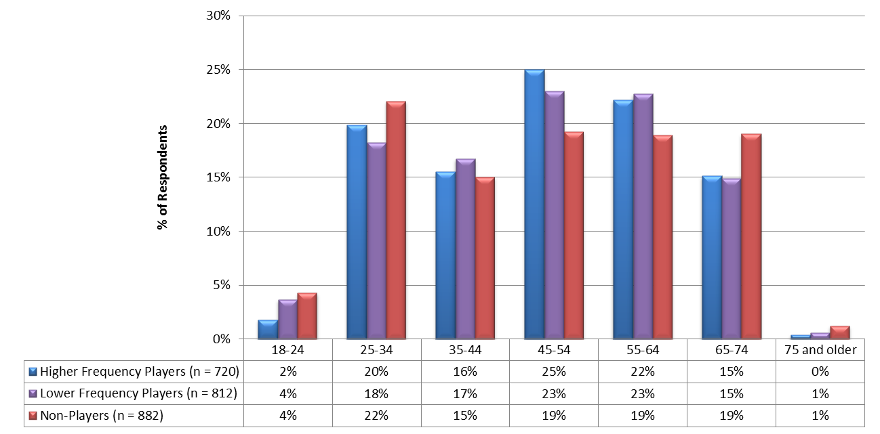
Draft – MSLA Proprietary
Section 1: Demographics
Age
The average age of the respondents was the same across all three segments in the study.
Average Age
High Frequency Players | 49
Low Frequency Players | 49
Non-Players | 49
Note: No statistically significant differences between segments, p ≤ .05
What is your age?

Slide 15
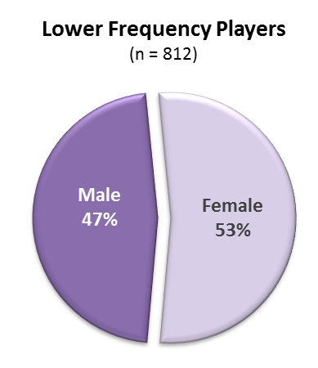
Draft – MSLA Proprietary
Section 1: Demographics
Gender
The High frequency players are slightly more male dominated and the low frequency and non-players tend to be slightly more female.
*^{L,N}
*^{H}
*^{H}
* Statistically significant difference when compared to the corresponding segment (H = High Frequency Players, L = Low Frequency Players, N = Non-Players), p ≤ .05
What is your gender?

Slide 16
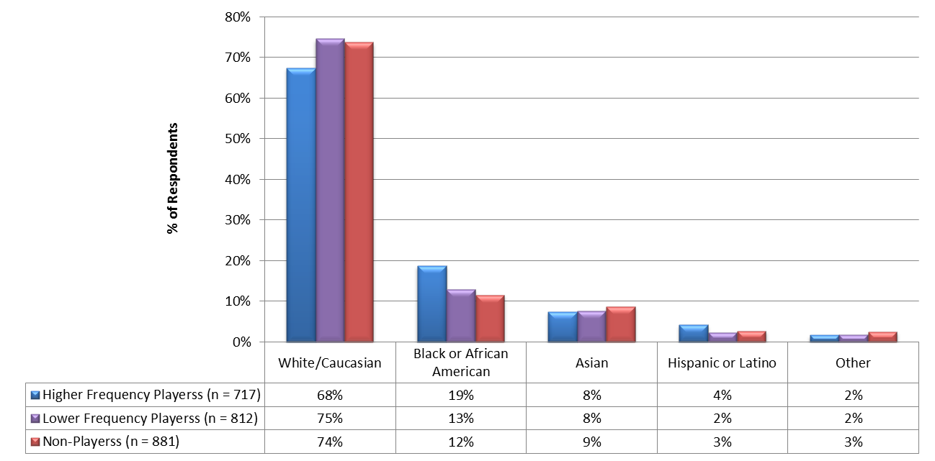
Draft – MSLA Proprietary
Section 1: Demographics
Race
The high majority of lottery players are White.
More high frequency players are African American compared to low frequency and non-players.
*^{L,N}
*^{H}
*^{H}
* Statistically significant difference when compared to the corresponding segment (H = High Frequency Players, L = Low Frequency Players, N = Non-Players), p ≤ .05
Please specify your race?

Slide 17
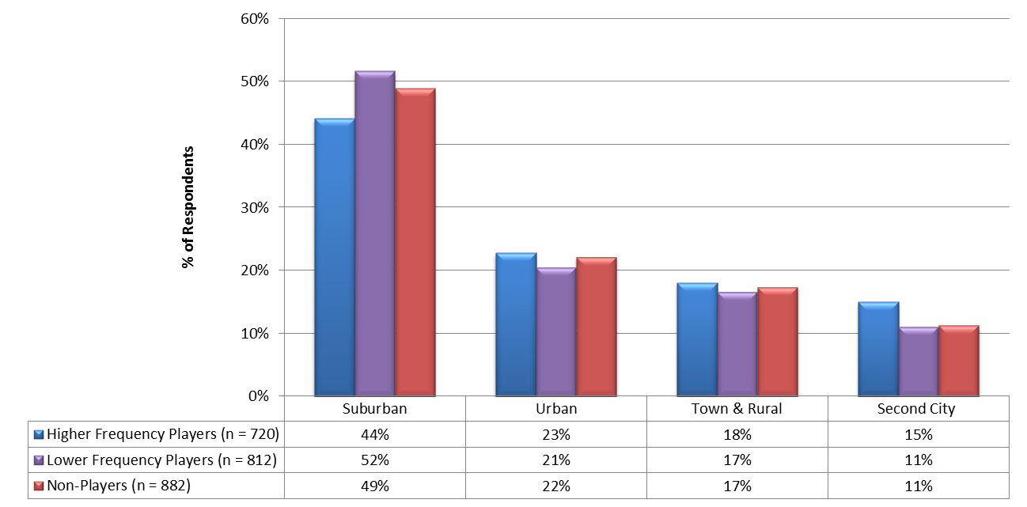
Draft – MSLA Proprietary
Section 1: Demographics
Urbanization Classification
The majority of Lottery players live in suburban areas.
More low frequency players live in suburban areas compared to high frequency players
*^{L,N}
*^{H}
* Statistically significant difference when compared to the corresponding segment (H = High Frequency Players, L = Low Frequency Players, N = Non-Players), p ≤ .05
Which of the following best describes where you live now?

Slide 18
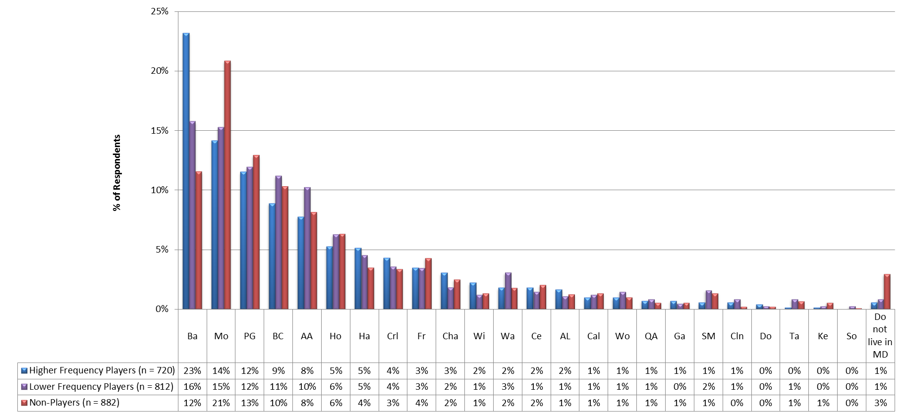
Draft – MSLA Proprietary
Section 1: Demographics
County of Residence
Baltimore county contains the most high frequency players with also twice as many as non-players.
Montgomery county has the most non-players.
*^{L,N}
*^{H,L}
*^{N}
* Statistically significant difference when compared to the corresponding segment (H = High Frequency Players, L = Low Frequency Players, N = Non-Players), p ≤ .05
What is your county of residence?

Slide 19
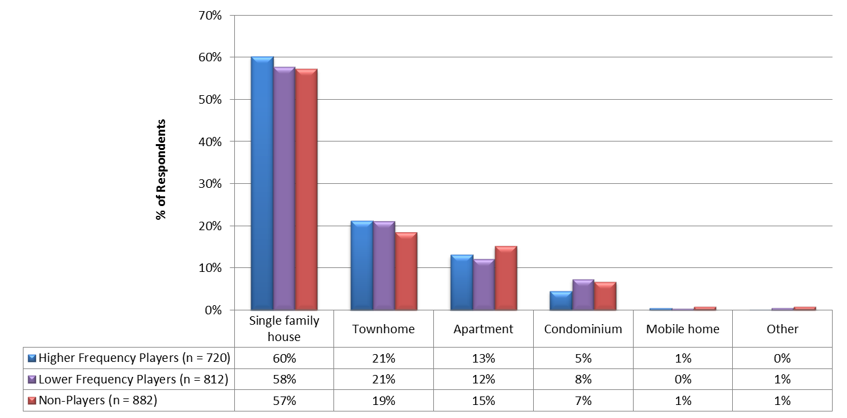
Draft – MSLA Proprietary
Section 1: Demographics
Type of Home
80% of respondents live in single family homes or townhomes.
Type of home was similar across all segments.
Note: No statistically significant differences between segments, p ≤ .05
Which of the following describes the type of home you currently live in?

Slide 20
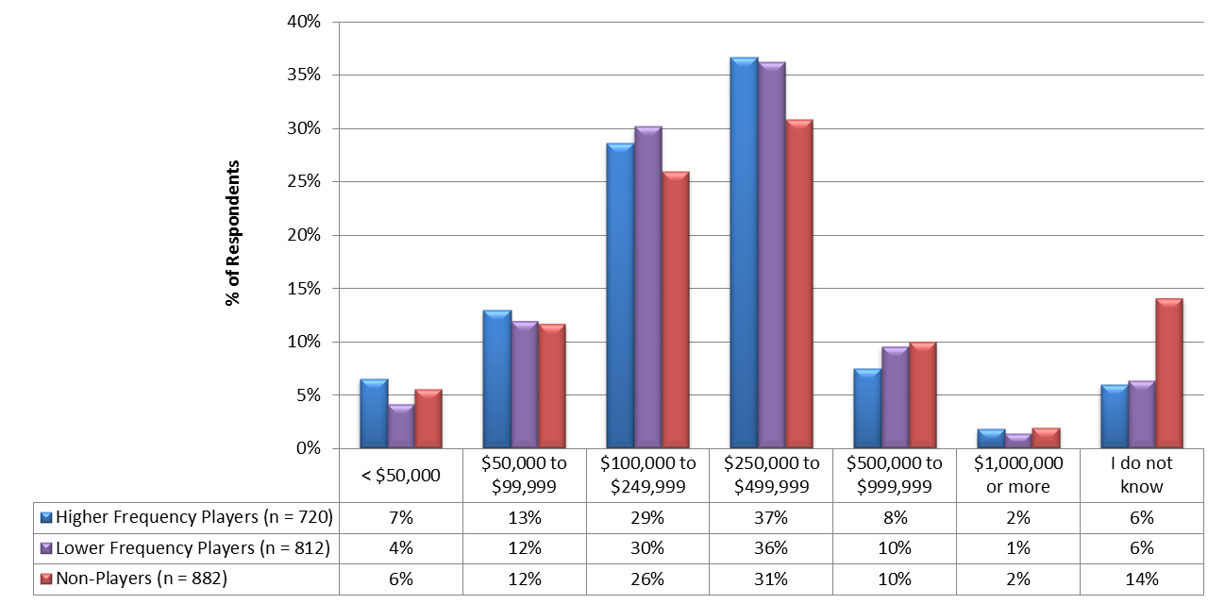
Draft – MSLA Proprietary
Section 1: Demographics
Estimated Home Value
Estimated home value was similar across all segments
Average Home Value
High Frequency Players | $292,000
Low Frequency Players | $306,000
Non-Players | $310,000
Note: No statistically significant differences between segments, p ≤ .05
About how much do you think this home (and lot) or apartment would sell for if it were for sale?

Slide 21
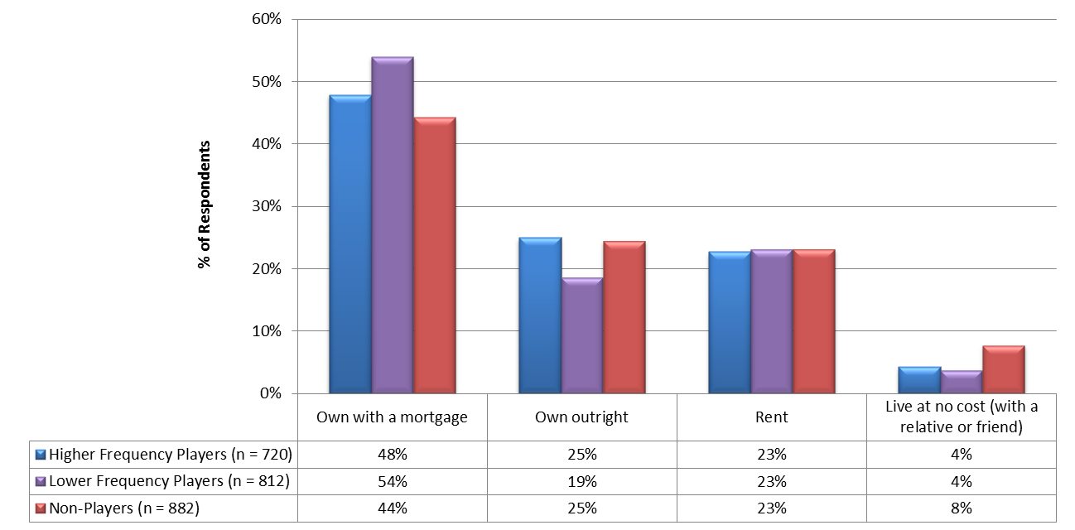
Draft – MSLA Proprietary
Section 1: Demographics
Home Ownership
Nearly three quarters of Lottery players own their homes.
Home ownership was similar across all segments.
Note: No statistically significant differences between segments, p ≤ .05
For your primary residence, do you:

Slide 22
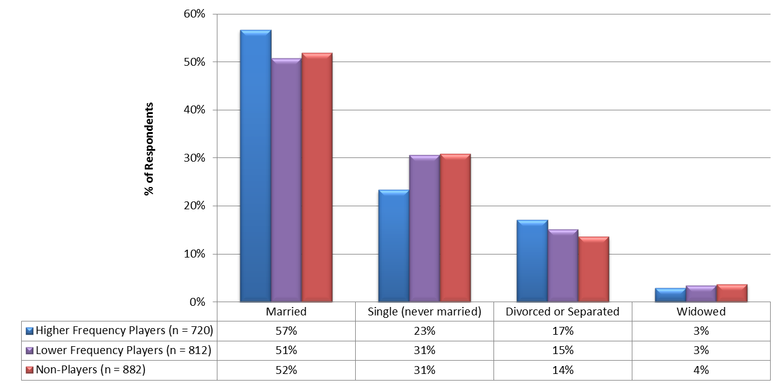
Draft – MSLA Proprietary
Section 1: Demographics
Marital Status
The high majority of Lottery players are married
More low frequency and non-players are single compared to high frequency players
*^{L}
*^{H}
*^{H}
* Statistically significant difference when compared to the corresponding segment (H = High Frequency Players, L = Low Frequency Players, N = Non-Players), p ≤ .05
Please indicate your marital status.

Slide 23
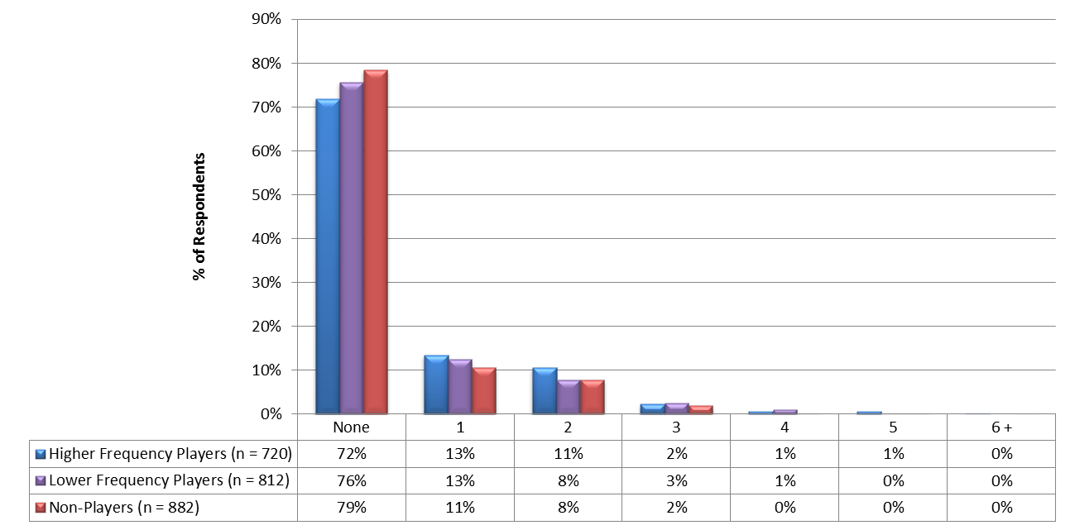
Draft – MSLA Proprietary
Section 1: Demographics
Number of Children in Household (Under Age of 18)
The high frequency player category tends to have more children in the household compared to low frequency and non-players.
*^{N}
*^{H}
* Statistically significant difference when compared to the corresponding segment (H = High Frequency Players, L = Low Frequency Players, N = Non-Players), p ≤ .05
Please indicate the number of children in your household under the age of 18.

Slide 24
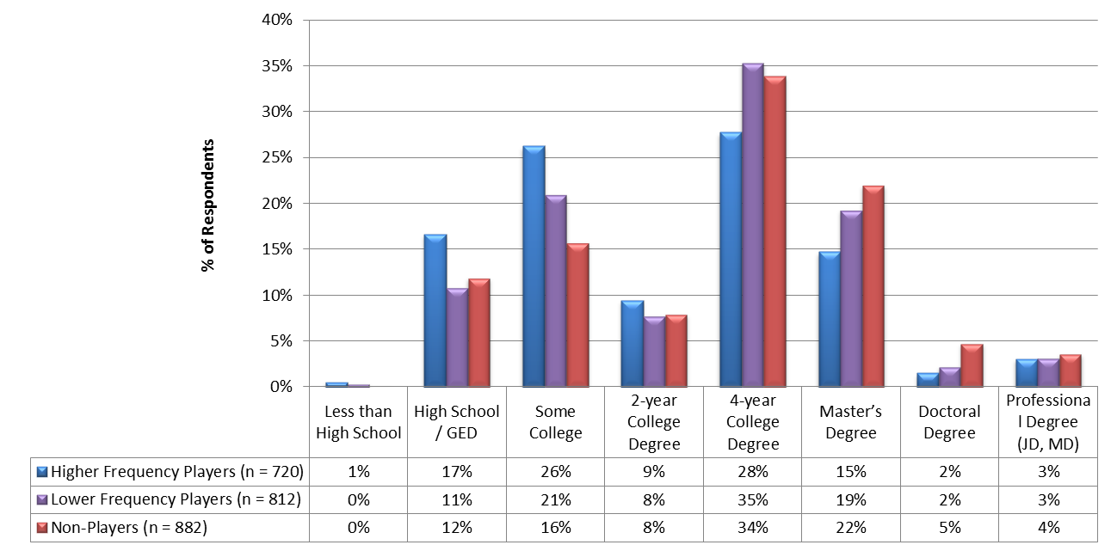
Draft – MSLA Proprietary
Section 1: Demographics
Highest Level of Education
High frequency players tend to be less educated compared to low frequency and non-players.
Non-player are the most educated segment.
*^{L,N}
*^{L,N}
*^{N}
*^{H}
*^{H}
*^{H}
*^{H}
*^{H,L}
* Statistically significant difference when compared to the corresponding segment (H = High Frequency Players, L = Low Frequency Players, N = Non-Players), p ≤ .05
What is the highest level of education you have completed?

Slide 25
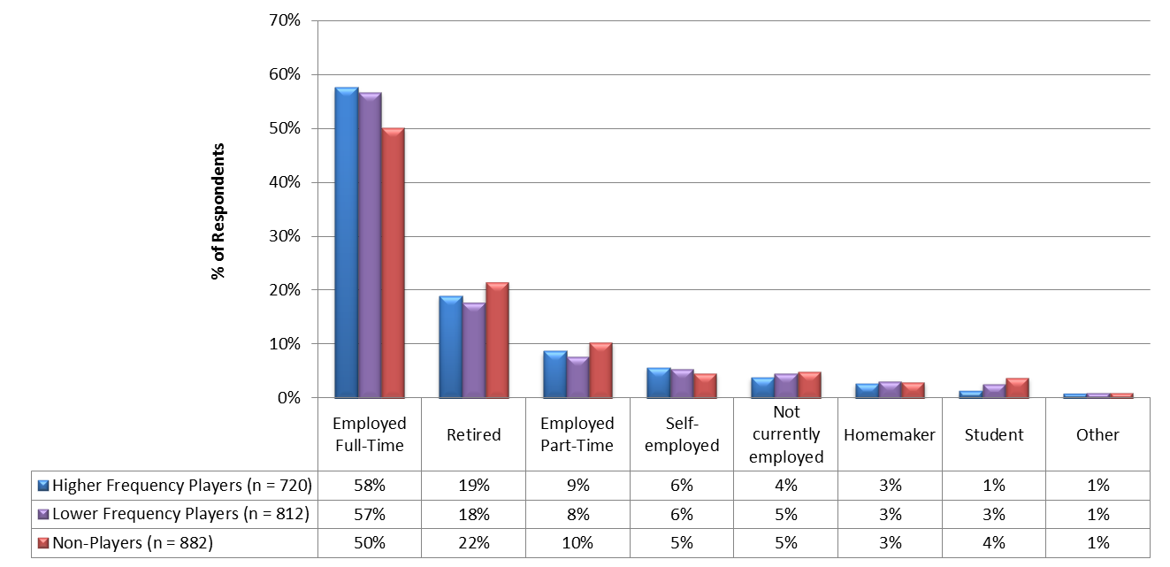
Draft – MSLA Proprietary
Section 1: Demographics
Current Work Status
The majority of Lottery players are employed full time with approximately 20% being retired.
*^{N}
*^{N}
* Statistically significant difference when compared to the corresponding segment (H = High Frequency Players, L = Low Frequency Players, N = Non-Players), p ≤ .05
What is your current work status?

Slide 26
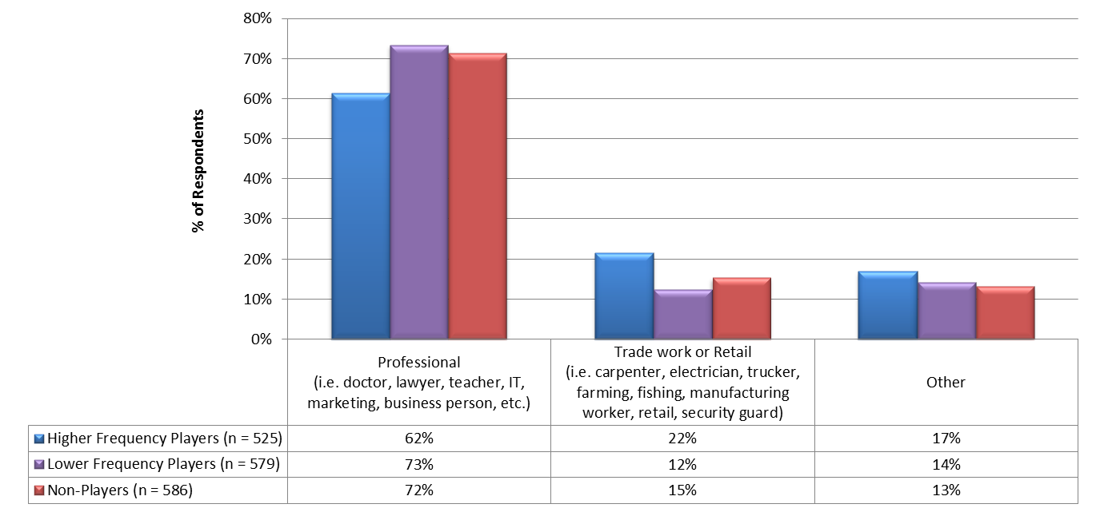
Draft – MSLA Proprietary
Section 1: Demographics
Type of Work
More low frequency and non-players are professionals compared to high frequency players
More high frequency player do trade or retail work than low frequency and non-players
*^{L,N}
*^{H}
*^{H}
* Statistically significant difference when compared to the corresponding segment (H = High Frequency Players, L = Low Frequency Players, N = Non-Players), p ≤ .05
How would you describe the work you do?

Slide 27
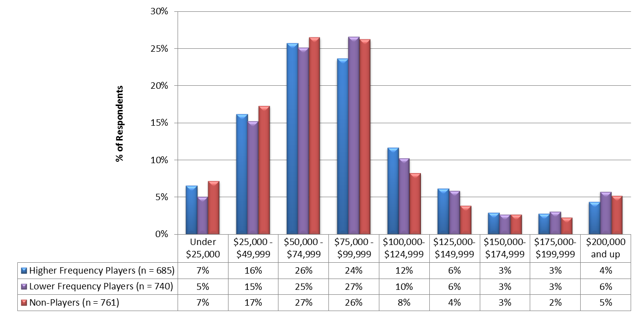
Draft – MSLA Proprietary
Section 1: Demographics
Annual Household Income
The majority of Lottery players fall in the middle income category ($50K - $99K).
Approximately one quarter of Lottery players have high household incomes ($100K or High)
Low frequency players have the highest average HHI.
Average Household Income
High Frequency Players | $86,000
Low Frequency Players | $89,000
Non-Players | $83,000
*^{N}
* Statistically significant difference when compared to the corresponding segment (H = High Frequency Players, L = Low Frequency Players, N = Non-Players), p ≤ .05
What is your annual household income?

Slide 28
Draft – MSLA Proprietary
Section 1: Demographics
Charitable Donations
All market segments donate to charities with a slightly more Lottery players compared to non-players.
*^{N}
*^{N}
*^{H,L}
* Statistically significant difference when compared to the corresponding segment (H = High Frequency Players, L = Low Frequency Players, N = Non-Players), p ≤ .05
Do you donate to charities?

Slide 29
Draft – MSLA Proprietary
2
Lifestyle

Slide 30
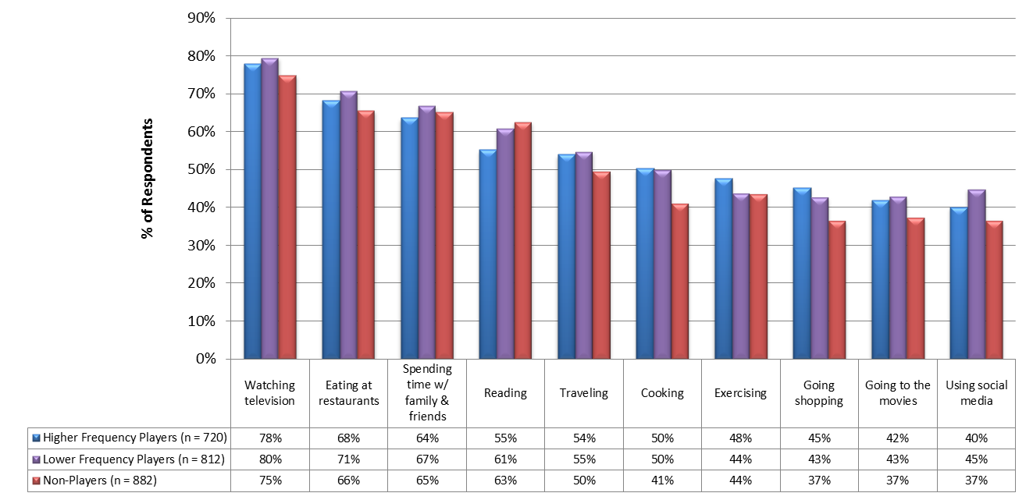
Section 2: Lifestyle
Draft – MSLA Proprietary
Leisure Activities
Slide 1 of 3
Generally people participate in similar leisure activities across all three market segments.
Cooking, going shopping, going to the movies and using social media were slightly more popular among Lottery players, while reading was higher for non-players
Chart is continued on next slide →
*^{N}
*^{N}
*^{N}
*^{N}
*^{H}
*^{N}
*^{N}
*^{N}
*^{N}
*^{N}
*^{H}
* Statistically significant difference when compared to the corresponding segment (H = High Frequency Players, L = Low Frequency Players, N = Non-Players), p ≤ .05
In which of the following leisure activities do you enjoy participating on a regular basis? (Check all that apply)

Slide 31
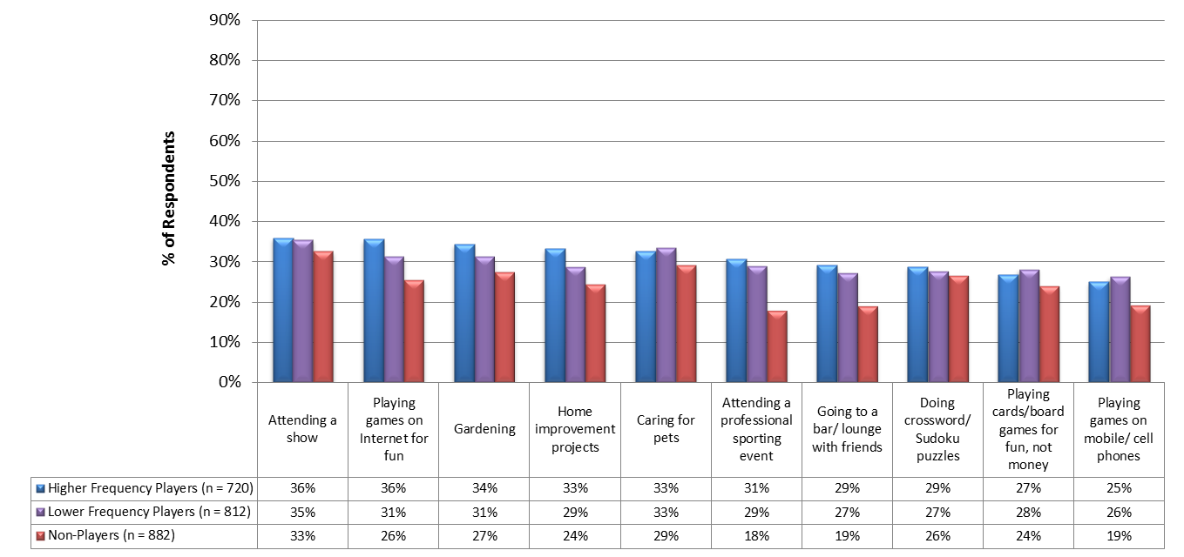
Section 2: Lifestyle
Draft – MSLA Proprietary
Leisure Activities
Slide 2 of 3
Leisure activities such as playing games for fun on the internet or cell phones, gardening, home improvement projects, sporting events and going to bars tend to be more popular with Lottery players than non-players.
Chart is continued on next slide →
*^{N}
*^{N}
*^{N}
*^{N}
*^{N}
*^{N}
*^{N}
*^{N}
*^{N}
*^{N}
*^{N}
*^{N}
* Statistically significant difference when compared to the corresponding segment (H = High Frequency Players, L = Low Frequency Players, N = Non-Players), p ≤ .05
In which of the following leisure activities do you enjoy participating on a regular basis? (Check all that apply)

Slide 32
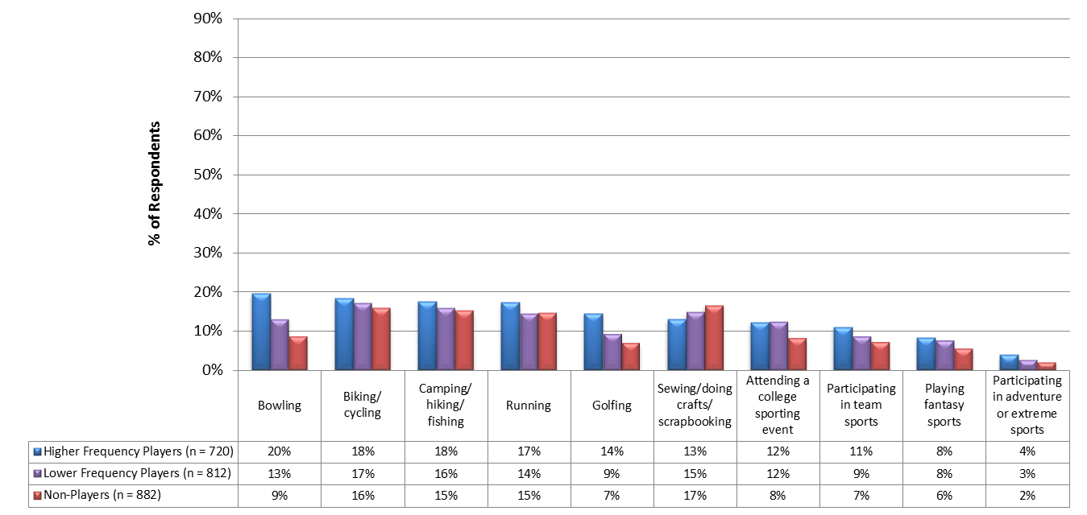
Section 2: Lifestyle
Draft – MSLA Proprietary
Leisure Activities
Slide 3 of 3
Leisure activities such as bowling and golfing tend to be more popular with Lottery players, particularly the high volume players.
*^{L,N}
*^{L,N}
*^{N}
*^{N}
*^{N}
*^{N}
*^{N}
*^{N}
*^{H}
* Statistically significant difference when compared to the corresponding segment (H = High Frequency Players, L = Low Frequency Players, N = Non-Players), p ≤ .05
In which of the following leisure activities do you enjoy participating on a regular basis? (Check all that apply)

Slide 33
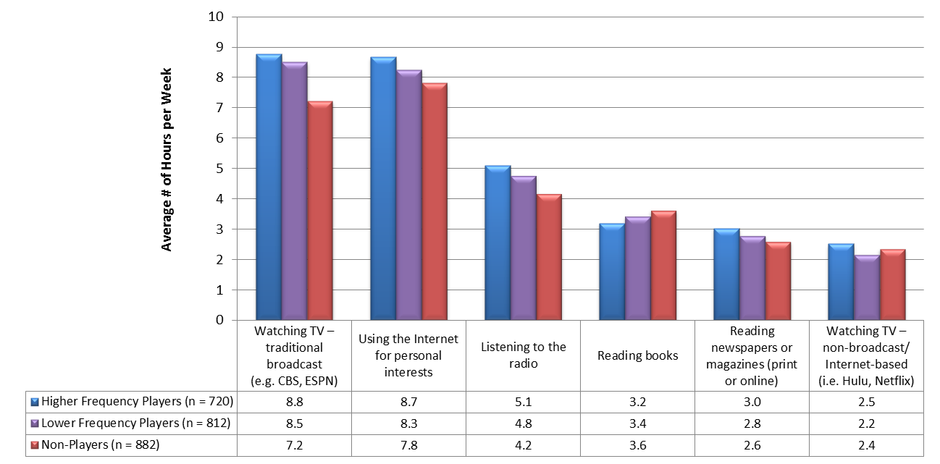
Draft – MSLA Proprietary
Section 2: Lifestyle
Leisure Time
Peoples leisure time is dominated by watching broadcast TV and using the internet, with Lottery players spending slightly more hours per week.
*^{N}
*^{N}
*^{N}
*^{N}
*^{N}
*^{N}
*^{H}
* Statistically significant difference when compared to the corresponding segment (H = High Frequency Players, L = Low Frequency Players, N = Non-Players), p ≤ .05
During a typical WEEK, how much time do you spend performing the following activities? (Check one for each row)

Slide 34
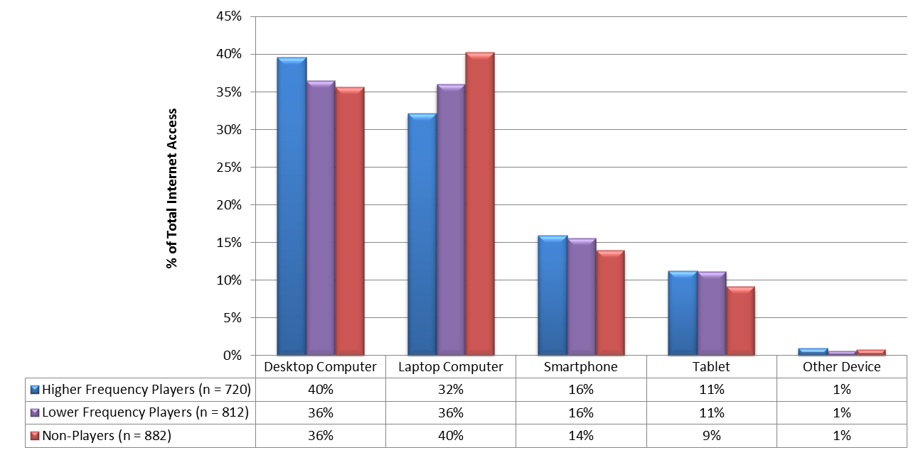
Draft – MSLA Proprietary
Section 2: Lifestyle
Accessing the Internet for Personal Use
When accessing the Internet for personal use , a desktop computer is used more frequently by high players, while laptop is higher for non-players.
All segments are using smartphones or tablets approximately 25% of the time.
*^{N}
*^{N}
*^{H}
*^{N}
*^{H,L}
* Statistically significant difference when compared to the corresponding segment (H = High Frequency Players, L = Low Frequency Players, N = Non-Players), p ≤ .05
When accessing the Internet for personal use, what percent of the time do you use each of the following: (Total must be equal to 100%)

Slide 35
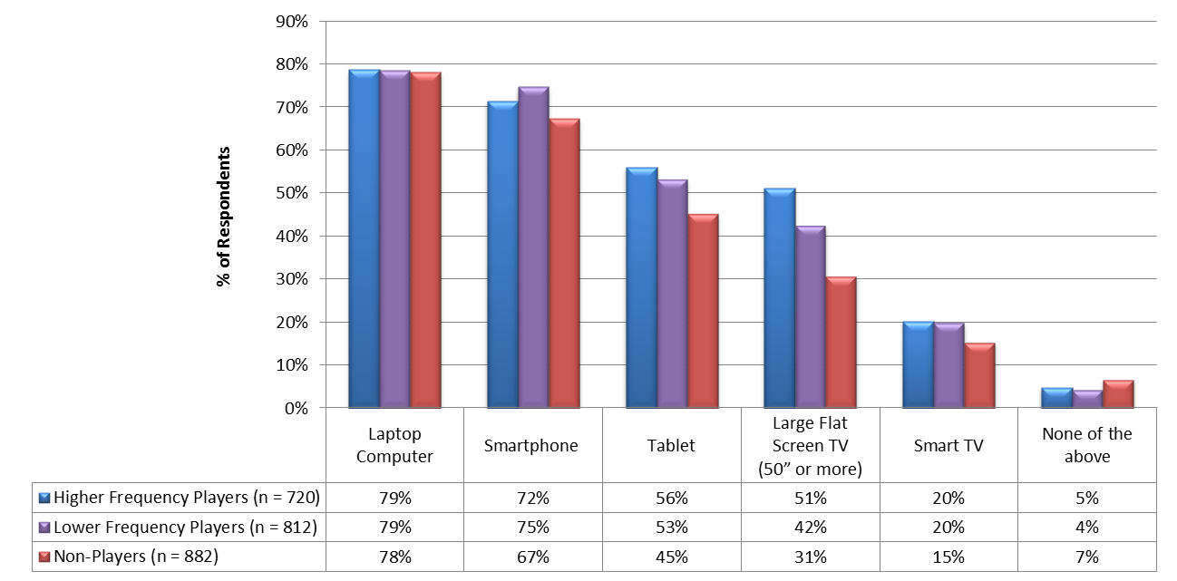
Draft – MSLA Proprietary
Section 2: Lifestyle
Devices Own
Laptop computers lead the list of devices owned with smartphone penetration almost as high.
Tablets, large flat screen TV’s, and smart TVs are more common with Lottery Players than non-players.
*^{N}
*^{L,N}
*^{N}
*^{N}
*^{N}
*^{N}
*^{N}
* Statistically significant difference when compared to the corresponding segment (H = High Frequency Players, L = Low Frequency Players, N = Non-Players), p ≤ .05
Which of the following devices do you own? (Check all that apply)

Slide 36
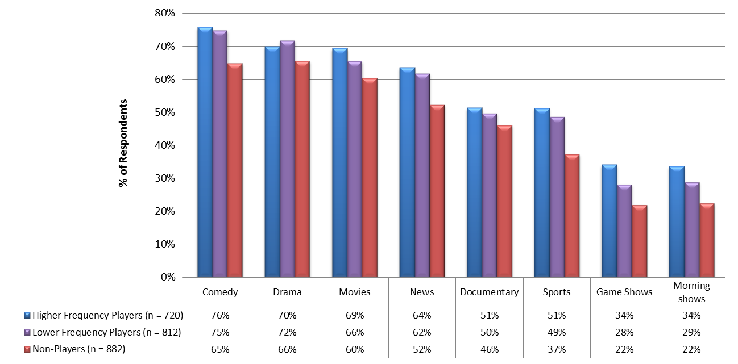
Section 2: Lifestyle
Draft – MSLA Proprietary
Television Programs Watched
Slide 1 of 2
Lottery players tend to watch more TV across all types with comedy, drama, movies and news being the most popular.
Chart is continued on next slide →
*^{N}
*^{N}
*^{N}
*^{N}
*^{N}
*^{L,N}
*^{L,N}
*^{N}
*^{N}
*^{N}
*^{N}
*^{N}
*^{N}
*^{N}
* Statistically significant difference when compared to the corresponding segment (H = High Frequency Players, L = Low Frequency Players, N = Non-Players), p ≤ .05
What types of television programs do you usually watch? (Check all that apply)

Slide 37
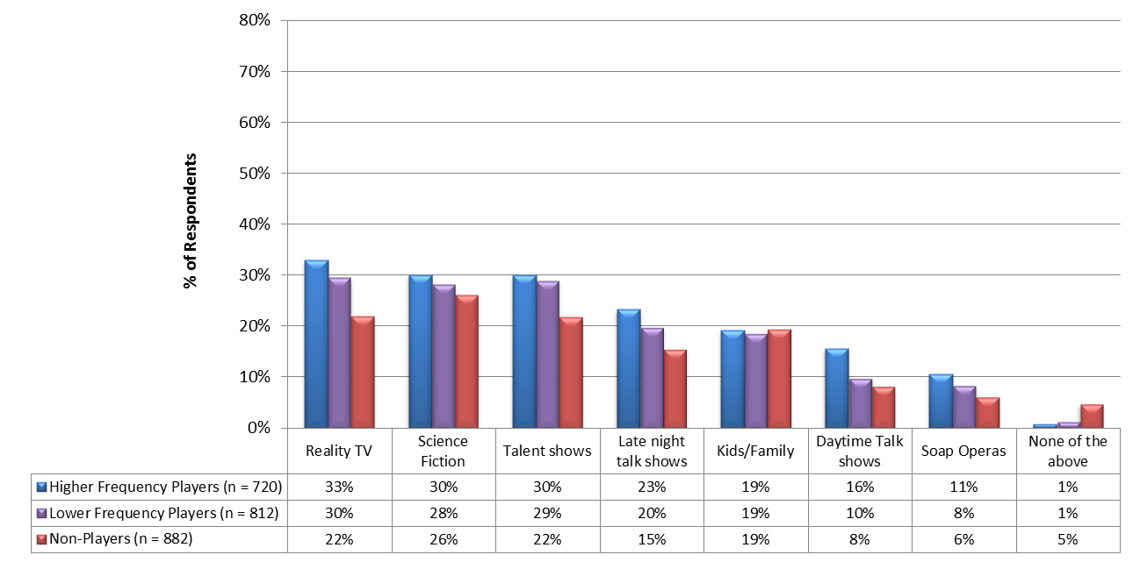
Section 2: Lifestyle
Draft – MSLA Proprietary
Television Programs Watched
Slide 2 of 2
*^{N}
*^{N}
*^{N}
*^{L,N}
*^{N}
*^{N}
*^{N}
*^{N}
* Statistically significant difference when compared to the corresponding segment (H = High Frequency Players, L = Low Frequency Players, N = Non-Players), p ≤ .05
What types of television programs do you usually watch? (Check all that apply)

Slide 38
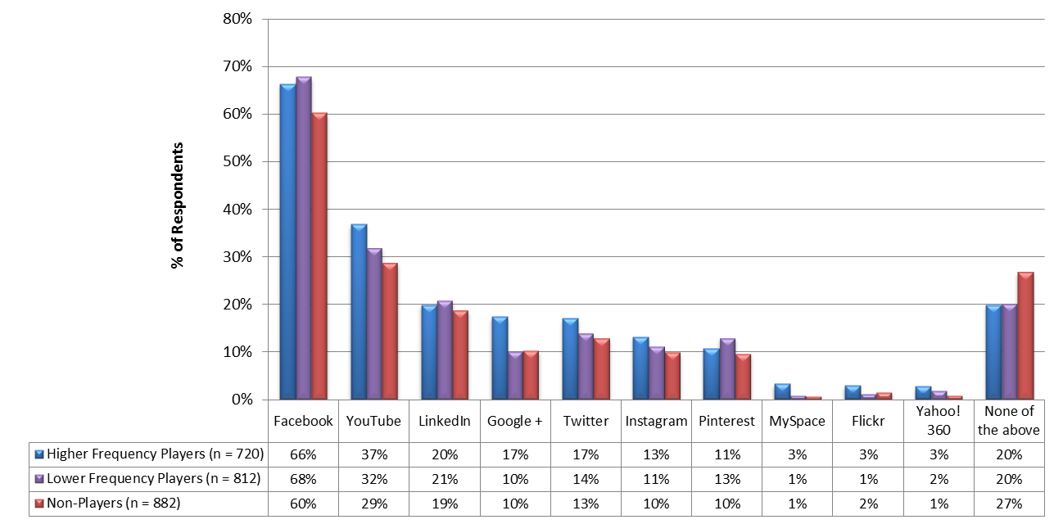
Draft – MSLA Proprietary
Section 2: Lifestyle
Social Media Websites Visited Regularly
Facebook dominates the social media category followed by YouTube.
Slightly fewer non-players use social media.
*^{N}
*^{L,N}
*^{L,N}
*^{N}
*^{N}
*^{N}
*^{N}
*^{H,L}
* Statistically significant difference when compared to the corresponding segment (H = High Frequency Players, L = Low Frequency Players, N = Non-Players), p ≤ .05
22. Which of the following social media websites do visit regularly? (Check all that apply.)

Slide 39
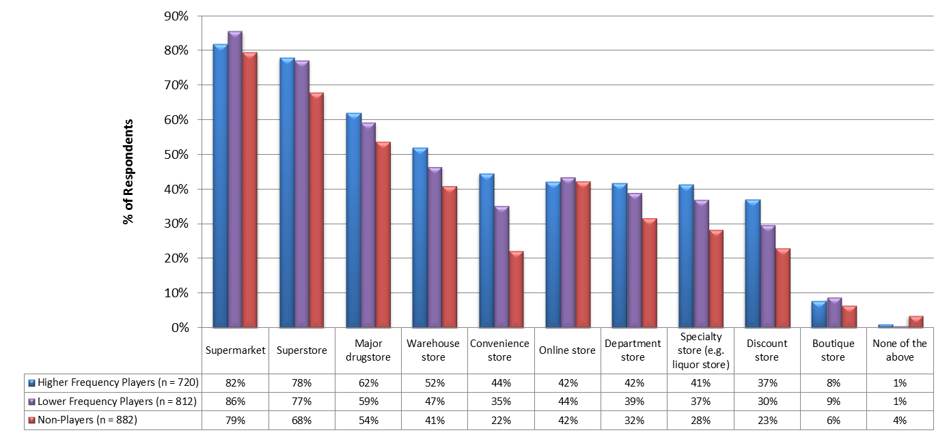
Draft – MSLA Proprietary
Section 2: Lifestyle
Shopping (in the past 30 days)
Shopping location is lead by supermarkets and superstores for all segments.
More Lottery players shop at convenience stores and specialty stores than non-players.
*^{N}
*^{N}
*^{L,N}
*^{L,N}
*^{N}
*^{N}
*^{L,N}
*^{N}
*^{N}
*^{N}
*^{N}
*^{N}
*^{N}
*^{N}
*^{N}
* Statistically significant difference when compared to the corresponding segment (H = High Frequency Players, L = Low Frequency Players, N = Non-Players), p ≤ .05
Where have you personally shopped in the past 30 days? (Check all that apply)

Slide 40
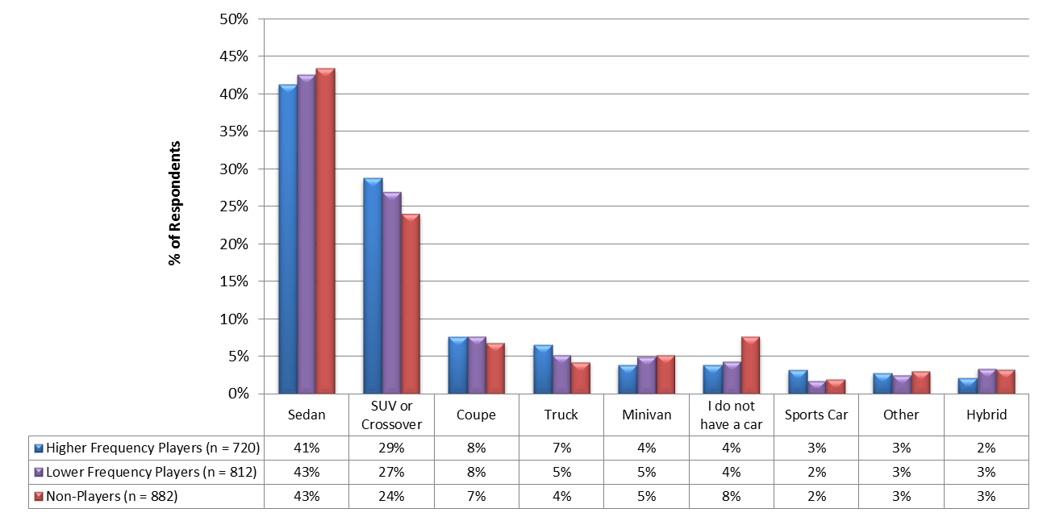
Draft – MSLA Proprietary
Section 2: Lifestyle
Type of Car
The type of car driven is dominated by sedans, followed by SUV/crossovers
Type of car is similar across all three market segments.
*^{N}
*^{N}
*^{L,H}
* Statistically significant difference when compared to the corresponding segment (H = High Frequency Players, L = Low Frequency Players, N = Non-Players), p ≤ .05
What type of car do you drive?

Slide 41
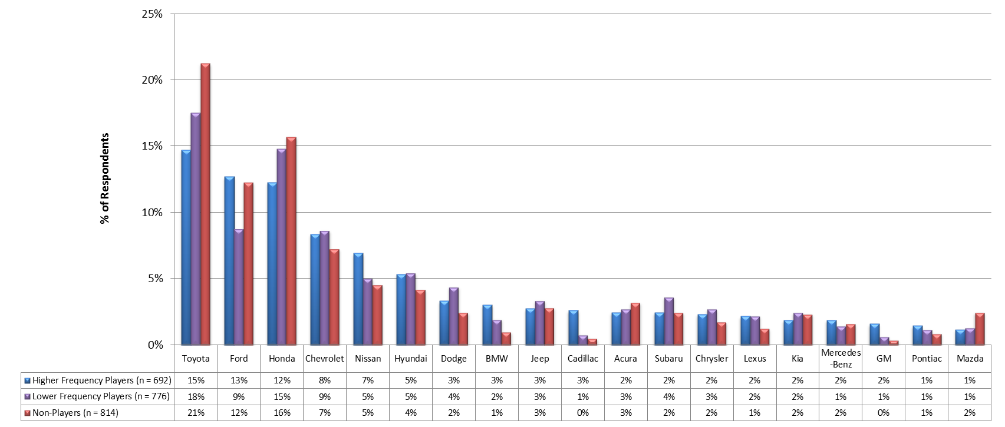
Section 2: Lifestyle
Draft – MSLA Proprietary
Car Brand
Slide 1 of 2
Toyota, Honda and Ford are the top three car brands with non-players strongly preferring Toyota.
Chart is continued on next slide →
*^{L}
*^{H}
*^{L}
* Statistically significant difference when compared to the corresponding segment (H = High Frequency Players, L = Low Frequency Players, N = Non-Players), p ≤ .05
What brand is your primary car?

Slide 42
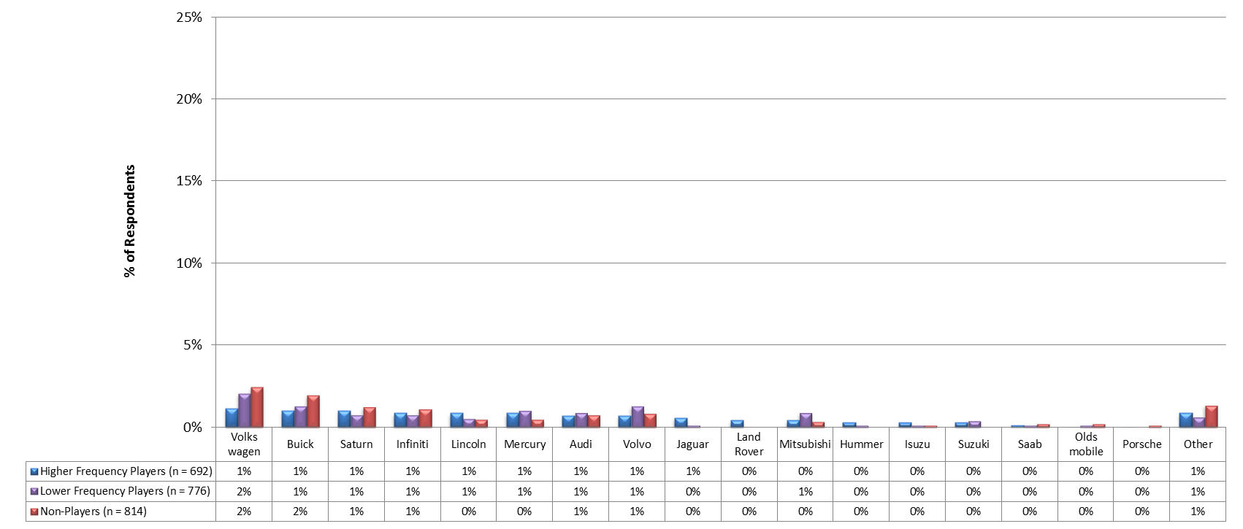
Section 2: Lifestyle
Draft – MSLA Proprietary
Car Brand
Slide 2 of 2
What brand is your primary car?

Slide 43
Draft – MSLA Proprietary
3
Gaming/Gambling Potential Assessment

Slide 44
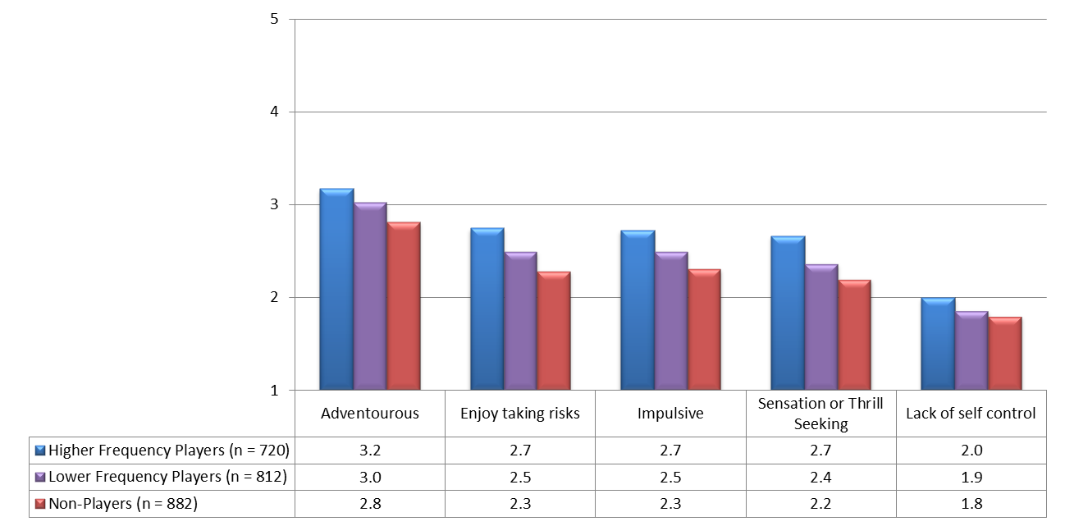
Draft – MSLA Proprietary
Section 3: Gaming/Gambling Potential Assessment
Risk Meter
When looking at individual traits that relate to risk taking, Lottery players score High than non-players across every category.
RISK METER TOTAL SCORE (out of a possible 25 points)
High Frequency Players | 13.3
Low Frequency Players | 12.2
Non-Players | 11.4
*^{N, L}
*^{N}
*^{N, L}
*^{N, L}
*^{N, L}
*^{N, L}
*^{N, L}
*^{N}
*^{N}
*^{N}
*^{N}
* Statistically significant difference when compared to the corresponding segment (H = High Frequency Players, L = Low Frequency Players, N = Non-Players), p ≤ .05
How well does each of the following traits describe you?

Slide 45
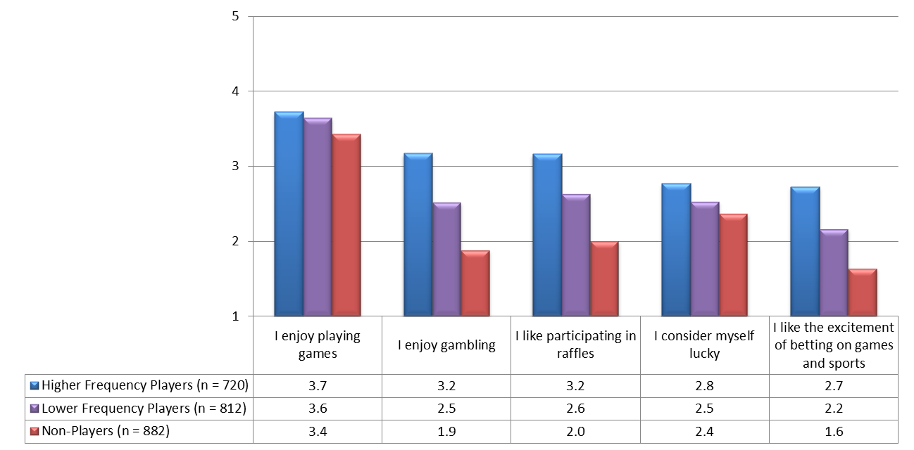
Draft – MSLA Proprietary
Section 3: Gaming/Gambling Potential Assessment
Gaming/Gambling Tendency
When looking at individual traits that relate to gaming tendencies, Lottery players score higher than non-players across every category especially in their enjoyment of gambling, participation in raffles and betting on games/sports.
The smallest gaps between players and non-players were “I enjoy playing games” and “I consider myself lucky”
GAMING/GAMBLING TENDENCY TOTAL SCORE (out of a possible 25 points)
High Frequency Players | 15.6
Low Frequency Players | 13.5
Non-Players | 11.3
*^{N, L}
*^{N}
*^{N}
*^{N, L}
*^{N, L}
*^{N, L}
*^{N, L}
*^{N}
*^{N}
*^{N}
*^{N}
*^{N}
* Statistically significant difference when compared to the corresponding segment (H = High Frequency Players, L = Low Frequency Players, N = Non-Players), p ≤ .05
How well does each of the following statements describe you?

Slide 46
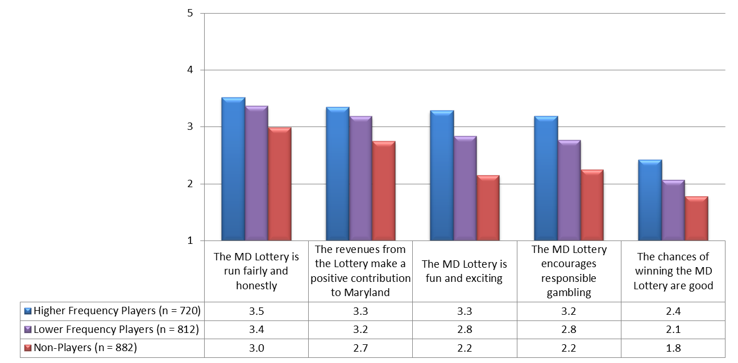
Draft – MSLA Proprietary
Section 3: Gaming/Gambling Potential Assessment
Maryland Lottery Perception
The perception of the Maryland Lottery is lower with the non-players across all statements particularly in their view that it is “fun and exciting” and “encourages responsible gaming”.
MARYLAND LOTTERY PERCEPTION TOTAL SCORE (out of a possible 50 points)
High Frequency Players | 31.5
Low Frequency Players | 28.4
Non-Players | 23.8
*^{N, L}
*^{N}
*^{N, L}
*^{N, L}
*^{N, L}
*^{N, L}
*^{N, L}
*^{N}
*^{N}
*^{N}
*^{N}
*^{N}
* Statistically significant difference when compared to the corresponding segment (H = High Frequency Players, L = Low Frequency Players, N = Non-Players), p ≤ .05
How well does each of the following statements describe your perception of the Maryland Lottery?

Slide 47
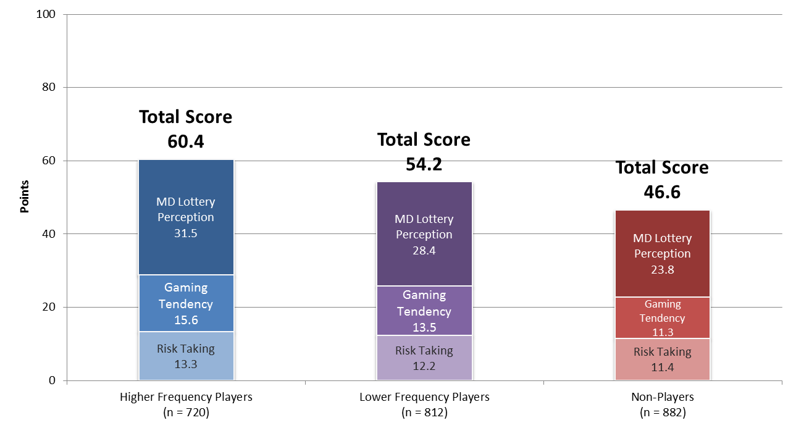
Draft – MSLA Proprietary
Section 3: Gaming/Gambling Potential Assessment
Total Gaming Potential Score (Out of a possible 100 points)
When looking at the gaming potential of the three market segments, they follow a logical progression from the high frequency players to non-players.
*^{N, L}
*^{N}
* Statistically significant difference when compared to the corresponding segment (H = High Frequency Players, L = Low Frequency Players, N = Non-Players), p ≤ .05
How well does each of the following traits describe you?
How well does each of the following statements describe you?
How well does each of the following statements describe your perception of the Maryland Lottery?

Slide 48
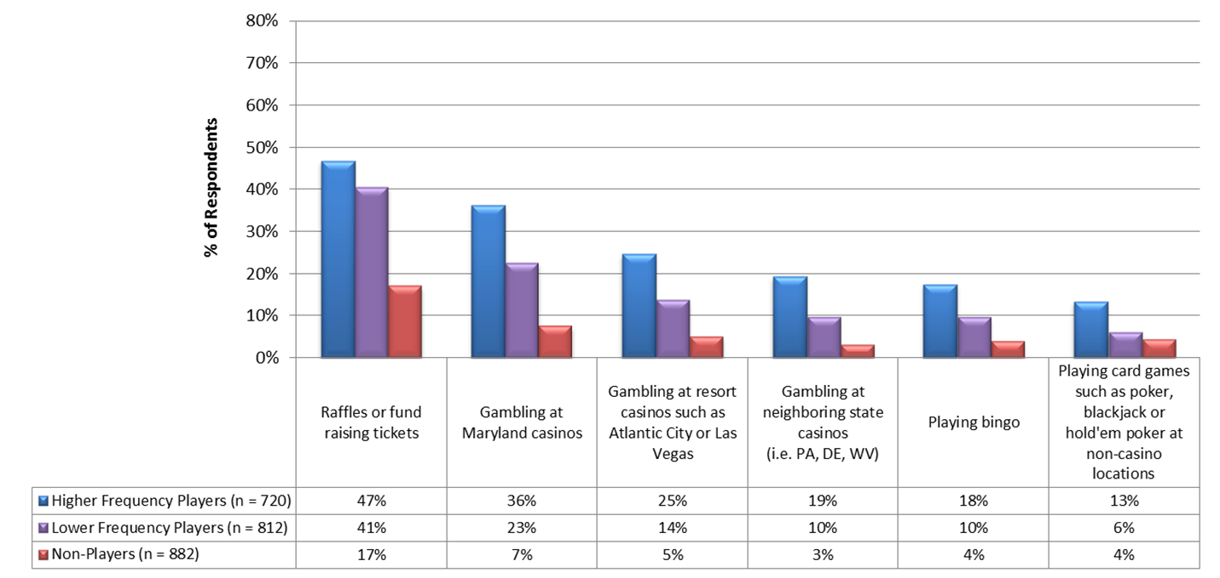
Section 3: Gaming/Gambling Potential Assessment
Draft – MSLA Proprietary
Gaming/Gambling Activities (Past 12 Months)
Slide 1 of 2
Almost half of the Lottery players have participated in raffles and over one third of the high frequency players gamble at Maryland casinos.
Chart is continued on next slide →
*^{L,N}
*^{L,N}
*^{L,N}
*^{L,N}
*^{L,N}
*^{L,N}
*^{N}
*^{N}
*^{N}
*^{N}
*^{N}
* Statistically significant difference when compared to the corresponding segment (H = High Frequency Players, L = Low Frequency Players, N = Non-Players), p ≤ .05
In the past 12 months, have you spent any money on any of the following activities?

Slide 49
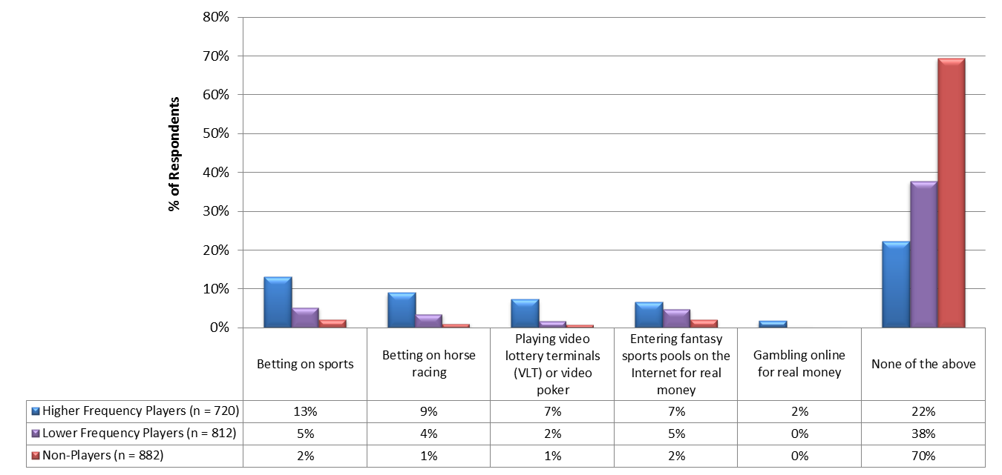
Section 3: Gaming/Gambling Potential Assessment
Draft – MSLA Proprietary
Gaming/Gambling Activities (Past 12 Months)
Slide 1 of 2
Seventy percent of the non-lottery players do not participate in any gaming/gambling activities
*^{L,N}
*^{L,N}
*^{N}
*^{N}
*^{N}
*^{H}
*^{H,L}
* Statistically significant difference when compared to the corresponding segment (H = High Frequency Players, L = Low Frequency Players, N = Non-Players), p ≤ .05
In the past 12 months, have you spent any money on any of the following activities?

Slide 50
Draft – MSLA Proprietary
4A
Lottery Player Behaviors

Slide 51
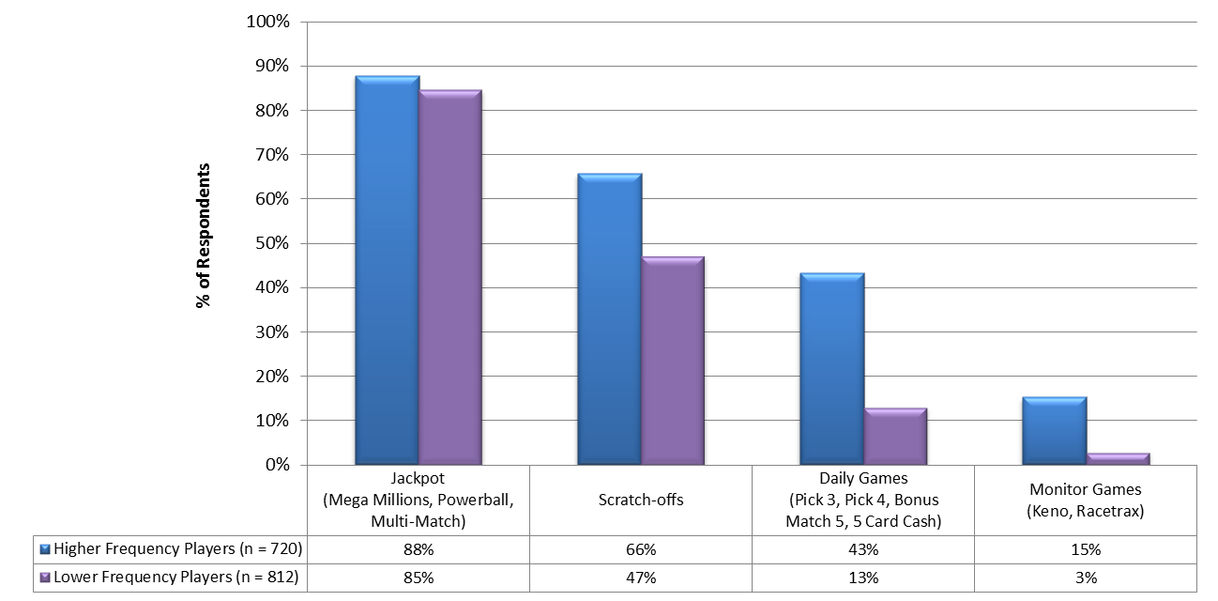
Draft – MSLA Proprietary
Section 4A: Lottery Player Behaviors
Games Played
Jackpot games are played evenly by high and low frequency players.
Two thirds of high frequency players buy scratch-offs.
*^{L}
*^{L}
*^{L}
* Statistically significant difference when compared to the corresponding segment (H = High Frequency Players, L = Low Frequency Players, N = Non-Players), p ≤ .05
Which of the following Maryland Lottery games have you purchased and played in the past 12 months?

Slide 52
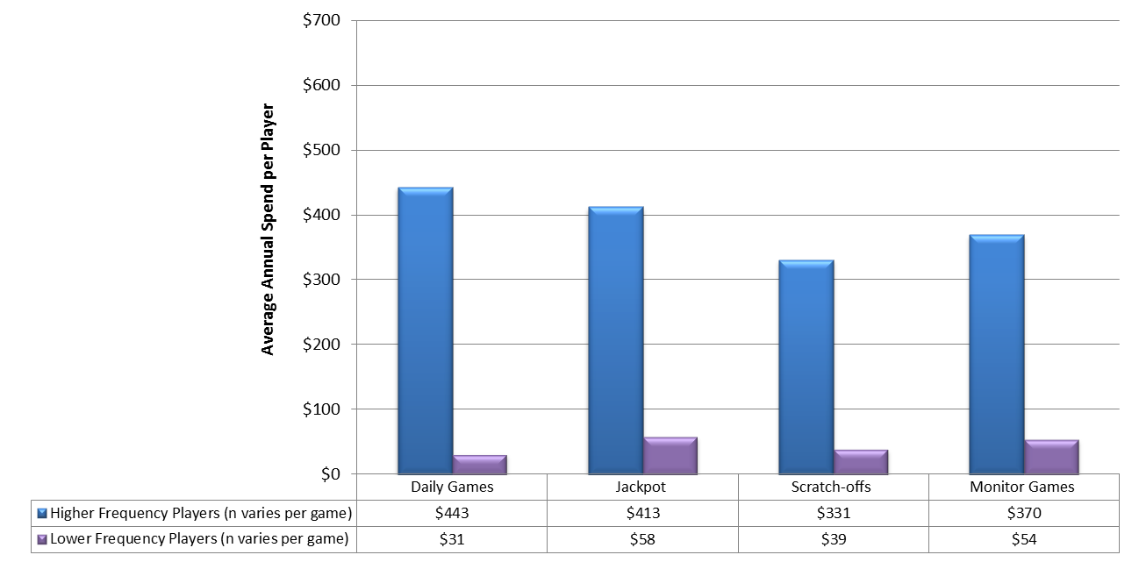
Draft – MSLA Proprietary
Section 4A: Lottery Player Behaviors
Annual Lottery Expenditure per Game
In total, the average annual lottery spend per player is $789 for high frequency players and $73 for low frequency players.
The Daily Games player segment leads the average annual spend for high volume players with $443 per year.
Average TOTAL Annual Lottery Spend per Player
High Frequency Players | $789
Low Frequency Players | $73
*^{L}
*^{L}
*^{L}
*^{L}
* Statistically significant difference when compared to the corresponding segment (H = High Frequency Players, L = Low Frequency Players, N = Non-Players), p ≤ .05
In the past 12 months, approximately how much did you spend on playing each of the following Maryland Lottery games?

Slide 53
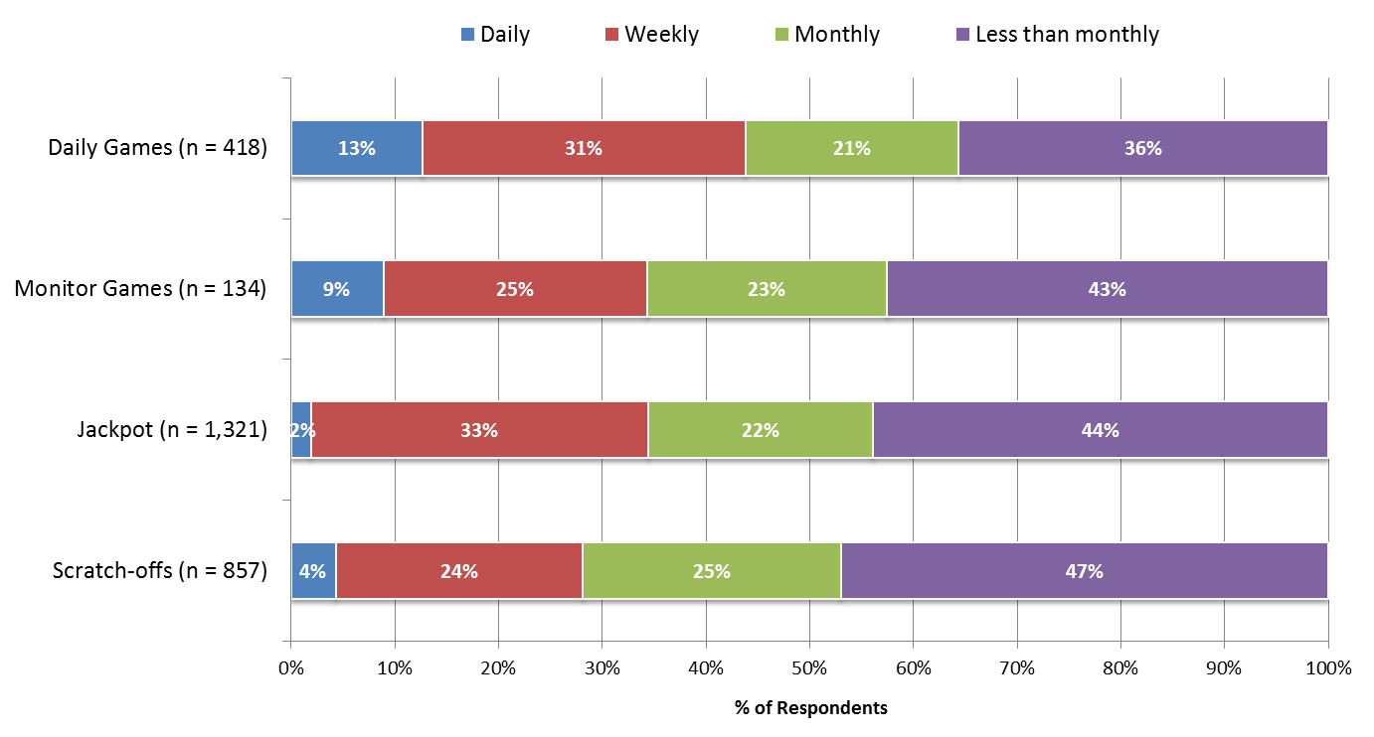
Draft – MSLA Proprietary
Section 4A: Lottery Player Behaviors
Frequency of Play per Game
More than half of Maryland Lottery players play at least monthly.
The daily games player segment has the highest percentage of ‘daily’ players
How often do you play each of the following Maryland Lottery games?

Slide 54
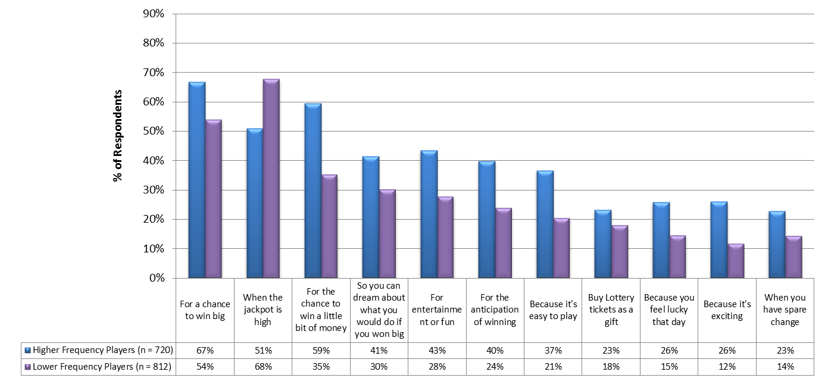
Section 4A: Lottery Player Behaviors
Draft – MSLA Proprietary
Reasons for Playing the Lottery
Slide 1 of 2
The main reasons for playing the lottery are “for a chance to win big”, “when the jackpot is high” and “to win a little bit of money”.
The top reason for low frequency players is “when the jackpot is high”
Chart is continued on next slide →
*^{L}
*^{L}
*^{L}
*^{L}
*^{L}
*^{L}
*^{L}
*^{L}
*^{L}
*^{L}
*^{H}
* Statistically significant difference when compared to the corresponding segment (H = High Frequency Players, L = Low Frequency Players, N = Non-Players), p ≤ .05
Please check the reasons why you play the Lottery. (Check all that apply)

Slide 55
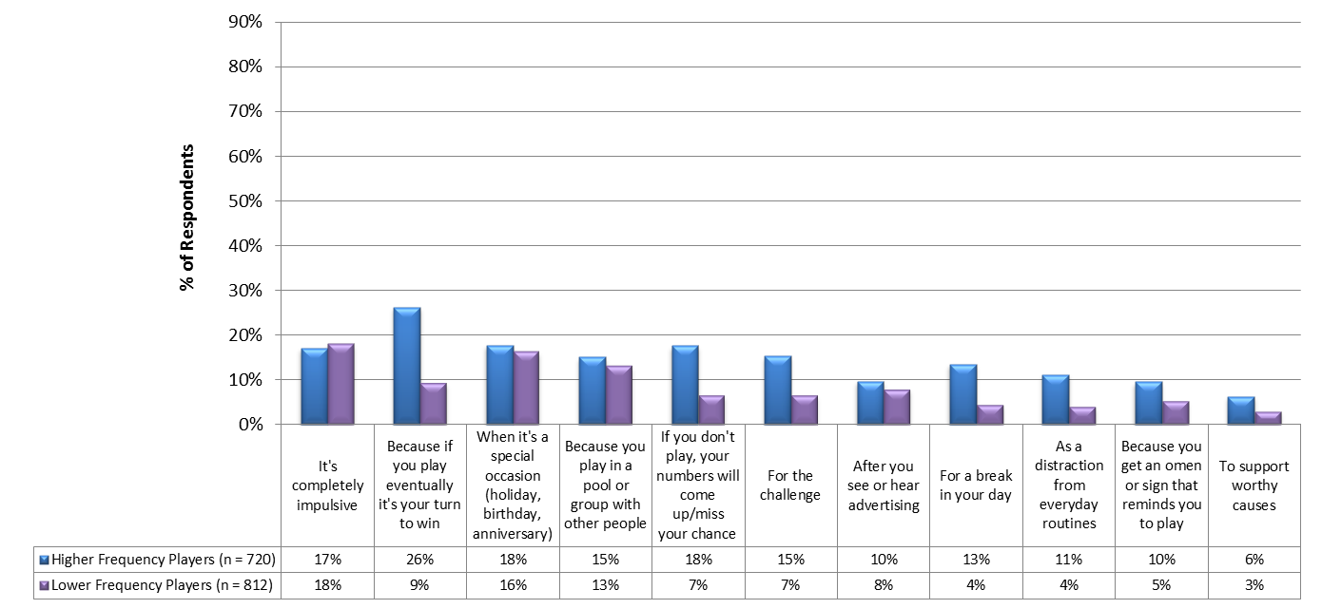
Section 4A: Lottery Player Behaviors
Draft – MSLA Proprietary
Reasons for Playing the Lottery
Slide 2 of 2
*^{L}
*^{L}
*^{L}
*^{L}
*^{L}
*^{L}
*^{L}
* Statistically significant difference when compared to the corresponding segment (H = High Frequency Players, L = Low Frequency Players, N = Non-Players), p ≤ .05
Please check the reasons why you play the Lottery. (Check all that apply)

Slide 56
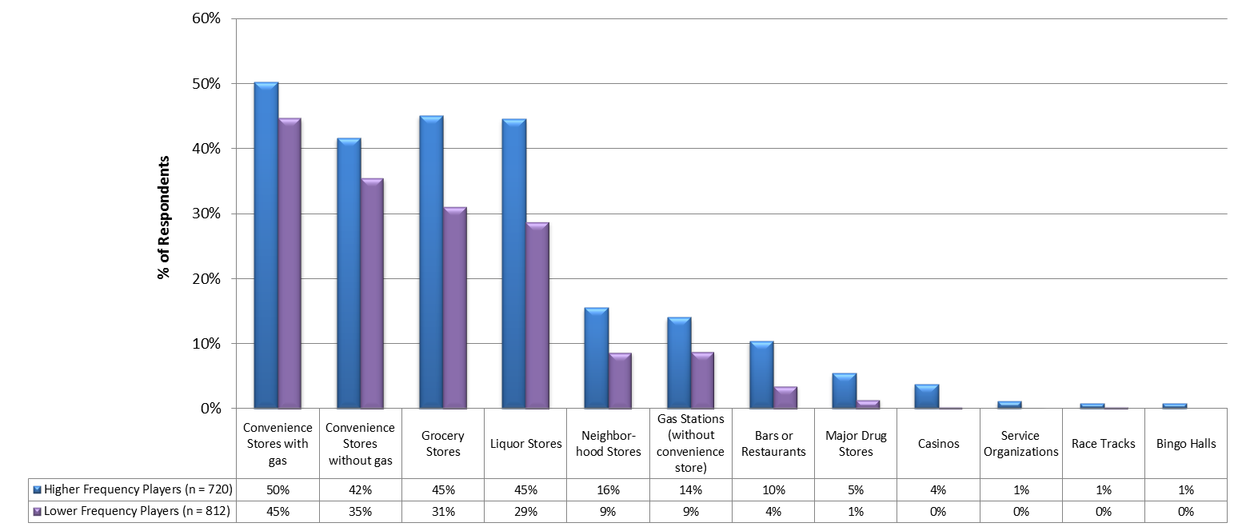
Draft – MSLA Proprietary
Section 4A: Lottery Player Behaviors
Location for Purchasing Lottery Games
Lottery game purchases are most often in convenience stores, grocery stores or liquor stores.
Fewer low frequency players are purchasing Lottery games from grocery store and liquor stores than high frequency players
*^{L}
*^{L}
*^{L}
*^{L}
*^{L}
*^{L}
*^{L}
*^{L}
*^{L}
* Statistically significant difference when compared to the corresponding segment (H = High Frequency Players, L = Low Frequency Players, N = Non-Players), p ≤ .05
Where do you typically purchase Maryland Lottery games? (Check all that apply)

Slide 57
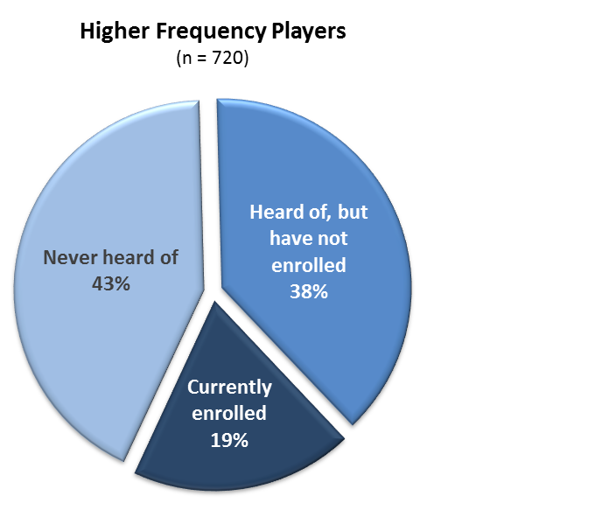
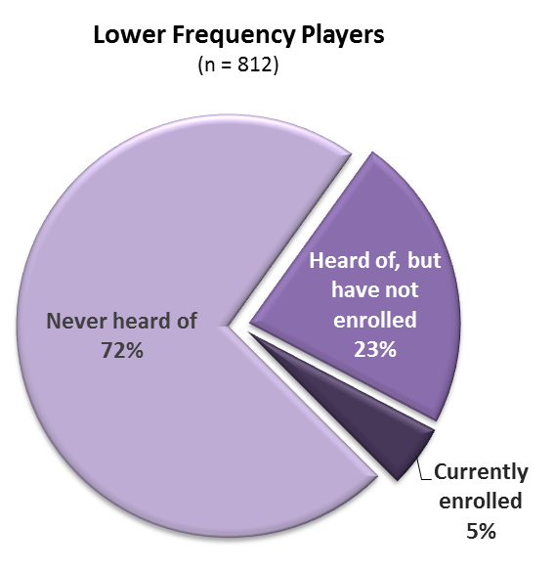
Draft – MSLA Proprietary
Section 4A: Lottery Player Behaviors
Familiarity with My Lottery Rewards Program
Twenty percent of high frequency players are enrolled in My Lottery Rewards.
Three quarters of low frequency players have never heard of the program.
*^{L}
*^{H}
*^{L}
* Statistically significant difference when compared to the corresponding segment (H = High Frequency Players, L = Low Frequency Players, N = Non-Players), p ≤ .05
How familiar are you with the My Lottery Rewards program?

Slide 58
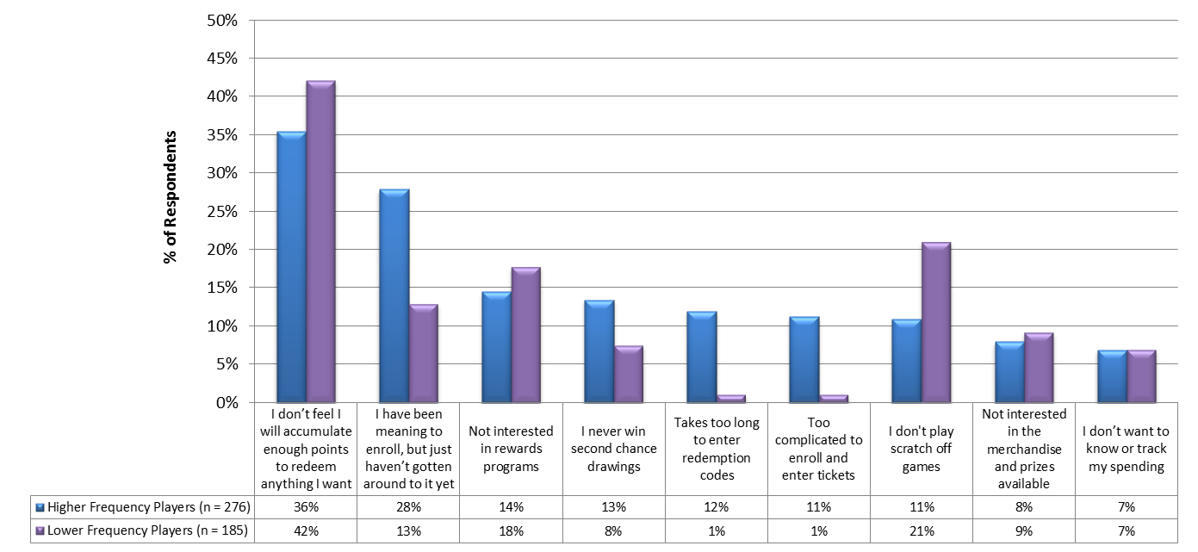
Draft – MSLA Proprietary
Section 4A: Lottery Player Behaviors
Reasons Have Not Enrolled in My Lottery Rewards Program
Not feeling they would accumulate enough points to redeem anything they want is the leading reason for not enrolling.
*^{L}
*^{L}
*^{L}
*^{L}
*^{L}
*^{H}
* Statistically significant difference when compared to the corresponding segment (H = High Frequency Players, L = Low Frequency Players, N = Non-Players), p ≤ .05
Why haven’t you enrolled in the My Lottery Rewards program? (Check all that apply)

Slide 59
Draft – MSLA Proprietary
4B
Lottery Non-Player Behaviors

Slide 60
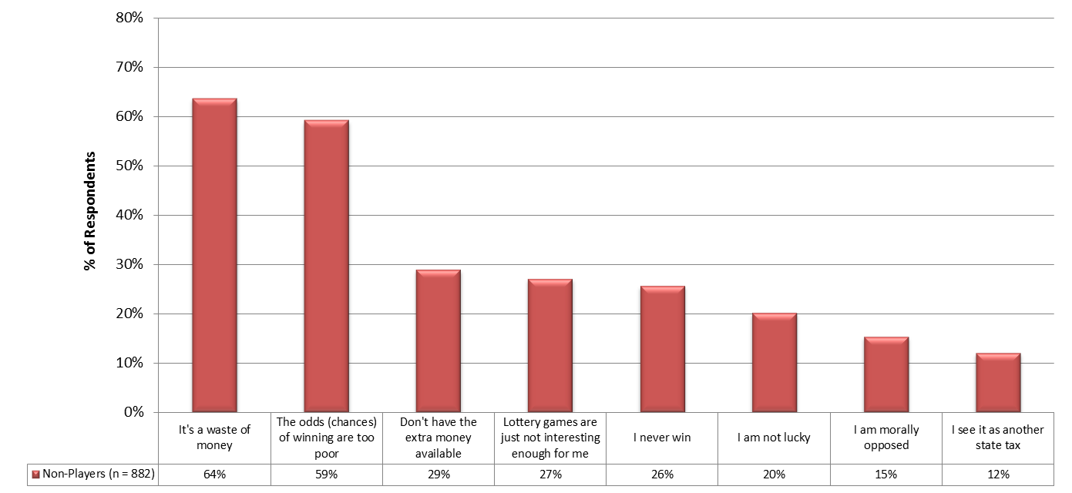
Section 4B: Lottery Non-Player Behaviors
Draft – MSLA Proprietary
Reasons for Not Playing the Lottery
Slide 1 of 2
The main reasons for not playing the lottery are “It’s a waste of money” and “Odds of winning are poor”.
15% of non-players are “morally opposed”
Chart is continued on next slide →
Please check the reasons why you don’t play the Lottery. (Check all that apply)

Slide 61
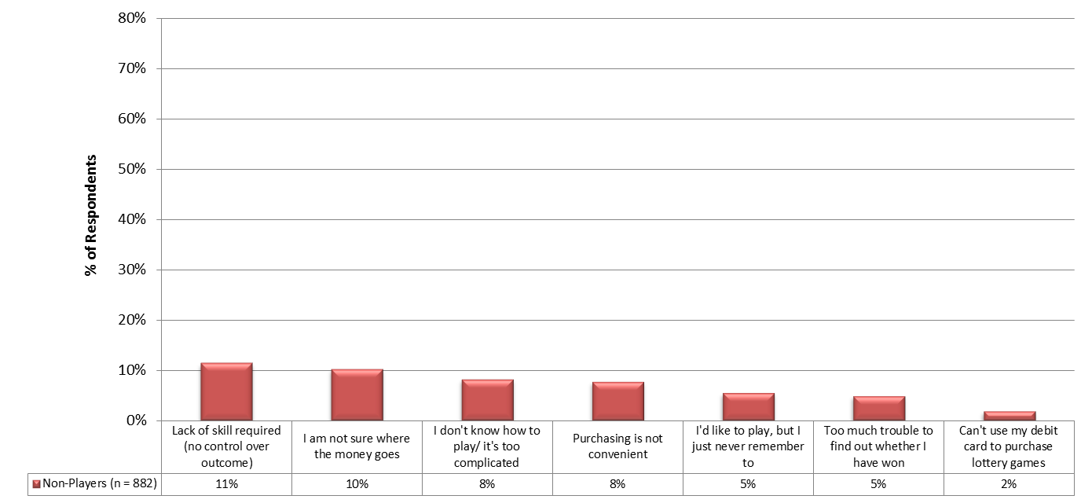
Section 4B: Lottery Non-Player Behaviors
Draft – MSLA Proprietary
Reasons for Not Playing the Lottery
Slide 2 of 2
Only 2% of non-players don’t play because they cannot use a debit card.
Please check the reasons why you don’t play the Lottery. (Check all that apply)

Slide 62
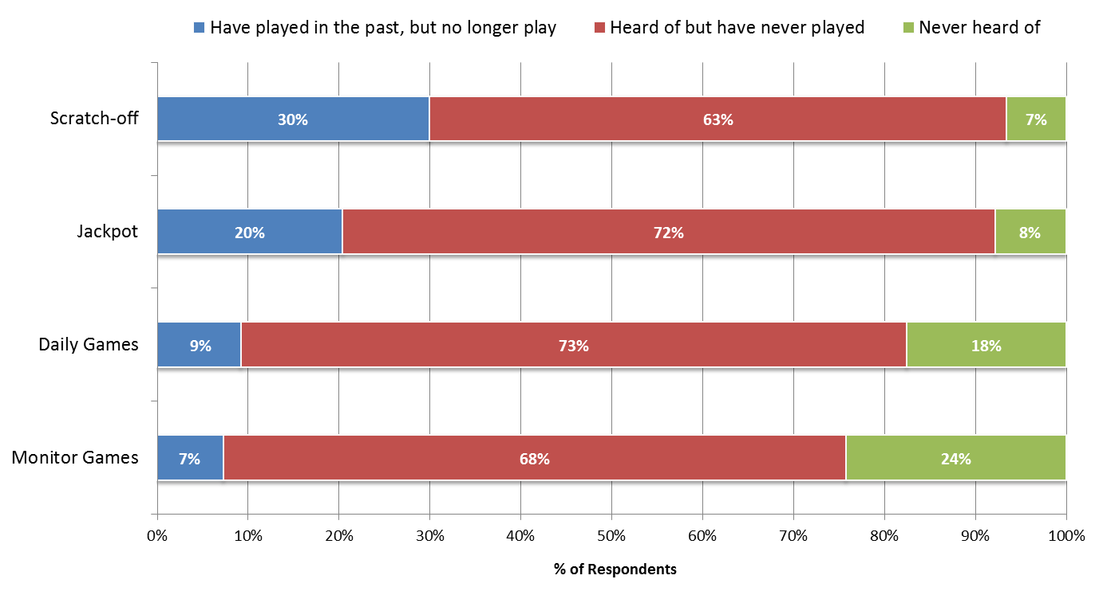
Draft – MSLA Proprietary
Section 4B: Lottery Non-Player Behaviors
Familiarity with the Lottery per Game
Game awareness among non-players is highest for Scracth-off and Jackpot.
24% of non-players have never heard of Monitor games and 18% have never heard of Daily games.
How familiar are you with each of the following games?

Slide 63
Draft – MSLA Proprietary
4B
New Games

Slide 64
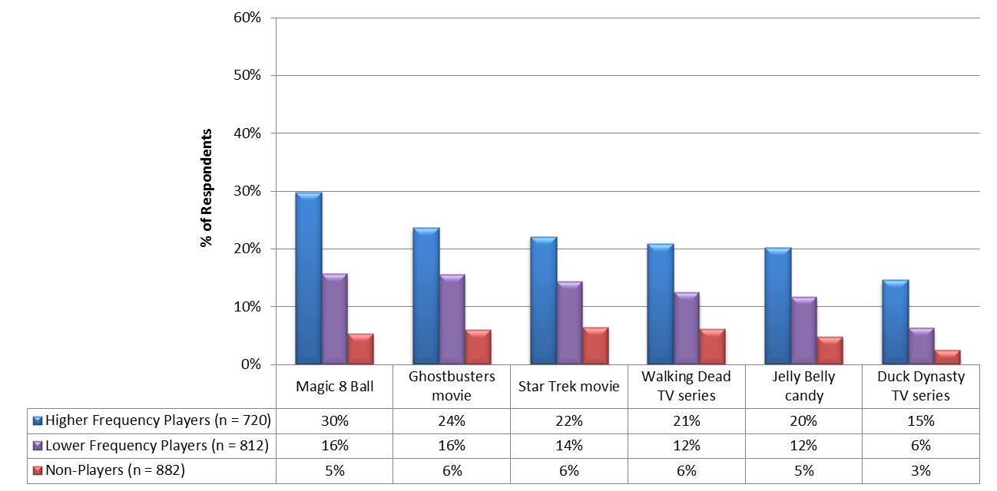
Section 5: New Games
Draft – MSLA Proprietary
Interest Level New Themed Scratch-Off Games
Magic 8 Ball was the preferred choice for a new themed scratch-off while Duck Dynasty was the least preferred.
% Rated 4 or 5
(Scale: 1 = Not at all Interested, 5 = Extremely Interested)
*^{L,N}
*^{L,N}
*^{L,N}
*^{L,N}
*^{L,N}
*^{L,N}
*^{N}
*^{N}
*^{N}
*^{N}
*^{N}
*^{N}
* Statistically significant difference when compared to the corresponding segment (H = High Frequency Players, L = Low Frequency Players, N = Non-Players), p ≤ .05
How interested would you be in each of the following themed scratch-off games if they were offered by the Maryland Lottery?

Slide 65
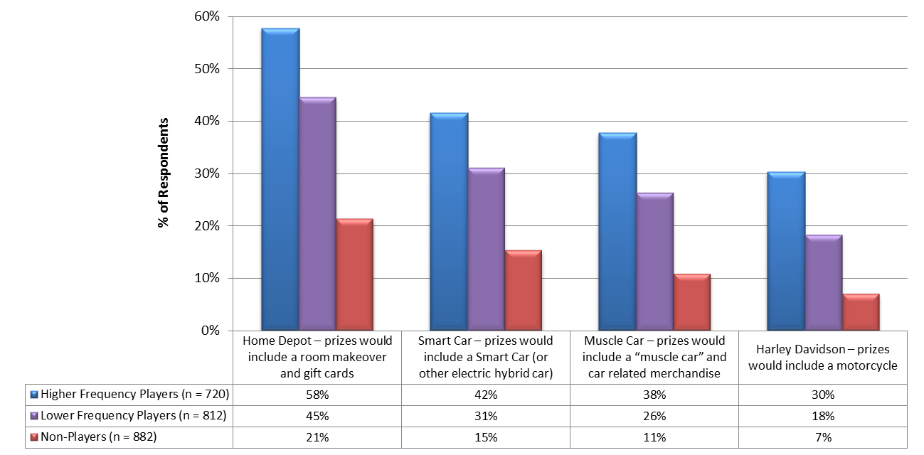
Section 5: New Games
Draft – MSLA Proprietary
Interest Level New Themed Scratch-Off Games with Related Prizes
Of the new related prizes for themed scratch-offs, Home Depot was the favorite.
21% of the non-player market segment would be interested in the Home Depot scratch-off game.
% Rated 4 or 5
(Scale: 1 = Not at all Interested, 5 = Extremely Interested)
*^{L,N}
*^{L,N}
*^{L,N}
*^{L,N}
*^{N}
*^{N}
*^{N}
*^{N}
* Statistically significant difference when compared to the corresponding segment (H = High Frequency Players, L = Low Frequency Players, N = Non-Players), p ≤ .05
How interested would you be in each of the following themed scratch-off games with related themed prizes if they were offered by the Maryland Lottery?

Slide 66
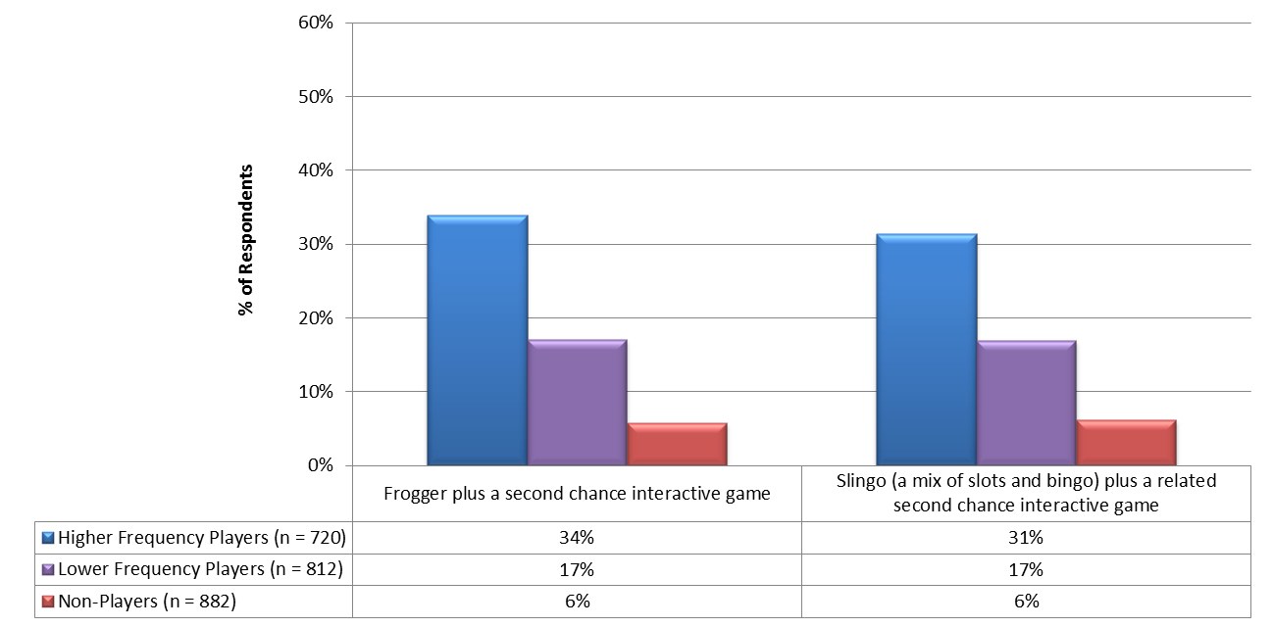
Section 5: New Games
Draft – MSLA Proprietary
Interest Level (% Rated 4 or 5 on a 1 – 5 Scale) New Themed Scratch-Off Games with 2nd Chance Online Games
The Frogger and Slingo games scored similarly with a third of the high frequency players being interested.
% Rated 4 or 5
(Scale: 1 = Not at all Interested, 5 = Extremely Interested)
*^{L,N}
*^{L,N}
*^{N}
*^{N}
* Statistically significant difference when compared to the corresponding segment (H = High Frequency Players, L = Low Frequency Players, N = Non-Players), p ≤ .05
How interested would you be in each of the following themed scratch-off games with a second chance of winning prizes by playing an online interactive game (available through website or a downloaded smartphone app)?

Slide 67
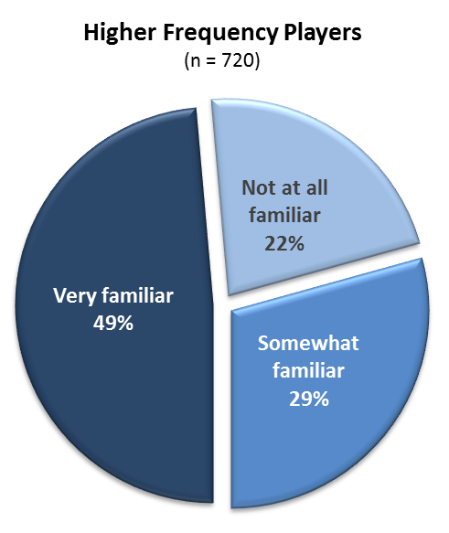
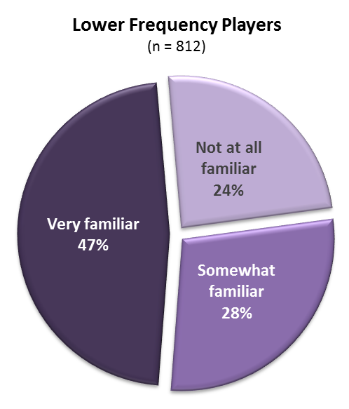
Draft – MSLA Proprietary
Section 5: New Games
Familiarity with Mr. Boh Logo
Lottery players are familiar with The Mr. Boh Logo, while 38% of non-players are not at all familiar.
*^{L,H}
*^{N}
*^{N}
* Statistically significant difference when compared to the corresponding segment (H = High Frequency Players, L = Low Frequency Players, N = Non-Players), p ≤ .05
How familiar are you with the logo below?

Slide 68
Draft – MSLA Proprietary
Section 5: New Games
Opinion About the Lottery Aligning with Mr. Boh
The majority of respondents were neutral or had a negative opinion of the Lottery aligning with Mr. Boh.
Approximately 40% of players and 17% of non-players though it was a good idea.
Mean Rating
High Frequency Players | 3.3
Low Frequency Players | 3.1
Non-Players | 2.7
*^{L,N}
*^{N}
* Statistically significant difference when compared to the corresponding segment (H = High Frequency Players, L = Low Frequency Players, N = Non-Players), p ≤ .05
Do you feel “Mr.Boh” (shown in the logo above) would be a good mascot for the Maryland Lottery to align with?

Slide 69
Section 5: New Games
Draft – MSLA Proprietary
Interest Level “Boh Knows Keno” Themed Keno Draw Screen
Overall, most respondents were neutral or not interested in “Boh Knows Keno”.
Only 6% of non-players would be interested.
The concept tested better with existing Keno Players with almost half having a favorable opinion.
Mean Rating
High Frequency Players | 2.8
Low Frequency Players | 2.5
Non-Players | 1.9
All Keno Players | 3.4
*^{L,N}
*^{N}
*^{H,L,N}
* Statistically significant difference when compared to the corresponding segment (H = High Frequency Players, L = Low Frequency Players, N = Non-Players), p ≤ .05
How interested would you be in a “Boh knows Keno” themed draw screen (display of winning numbers on monitor) for Keno games?

Slide 70
Section 5: New Games
Draft – MSLA Proprietary
Preferred Odds of Winning vs. Prize Payout For a $1 Ticket
When given a choice of various odds, the “1 in 500 chance for $100” was most preferred followed by the “1 in 10 chance for $5”.
*^{N}
*^{N}
*^{N}
*^{N}
*^{N}
*^{N}
*^{N}
*^{N}
*^{N}
*^{N}
*^{H,L}
* Statistically significant difference when compared to the corresponding segment (H = High Frequency Players, L = Low Frequency Players, N = Non-Players), p ≤ .05
Which of the following odds of winning would you prefer if the Maryland Lottery were to offer a new or enhanced game to purchase and play?

Slide 71
Draft – MSLA Proprietary
Section 5: New Games
Media Effectiveness for New Game Communications
Television was the most effective communication vehicle followed closely by retailers, radio, billboards, website and social media.
Mean Rating
(Scale: 1 = Not at all Effective, 5 = Extremely Effective)
*^{L,N}
*^{L,N}
*^{L,N}
*^{L,N}
*^{L,N}
*^{L,N}
*^{L,N}
*^{L,N}
*^{L,N}
*^{L,N}
*^{L,N}
*^{N}
*^{N}
*^{N}
*^{N}
*^{N}
*^{N}
*^{N}
*^{N}
*^{N}
*^{N}
* Statistically significant difference when compared to the corresponding segment (H = High Frequency Players, L = Low Frequency Players, N = Non-Players), p ≤ .05
In order for the Maryland Lottery to communicate information about new games, how effective would the following media vehicles be?

Slide 72
Section 5: New Games
Draft – MSLA Proprietary
Increased Likelihood of Playing if Portion of Lottery Proceeds Went To This Cause
When asked if they would be more likely to purchase a lottery ticket if they knew where the proceeds were going, the top “cause” was public education with 63% of players and 44% with non-players.
*^{N}
*^{L,N}
*^{N}
*^{L,N}
*^{L,N}
*^{N}
*^{N}
*^{N}
*^{N}
*^{N}
*^{H}
*^{H,L}
* Statistically significant difference when compared to the corresponding segment (H = High Frequency Players, L = Low Frequency Players, N = Non-Players), p ≤ .05
Would you be more likely to purchase (or purchase more) lottery game tickets if you knew the proceeds were going towards one or more of the following causes: (Check all that apply)

Slide 73
Draft – MSLA Proprietary
Segmentation Profiles
Player Profiles by Game
Profile Summaries
Profile Comparisons
(High Frequency vs. Low Frequency vs. Non-Players)
Detailed Profiles
High Frequency Player Profiles
Low Frequency Player Profiles
Non-Players

Slide 74
Draft – MSLA Proprietary
Segmentation Profiles
Player Profiles By Game

Slide 75
Daily Games Player Profile
(Pick 3, 4, Bonus Match 5, 5 Card Cash)
(n = 418)
P R O F I L E S U M M A R Y
 |  | Top Response (or Average) | 2nd Top Response
DEMOGRAPHICS | Age | 51 years
 | Gender | Female – 50% | Male – 50%
 | Race | White – 64% | AA– 28%
 | Home Type | SFH – 59% | Townhome – 22%
 | Estimated Home Value: | $282,000
 | Home Ownership | Own– 76% | Rent – 22%
 | Marital Status | Married – 53% | Single – 23%
 | Children Under 18 | 30%
 | Education | Some college – 40% | 4 years college – 25%
 | Work Status | Full time – 56% | Retired – 20%
 | Type of Work | Professional – 60% | Trade/Retail – 22%
 | Household Income | $86,000
 | Donate to Charities | 87%
L I F E S TY L E | Leisure Activities | Watching TV – 81% | Eating out – 73%
 | Leisure Time | Broadcast TV–10 hours | Using Internet – 9 hours
 | Accessing Internet | Desktop – 41% of time | Laptop – 30% of time
 | Devices Owned | Laptop – 76% | Smartphone – 71%
 | TV Programs | Comedy – 75% | Drama – 74%
 | Social Media | Facebook – 67% | YouTube – 37%
 | Shopping | Supermarket – 86% | Superstore – 82%
 | Car Type | Sedan – 41% | SUV – 30%
 | Car Brand | Toyota – 14% | Ford – 13%
Daily games players are on average 51 years old which is the oldest of the four Lottery game player segments. Most of their state wide demographics are similar to the other Maryland Lottery player groups. However, 28% of the players are African American which is the highest and nearly double the other Maryland Lottery player groups. They have some college education and half are working full time. They spend their leisure time watching broadcast TV, reading, cooking, and eating out. Their Gaming Score is 62 which is the second highest behind Monitor players
% of Players Who Play Daily Games
C U R R E N T L O T T E R Y E X P E N D I T U R E
Play Rate | % of Respondents | Daily Games Spend/Year | Lottery Games Spend/Year
Daily | 13% | $1,550 | $2,604
Weekly | 31% | $365 | $852
Monthly | 21% | $94 | $574
< Monthly | 36% | $32 | $350
G A M B L I N G / G A M I N G P O T E N T I A L
Risk Meter | 14 out of 25 points
Gaming/Gambling Tendency | 16 out of 25 points
Maryland Lottery Perception | 32 out of 50 points
Total Score | 62 out of 100 points

Slide 76
Jackpot Player Profile
(Mega Millions, Powerball, Multi-Match)
(n = 1,321)
P R O F I L E S U M M A R Y
 |  | Top Response (or Average) | 2nd Top Response
DEMOGRAPHICS | Age | 50 years
 | Gender | Male – 51% | Female – 49%
 | Race | White – 71% | AA– 16%
 | Home Type | SFH – 60% | Townhome – 21%
 | Estimated Home Value: | $305,000
 | Home Ownership | Own– 75% | Rent – 21%
 | Marital Status | Married – 55% | Single – 25%
 | Children Under 18 | 26%
 | Education | Some college – 33% | 4 years college – 32%
 | Work Status | Full time – 58% | Retired – 19%
 | Type of Work | Professional – 68% | Trade/Retail – 17%
 | Household Income | $88,000
 | Donate to Charities | 87%
L I F E S TY L E | Leisure Activities | Watching TV – 79% | Eating out – 71%
 | Leisure Time | Broadcast TV–9 hours | Using Internet – 9 hours
 | Accessing Internet | Desktop – 39% of time | Laptop – 34% of time
 | Devices Owned | Laptop – 79% | Smartphone – 73%
 | TV Programs | Comedy – 76% | Drama – 72%
 | Social Media | Facebook – 68% | YouTube – 34%
 | Shopping | Supermarket – 86% | Superstore – 78%
 | Car Type | Sedan – 42% | SUV– 29%
 | Car Brand | Toyota – 16% | Honda – 12%
Jackpot players represent the largest group of the four Lottery game player segments. One out of every three Jackpot players purchases a Jackpot game on a weekly basis. Their average home value and household income is slightly High than the other three segments. They have some college education and 58% are working full time. They spend their leisure time watching broadcast TV, eating out, reading, traveling and cooking. Their Gaming Score of 58 is the lowest of all four player segments.
% of Players Who Play Jackpot
C U R R E N T L O T T E R Y E X P E N D I T U R E
Play Rate | % of Respondents | Daily Games Spend/Year | Lottery Games Spend/Year
Daily | 2% | $1,650 | $2,623
Weekly | 33% | $471 | $883
Monthly | 22% | $123 | $310
< Monthly | 44% | $30 | $81
G A M B L I N G / G A M I N G P O T E N T I A L
Risk Meter | 13 out of 25 points
Gaming/Gambling Tendency | 15 out of 25 points
Maryland Lottery Perception | 30 out of 50 points
Total Score | 58 out of 100 points

Slide 77
Scratch-Offs Player Profile
(n = 857)
P R O F I L E S U M M A R Y
 |  | Top Response (or Average) | 2nd Top Response
DEMOGRAPHICS | Age | 47 years
 | Gender | Female – 54% | Male – 46%
 | Race | White – 75% | AA– 15%
 | Home Type | SFH – 60% | Townhome – 20%
 | Estimated Home Value: | $293,000
 | Home Ownership | Own– 71% | Rent – 24%
 | Marital Status | Married – 51% | Single – 29%
 | Children Under 18 | 29%
 | Education | Some college – 35% | 4 years college – 31%
 | Work Status | Full time – 58% | Retired – 15%
 | Type of Work | Professional – 63% | Trade/Retail – 20%
 | Household Income | $85,000
 | Donate to Charities | 86%
L I F E S TY L E | Leisure Activities | Watching TV – 82% | Eating out – 73%
 | Leisure Time | Broadcast TV–9 hours | Using Internet – 9 hours
 | Accessing Internet | Desktop – 36% of time | Laptop – 34% of time
 | Devices Owned | Laptop – 80% | Smartphone – 74%
 | TV Programs | Comedy – 86% | Drama – 74%
 | Social Media | Facebook – 71% | YouTube – 36%
 | Shopping | Supermarket – 86% | Superstore – 82%
 | Car Type | Sedan – 41% | SUV– 29%
 | Car Brand | Toyota – 16% | Honda – 12%
Scratch-off players are the youngest segment and have a High percentage of females playing the game. Many of the demographic and lifestyle attributes are similar to the other groups. A quarter of this group play Scratch-offs weekly, while another quarter plays on a monthly basis. They spend the majority of their leisure time watching broadcast TV, eating out, and spending time with friends and family, which is similar to the other segments. They have a moderate Gaming Score of 60.
% of Players Who Play Scratch-Offs
C U R R E N T L O T T E R Y E X P E N D I T U R E
Play Rate | % of Respondents | Daily Games Spend/Year | Lottery Games Spend/Year
Daily | 4% | $1,115 | $2,035
Weekly | 24% | $409 | $926
Monthly | 25% | $151 | $460
< Monthly | 47% | $33 | $177
G A M B L I N G / G A M I N G P O T E N T I A L
Risk Meter | 13 out of 25 points
Gaming/Gambling Tendency | 15 out of 25 points
Maryland Lottery Perception | 32 out of 50 points
Total Score | 60 out of 100 points

Slide 78
Monitor Games Player Profile
(Keno, Racetrax)
(n = 134)
P R O F I L E S U M M A R Y
 |  | Top Response (or Average) | 2nd Top Response
DEMOGRAPHICS | Age | 47 years
 | Gender | Male – 63% | Female – 37%
 | Race | White – 79% | AA– 13%
 | Home Type | SFH – 66% | Townhome – 17%
 | Estimated Home Value: | $280,000
 | Home Ownership | Own– 77% | Rent – 19%
 | Marital Status | Married – 55% | Single – 21%
 | Children Under 18 | 28%
 | Education | Some college – 41% | High School – 24%
 | Work Status | Full time – 55% | Retired – 21%
 | Type of Work | Professional – 58% | Trade/Retail – 29%
 | Household Income | $81,000
 | Donate to Charities | 87%
L I F E S TY L E | Leisure Activities | Eating out – 85% | Watching TV – 84%
 | Leisure Time | Broadcast TV–10 hours | Using Internet – 9 hours
 | Accessing Internet | Desktop – 43% of time | Laptop – 30% of time
 | Devices Owned | Laptop – 79% | Smartphone – 69%
 | TV Programs | Comedy – 84% | Drama – 78%
 | Social Media | Facebook – 72% | YouTube – 39%
 | Shopping | Supermarket – 88% | Superstore – 82%
 | Car Type | Sedan – 43% | SUV– 28%
 | Car Brand | Chevy – 12% | Ford – 12%
Similar to the Scratch-off players, this group is younger, however a much High proportion of the players are males (2 out of 3 players). They have the lowest aggregate education level with most have some college or a high school education. Their daily players are big spenders for monitor games and all lottery
games in general, averaging over four thousand
dollars spent per year. Their Gaming Score of 66
is six points High compared to the other gaming segments and they have the highest gaming/gambling tendency score (18 out of 25 points).
% of Players
Who Play Monitor Games
C U R R E N T L O T T E R Y E X P E N D I T U R E
Play Rate | % of Respondents | Daily Games Spend/Year | Lottery Games Spend/Year
Daily | 9% | $1,999 | $4,320
Weekly | 25% | $274 | $1,456
Monthly | 23% | $177 | $958
< Monthly | 43% | $56 | $404
G A M B L I N G / G A M I N G P O T E N T I A L
Risk Meter | 14 out of 25 points
Gaming/Gambling Tendency | 18 out of 25 points
Maryland Lottery Perception | 34 out of 50 points
Total Score | 66 out of 100 points

Slide 79
Draft – MSLA Proprietary
Segmentation Profiles
Profile Summaries

Slide 80
High Frequency Players
Profile Summaries
 | Urban | Smaller City | Suburban | Rural
Low Income | 44 – Average age (↓) 38% - White (↓) 53% - Single (↑) $34,000 – HHI Restaurants - top activity 83% on Facebook (↑) 62/100 – Gaming Score | 37 – Average age (↓) 57% - White 57% - Single (↑) $34,000 – HHI Restaurants - top activity 89% on Facebook (↑) 61/100 – Gaming Score | 46 – Average age 64% - White 42% - Single (↑) $33,000 – HHI Family/Friends- top activity 64% on Facebook 59/100 – Gaming Score | 50 – Average age 82% - White 52% - Married $34,000 – HHI Family/Friends - top activity 52% on Facebook (↓) 60/100 – Gaming Score
Middle Income | 46 – Average age 55% - White (↓) 44% - Married (↓) $74,000 – HHI Restaurants - top activity 64% on Facebook 63/100 – Gaming Score | 46 – Average age 81% - White (↑) 56% - Married $75,000 – HHI Traveling - top activity 54% on Facebook (↓) 61/100 – Gaming Score | 52 – Average age (↑) 68% - White 60% - Married $76,000 – HHI Restaurants - top activity 70% on Facebook 61/100 – Gaming Score | 51 – Average age 90% - White (↑) 68% - Married (↑) $71,000 – HHI Family/Friends - top activity 77% on Facebook 60/100 – Gaming Score
High Income | 48 – Average age 78% - White 68% - Married $154,000 – HHI Traveling - top activity 70% on Facebook 63/100 – Gaming Score | 48 – Average age 54% - White 75% - Married $152,000 – HHI Traveling - top activity 67% on Facebook 60/100 – Gaming Score | 52 – Average age (↑) 62% - White 78% - Married (↑) $148,000 – HHI Restaurants - top activity 65% on Facebook 60/100 – Gaming Score | 56 – Average age (↑) 73% - White 76% - Married (↑) $148,000 – HHI Gardening - top activity 55% on Facebook 61/100 – Gaming Score
Note: Top activity listed excludes Watching TV, almost always the number one response.

Slide 81
High Frequency Players
Profile Summaries (continued)
 | Urban | Smaller City | Suburban | Rural
Low Income | 50% - Daily Games 80% - Jackpot 58% - Scratch-Offs 18% - Monitor Games $576 - Total Spend 62/100 – Gaming Score | 29% - Daily Games (↓) 79% - Jackpot 86% - Scratch-Offs (↑) 14% - Monitor Games $836 - Total Spend 61/100 – Gaming Score | 38% - Daily Games 85% - Jackpot 64% - Scratch-Offs 16% - Monitor Games $1,108 - Total Spend 59/100 – Gaming Score | 45% - Daily Games 94% - Jackpot 70% - Scratch-Offs 21% - Monitor Games $1,257 - Total Spend 60/100 – Gaming Score
Middle Income | 45% - Daily Games 85% - Jackpot 63% - Scratch-Offs 9% - Monitor Games $987 - Total Spend 63/100 – Gaming Score | 38% - Daily Games 92% - Jackpot 65% - Scratch-Offs 12% - Monitor Games $820 - Total Spend 61/100 – Gaming Score | 47% - Daily Games 91% - Jackpot 72% - Scratch-Offs 22% - Monitor Games (↑) $756 - Total Spend 61/100 – Gaming Score | 32% - Daily Games 85% - Jackpot 70% - Scratch-Offs 17% - Monitor Games $414 - Total Spend 60/100 – Gaming Score
High Income | 43% - Daily Games 90% - Jackpot 53% - Scratch-Offs 15% - Monitor Games $1,098 - Total Spend 63/100 – Gaming Score | 42% - Daily Games 79% - Jackpot 54% - Scratch-Offs 8% - Monitor Games $594 - Total Spend 60/100 – Gaming Score | 45% - Daily Games 88% - Jackpot 64% - Scratch-Offs 10% - Monitor Games $675 - Total Spend 60/100 – Gaming Score | 67% - Daily Games (↑) 91% - Jackpot 70% - Scratch-Offs 21% - Monitor Games $946 - Total Spend 61/100 – Gaming Score

Slide 82
Low Frequency Players
Profile Summaries
 | Urban | Smaller City | Suburban | Rural
Low Income | 40 – Average age (↓) 55% - White (↓) 68% - Single (↑) $35,000 – HHI Family/Friends- top activity 74% on Facebook 58/100 – Gaming Score (↑) | 43 – Average age 71% - White 53% - Single (↑) $33,000 – HHI Family/Friends - top activity 82% on Facebook 53/100 – Gaming Score | 48 – Average age 70% - White 44% - Single (↑) $35,000 – HHI Restaurants - top activity 61% on Facebook 54/100 – Gaming Score | 56 – Average age (↑) 94% - White (↑) 37% - Married $34,000 – HHI Reading - top activity 71% on Facebook 56/100 – Gaming Score
Middle Income | 43 – Average age (↓) 59% - White (↓) 52% - Single (↑) $73,000 – HHI Restaurants - top activity 67% on Facebook 56/100 – Gaming Score | 47 – Average age 80% - White 52% - Married $77,000 – HHI Restaurants - top activity 80% on Facebook 53/100 – Gaming Score | 49 – Average age 77% - White 52% - Married $76,000 – HHI Restaurants - top activity 69% on Facebook 53/100 – Gaming Score | 53 – Average age (↑) 92% - White (↑) 59% - Married $77,000 – HHI Family/Friends - top activity 69% on Facebook 56/100 – Gaming Score
High Income | 49 – Average age 66% - White 61% - Married $161,000 – HHI Restaurants - top activity 63% on Facebook 55/100 – Gaming Score | 45 – Average age 75% - White 75% - Married (↑) $143,000 – HHI Restaurants - top activity 65% on Facebook 55/100 – Gaming Score | 53 – Average age (↑) 70% - White 81% - Married (↑) $154,000 – HHI Restaurants - top activity 64% on Facebook 55/100 – Gaming Score | 50 – Average age 81% - White 85% - Married (↑) $153,000 – HHI Family/Friends - top activity 70% on Facebook 51/100 – Gaming Score
Note: Top activity listed excludes Watching TV, almost always the number one response

Slide 83
Low Frequency Players
Profile Summaries (continued)
 | Urban | Smaller City | Suburban | Rural
Low Income | 16% - Daily Games 87% - Jackpot 53% - Scratch-Offs 8% - Monitor Games $64 - Total Spend 58/100 – Gaming Score (↑) | 18% - Daily Games 76% - Jackpot 47% - Scratch-Offs 0% - Monitor Games $61 - Total Spend 53/100 – Gaming Score | 13% - Daily Games 84% - Jackpot 48% - Scratch-Offs 5% - Monitor Games $59 - Total Spend 54/100 – Gaming Score | 11% - Daily Games 80% - Jackpot 57% - Scratch-Offs 6% - Monitor Games $52 - Total Spend 56/100 – Gaming Score
Middle Income | 25% - Daily Games (↑) 76% - Jackpot (↓) 47% - Scratch-Offs 1% - Monitor Games $75 - Total Spend 56/100 – Gaming Score | 9% - Daily Games 84% - Jackpot 52% - Scratch-Offs 5% - Monitor Games $59 - Total Spend 53/100 – Gaming Score | 11% - Daily Games 86% - Jackpot 43% - Scratch-Offs 4% - Monitor Games $48 - Total Spend 53/100 – Gaming Score | 6% - Daily Games 94% - Jackpot (↑) 53% - Scratch-Offs 2% - Monitor Games $60 - Total Spend 56/100 – Gaming Score
High Income | 3% - Daily Games (↓) 76% - Jackpot 58% - Scratch-Offs 3% - Monitor Games $74 - Total Spend 55/100 – Gaming Score | 15% - Daily Games 85% - Jackpot 55% - Scratch-Offs 0% - Monitor Games $39 - Total Spend 55/100 – Gaming Score | 16% - Daily Games 87% - Jackpot 45% - Scratch-Offs 2% - Monitor Games $83 - Total Spend 55/100 – Gaming Score | 7% - Daily Games 96% - Jackpot 52% - Scratch-Offs 7% - Monitor Games $56 - Total Spend 51/100 – Gaming Score

Slide 84
Non-Players
Profile Summaries
 | Urban | Smaller City | Suburban | Rural
Low Income | 39 – Average age (↓) 51% - White (↓) 63% - Single (↑) $34,000 – HHI Watching TV - top activity 65% on Facebook 49/100 – Gaming Score | 43 – Average age 73% - White 50% - Single (↑) $34,000 – HHI Watching TV - top activity 69% on Facebook 48/100 – Gaming Score | 46 – Average age 72% - White 46% - Single (↑) $33,000 – HHI Watching TV - top activity 60% on Facebook 48/100 – Gaming Score | 46 – Average age 88% - White (↑) 33% - Single $34,000 – HHI Watching TV - top activity 58% on Facebook 43/100 – Gaming Score
Middle Income | 46 – Average age 60% - White (↓) 48% - Married $73,000 – HHI Time w/ friends – top activity 71% on Facebook 47/100 – Gaming Score | 45 – Average age 64% - White 52% - Married $78,000 – HHI Watching TV - top activity 62% on Facebook 47/100 – Gaming Score | 50 – Average age 78% - White 48% - Married $75,000 – HHI Watching TV - top activity 64% on Facebook 46/100 – Gaming Score | 56 – Average age (↑) 93% - White (↑) 69% - Married (↑) $76,000 – HHI Watching TV - top activity 57% on Facebook 44/100 – Gaming Score
High Income | 49 – Average age 76% - White 76% - Married (↑) $158,000 – HHI Dining out – top activity 62% on Facebook 45/100 – Gaming Score | 48 – Average age 69% - White 69% - Married $145,000 – HHI Dining out – top activity 69% on Facebook 47/100 – Gaming Score | 51 – Average age 71% - White 70% - Married (↑) $156,000 – HHI Watching TV - top activity 48% on Facebook (↓) 49/100 – Gaming Score | 51 – Average age 86% - White 81% - Married (↑) $154,000 – HHI Watching TV - top activity 62% on Facebook 44/100 – Gaming Score

Slide 85
Draft – MSLA Proprietary
Segmentation Profiles
Profile Comparisons

Slide 86
Profile Comparison
URBAN / LOW INCOME
 |  | High Frequency Players | Low Frequency Players | Non-Players
DEMOGRAPHICS | Age | 44 years | 40 years | 39 years
 | Gender | Male – 55% | Male – 63% | Female – 59%
 | Race | White – 38% | White – 55% | White – 51%
 | Home Type | Townhome – 38% | Townhome – 55% | Apartment – 53%
 | Estimated Home Value: | $189,000 | $175,000 | $191,000
 | Home Ownership | Rent – 48% | Rent – 58% | Rent – 76%
 | Marital Status | Single – 53% | Single – 68% | Single – 63%
 | Children Under 18 | 15% | 11% | 14%
 | Education | Some College – 40% | 4 Year College – 29% | Some college – 33%
 | Work Status | Full Time – 50% | Full Time – 45% | Full time – 49%
 | Type of Work | Professional – 54% | Professional – 52% | Professional – 65%
 | Household Income | $34,000 | $35,000 | $34,000
 | Donate to Charities | 55% | 66% | 69%
L I F E S TY L E | Leisure Activities | Watching TV – 75% | Watching TV – 74% | Watching TV – 78%
 | Leisure Time | Internet – 9 hours | Internet – 12 hours | Internet – 9 hours
 | Accessing Internet | Laptop – 32% of time | Laptop – 50% of time | Laptop – 46% of time
 | Devices Owned | Laptop – 83% | Laptop – 84% | Laptop – 86%
 | TV Programs | Comedy – 83% | Comedy – 76% | Comedy – 73%
 | Social Media | Facebook – 83% | Facebook – 74% | Facebook – 65%
 | Shopping | Supermarket – 73% | Supermarket – 79% | Supermarket – 78%
 | Car Type | Sedan – 38% | Sedan – 42% | Sedan – 47%
 | Car Brand | Chevrolet – 21% | Honda – 21% | Toyota – 20%
C U R R E N T L O T T E R Y P L A Y
 | High Frequency Players | Low Frequency Players | Non-Players
Daily Games | 50% | 16% | n/a
Jackpot | 80% | 87% | n/a
Scratch-Offs | 58% | 53% | n/a
Monitor Games | 18% | 8% | n/a
Total Annual Spend | $576 | $64 | n/a
G A M B L I N G / G A M I N G P O T E N T I A L
 | High Frequency Players | Low Frequency Players | Non-Players
Risk Meter | 15 | 14 | 13
Gaming/ Gambling Tendency | 16 | 14 | 12
Maryland Lottery Perception | 31 | 30 | 24
Total Score | 62 | 58 | 49

Slide 87
Profile Comparison
URBAN / MIDDLE INCOME
 |  | High Frequency Players | Low Frequency Players | Non-Players
DEMOGRAPHICS | Age | 46 years | 43 years | 46 years
 | Gender | Male – 55% | Female – 59% | Female – 54%
 | Race | White – 55% | White – 59% | White – 60%
 | Home Type | SFH – 35% | SFH – 34% | SFH – 40%
 | Estimated Home Value: | $252,000 | $257,000 | $260,000
 | Home Ownership | Own – 59% | Own – 54% | Own – 60%
 | Marital Status | Married – 44% | Single – 52% | Married – 48%
 | Children Under 18 | 36% | 25% | 28%
 | Education | Some College – 31% | 4 Year College – 38% | Post college – 43%
 | Work Status | Full Time – 76% | Full Time – 73% | Full time – 70%
 | Type of Work | Professional – 68% | Professional – 91% | Professional – 84%
 | Household Income | $74,000 | $73,000 | $73,000
 | Donate to Charities | 85% | 85% | 85%
L I F E S TY L E | Leisure Activities | Watching TV – 83% | Watching TV – 77% | Time with friends – 79%
 | Leisure Time | Broadcast TV – 8 hours | Internet – 8 hours | Internet – 8 hours
 | Accessing Internet | Desktop – 39% of time | Laptop – 38% of time | Laptop – 39% of time
 | Devices Owned | Smartphone – 79% | Laptop – 87% | Laptop – 84%
 | TV Programs | Movies – 80% | Drama – 76% | Comedy – 65%
 | Social Media | Facebook – 64% | Facebook – 67% | Facebook – 71%
 | Shopping | Supermarket – 85% | Supermarket – 84% | Supermarket – 83%
 | Car Type | Sedan – 38% | Sedan – 51% | Sedan – 46%
 | Car Brand | Toyota – 14% | Toyota – 19% | Toyota – 32%
C U R R E N T L O T T E R Y P L A Y
 | High Frequency Players | Low Frequency Players | Non-Players
Daily Games | 45% | 25% | n/a
Jackpot | 85% | 76% | n/a
Scratch-Offs | 63% | 47% | n/a
Monitor Games | 9% | 1% | n/a
Total Annual Spend | $967 | $75 | n/a
G A M B L I N G / G A M I N G P O T E N T I A L
 | High Frequency Players | Low Frequency Players | Non-Players
Risk Meter | 15 | 14 | 12
Gaming/ Gambling Tendency | 16 | 14 | 11
Maryland Lottery Perception | 32 | 28 | 24
Total Score | 63 | 56 | 47

Slide 88
Profile Comparison
URBAN / HIGH INCOME
 |  | High Frequency Players | Low Frequency Players | Non-Players
DEMOGRAPHICS | Age | 48 years | 49 years | 49 years
 | Gender | Male – 85% | Male – 71% | Male – 71%
 | Race | White – 78% | White – 66% | White – 76%
 | Home Type | SFH – 55% | SFH – 58% | SFH – 52%
 | Estimated Home Value: | $432,000 | $449,000 | $500,000
 | Home Ownership | Own – 80% | Own – 82% | Own – 69%
 | Marital Status | Married – 68% | Married – 61% | Married – 76%
 | Children Under 18 | 35% | 26% | 26%
 | Education | 4 Year College – 40% | 4 Year College – 50% | Post college – 69%
 | Work Status | Full Time – 68% | Full Time – 79% | Full time – 64%
 | Type of Work | Professional – 77% | Professional – 88% | Professional – 86%
 | Household Income | $154,000 | $161,000 | $158,000
 | Donate to Charities | 83% | 89% | 93%
L I F E S TY L E | Leisure Activities | Traveling – 73% | Restaurants – 84% | Restaurants – 90%
 | Leisure Time | Internet – 9 hours | Broadcast TV – 7 hours | Internet – 7 hours
 | Accessing Internet | Laptop – 35% of time | Laptop – 33% of time | Laptop – 40% of time
 | Devices Owned | Laptop – 83% | Smartphone – 92% | Laptop – 88%
 | TV Programs | Comedy – 78% | Comedy – 84% | Comedy – 64%
 | Social Media | Facebook – 70% | Facebook – 63% | Facebook – 62%
 | Shopping | Supermarket – 80% | Supermarket – 92% | Supermarket – 83%
 | Car Type | SUV/Crossover – 40% | Sedan – 45% | Sedan – 40%
 | Car Brand | Honda – 13% | Honda – 16% | Toyota – 23%
C U R R E N T L O T T E R Y P L A Y
 | High Frequency Players | Low Frequency Players | Non-Players
Daily Games | 43% | 3% | n/a
Jackpot | 90% | 76% | n/a
Scratch-Offs | 53% | 58% | n/a
Monitor Games | 15% | 3% | n/a
Total Annual Spend | $1,098 | $74 | n/a
G A M B L I N G / G A M I N G P O T E N T I A L
 | High Frequency Players | Low Frequency Players | Non-Players
Risk Meter | 14 | 12 | 12
Gaming/ Gambling Tendency | 17 | 14 | 11
Maryland Lottery Perception | 32 | 29 | 22
Total Score | 63 | 55 | 45

Slide 89
Profile Comparison
SMALLER CITY / LOW INCOME
 |  | High Frequency Players | Low Frequency Players | Non-Players
DEMOGRAPHICS | Age | 37 years | 43 years | 43 years
 | Gender | Male – 57% | Female – 59% | Female – 50%
 | Race | White – 57% | White – 71% | White – 73%
 | Home Type | SFH – 43% | SFH – 29% | SFH – 38%
 | Estimated Home Value: | $164,000 | $168,000 | $160,000
 | Home Ownership | Own – 43% | Rent – 53% | Own – 50%
 | Marital Status | Single – 57% | Single – 53% | Single – 50%
 | Children Under 18 | 46% | 24% | 23%
 | Education | Some College – 50% | High School – 41% | Some college – 38%
 | Work Status | Full Time – 61% | Full Time – 41% | Full time – 50%
 | Type of Work | Trade/Retail – 62% | Professional – 42% | Trade/Retail – 67%
 | Household Income | $34,000 | $33,000 | $34,000
 | Donate to Charities | 64% | 59% | 73%
L I F E S TY L E | Leisure Activities | Watching TV – 79% | Watching TV – 88% | Watching TV– 73%
 | Leisure Time | Internet – 8 hours | Broadcast TV – 8 hours | Broadcast – 9 hours
 | Accessing Internet | Desktop – 31% of time | Laptop – 47% of time | Laptop – 44% of time
 | Devices Owned | Smartphone – 86% | Smartphone – 82% | Laptop – 73%
 | TV Programs | Comedy – 79% | Movies – 76% | Comedy – 77%
 | Social Media | Facebook – 89% | Facebook – 82% | Facebook – 69%
 | Shopping | Superstore – 71% | Supermarket – 88% | Supermarket – 92%
 | Car Type | Sedan – 54% | Sedan – 59% | Sedan – 42%
 | Car Brand | Ford – 16% | Chevrolet – 29% | Toyota – 24%
C U R R E N T L O T T E R Y P L A Y
 | High Frequency Players | Low Frequency Players | Non-Players
Daily Games | 29% | 18% | n/a
Jackpot | 79% | 76% | n/a
Scratch-Offs | 86% | 47% | n/a
Monitor Games | 14% | 0% | n/a
Total Annual Spend | $836 | $61 | n/a
G A M B L I N G / G A M I N G P O T E N T I A L
 | High Frequency Players | Low Frequency Players | Non-Players
Risk Meter | 13 | 11 | 12
Gaming/ Gambling Tendency | 15 | 13 | 12
Maryland Lottery Perception | 33 | 29 | 24
Total Score | 61 | 53 | 48

Slide 90
Profile Comparison
SMALLER CITY / MIDDLE INCOME
 |  | High Frequency Players | Low Frequency Players | Non-Players
DEMOGRAPHICS | Age | 46 years | 47 years | 45 years
 | Gender | Male – 63% | Female – 59% | Female – 52%
 | Race | White – 81% | White – 80% | White – 64%
 | Home Type | SFH – 50% | SFH – 48% | SFH – 44%
 | Estimated Home Value: | $244,000 | $258,000 | $237,000
 | Home Ownership | Own – 69% | Own – 66% | Own – 66%
 | Marital Status | Married – 56% | Married – 52% | Married – 52%
 | Children Under 18 | 21% | 25% | 20%
 | Education | 4 Year College – 40% | 4 Year College – 43% | 4 years college – 40%
 | Work Status | Full Time – 65% | Full Time – 57% | Full time – 64%
 | Type of Work | Professional – 67% | Professional – 72% | Professional – 88%
 | Household Income | $75,000 | $77,000 | $78,000
 | Donate to Charities | 85% | 91% | 80%
L I F E S TY L E | Leisure Activities | Watching TV– 71% | Watching TV – 80% | Watching TV– 62%
 | Leisure Time | Broadcast TV – 8 hours | Broadcast TV – 9 hours | Internet – 9 hours
 | Accessing Internet | Desktop – 42% of time | Desktop – 41% of time | Laptop – 41% of time
 | Devices Owned | Laptop – 81% | Laptop – 75% | Laptop – 85%
 | TV Programs | Comedy – 77% | Drama – 77% | Documentary – 56%
 | Social Media | Facebook – 54% | Facebook – 80% | Facebook – 62%
 | Shopping | Supermarket – 87% | Supermarket – 86% | Superstore – 78%
 | Car Type | Sedan – 46% | SUV/Crossover – 39% | Sedan – 44%
 | Car Brand | Dodge – 10% | Honda – 14% | Ford – 18%
C U R R E N T L O T T E R Y P L A Y
 | High Frequency Players | Low Frequency Players | Non-Players
Daily Games | 38% | 9% | n/a
Jackpot | 92% | 84% | n/a
Scratch-Offs | 65% | 52% | n/a
Monitor Games | 12% | 5% | n/a
Total Annual Spend | $820 | $59 | n/a
G A M B L I N G / G A M I N G P O T E N T I A L
 | High Frequency Players | Low Frequency Players | Non-Players
Risk Meter | 14 | 12 | 12
Gaming/ Gambling Tendency | 16 | 13 | 12
Maryland Lottery Perception | 31 | 28 | 23
Total Score | 61 | 53 | 47

Slide 91
Profile Comparison
SMALLER CITY / HIGH INCOME
 |  | High Frequency Players | Low Frequency Players | Non-Players
DEMOGRAPHICS | Age | 48 years | 45 years | 48 years
 | Gender | Male – 62% | Male – 50% | Female – 62%
 | Race | White – 54% | White – 75% | White – 69%
 | Home Type | SFH – 58% | SFH – 45% | SFH – 62%
 | Estimated Home Value: | $431,000 | $321,000 | $550,000
 | Home Ownership | Own – 83% | Own – 70% | Own – 77%
 | Marital Status | Married – 75% | Married – 75% | Married – 69%
 | Children Under 18 | 46% | 25% | 31%
 | Education | 4 Year College – 46% | 4 Year College – 45% | Post college – 54%
 | Work Status | Full Time – 71% | Full Time – 75% | Full time – 46%
 | Type of Work | Professional – 100% | Professional – 76% | Professional – 86%
 | Household Income | $152,000 | $143,000 | $145,000
 | Donate to Charities | 88% | 85% | 92%
L I F E S TY L E | Leisure Activities | Watching TV – 71% | Restaurants – 80% | Restaurants – 92%
 | Leisure Time | Broadcast TV – 8 hours | Internet – 9 hours | Internet – 12 hours
 | Accessing Internet | Laptop – 34% of time | Laptop – 45% of time | Laptop – 36% of time
 | Devices Owned | Smartphone – 88% | Smartphone – 95% | Laptop – 85%
 | TV Programs | News – 71% | Comedy – 80% | Movies – 77%
 | Social Media | Facebook – 67% | Facebook – 65% | Facebook – 69%
 | Shopping | Superstore – 79% | Superstore – 85% | Supermarket – 85%
 | Car Type | Sedan – 67% | Sedan – 45% | Sedan – 38%
 | Car Brand | Toyota – 17% | Honda – 20% | Honda – 46%
C U R R E N T L O T T E R Y P L A Y
 | High Frequency Players | Low Frequency Players | Non-Players
Daily Games | 42% | 15% | n/a
Jackpot | 79% | 85% | n/a
Scratch-Offs | 54% | 55% | n/a
Monitor Games | 8% | 0% | n/a
Total Annual Spend | $594 | $39 | n/a
G A M B L I N G / G A M I N G P O T E N T I A L
 | High Frequency Players | Low Frequency Players | Non-Players
Risk Meter | 14 | 14 | 12
Gaming/ Gambling Tendency | 15 | 13 | 11
Maryland Lottery Perception | 31 | 28 | 24
Total Score | 60 | 55 | 47

Slide 92
Profile Comparison
SUBURBAN / LOW INCOME
 |  | High Frequency Players | Low Frequency Players | Non-Players
DEMOGRAPHICS | Age | 46 years | 48 years | 46 years
 | Gender | Male – 47% | Female – 56% | Female – 53%
 | Race | White – 64% | White – 70% | White – 72%
 | Home Type | SFH – 42% | SFH – 34% | SFH – 47%
 | Estimated Home Value: | $231,000 | $189,000 | $230,000
 | Home Ownership | Own – 49% | Own – 51% | Own – 49%
 | Marital Status | Single – 42% | Single – 44% | Single – 46%
 | Children Under 18 | 40% | 18% | 13%
 | Education | Some College – 45% | 4 Year College – 33% | 4 years college – 31%
 | Work Status | Full Time – 35% | Full Time – 48% | Retired – 26%
 | Type of Work | Professional – 37% | Trade/Retail – 35% | Professional – 53%
 | Household Income | $33,000 | $35,000 | $33,000
 | Donate to Charities | 75% | 69% | 63%
L I F E S TY L E | Leisure Activities | Watching TV – 76% | Watching TV – 79% | Watching TV– 72%
 | Leisure Time | Internet – 11 hours | Broadcast TV – 9 hours | Internet – 7 hours
 | Accessing Internet | Desktop – 39% of time | Desktop – 38% of time | Laptop – 43% of time
 | Devices Owned | Laptop – 73% | Smartphone – 72% | Laptop – 71%
 | TV Programs | Comedy – 69% | Comedy – 74% | Drama – 64%
 | Social Media | Facebook– 64% | Facebook – 61% | Facebook – 60%
 | Shopping | Supermarket – 82% | Supermarket – 79% | Supermarket – 67%
 | Car Type | Sedan – 42% | Sedan – 44% | Sedan – 45%
 | Car Brand | Ford – 17% | Honda – 11% | Honda – 20%
C U R R E N T L O T T E R Y P L A Y
 | High Frequency Players | Low Frequency Players | Non-Players
Daily Games | 38% | 13% | n/a
Jackpot | 85% | 84% | n/a
Scratch-Offs | 64% | 48% | n/a
Monitor Games | 16% | 5% | n/a
Total Annual Spend | $1,108 | $59 | n/a
G A M B L I N G / G A M I N G P O T E N T I A L
 | High Frequency Players | Low Frequency Players | Non-Players
Risk Meter | 13 | 12 | 11
Gaming/ Gambling Tendency | 15 | 13 | 12
Maryland Lottery Perception | 31 | 29 | 25
Total Score | 59 | 54 | 48

Slide 93
Profile Comparison
SUBURBAN / MIDDLE INCOME
 |  | High Frequency Players | Low Frequency Players | Non-Players
DEMOGRAPHICS | Age | 52 years | 49 years | 50 years
 | Gender | Male – 56% | Female – 61% | Female – 65%
 | Race | White – 68% | White – 77% | White – 78%
 | Home Type | SFH – 64% | SFH – 56% | SFH – 58%
 | Estimated Home Value: | $268,000 | $276,000 | $264,000
 | Home Ownership | Own – 79% | Own – 78% | Own – 77%
 | Marital Status | Married – 60% | Married – 52% | Married – 48%
 | Children Under 18 | 26% | 27% | 18%
 | Education | Some College – 40% | 4 Year College – 42% | 4 years college – 37%
 | Work Status | Full Time – 56% | Full Time – 63% | Full time – 58%
 | Type of Work | Professional – 60% | Professional – 73% | Professional – 79%
 | Household Income | $76,000 | $76,000 | $75,000
 | Donate to Charities | 91% | 89% | 85%
L I F E S TY L E | Leisure Activities | Watching TV – 88% | Watching TV – 79% | Watching TV– 80%
 | Leisure Time | Broadcast TV – 10 hours | Broadcast TV – 8 hours | Broadcast TV – 8 hours
 | Accessing Internet | Desktop – 42% of time | Desktop – 37% of time | Laptop – 42% of time
 | Devices Owned | Laptop – 78% | Laptop – 81% | Laptop – 81%
 | TV Programs | Comedy – 79% | Comedy – 81% | Drama – 71%
 | Social Media | Facebook – 70% | Facebook – 69% | Facebook – 64%
 | Shopping | Supermarket – 86% | Supermarket – 85% | Supermarket – 77%
 | Car Type | Sedan – 45% | Sedan – 49% | Sedan – 45%
 | Car Brand | Toyota – 22% | Honda – 19% | Toyota – 23%
C U R R E N T L O T T E R Y P L A Y
 | High Frequency Players | Low Frequency Players | Non-Players
Daily Games | 47% | 11% | n/a
Jackpot | 91% | 86% | n/a
Scratch-Offs | 72% | 43% | n/a
Monitor Games | 22% | 4% | n/a
Total Annual Spend | $756 | $48 | n/a
G A M B L I N G / G A M I N G P O T E N T I A L
 | High Frequency Players | Low Frequency Players | Non-Players
Risk Meter | 13 | 12 | 11
Gaming/ Gambling Tendency | 16 | 13 | 11
Maryland Lottery Perception | 32 | 28 | 24
Total Score | 61 | 53 | 46

Slide 94
Profile Comparison
SUBURBAN / HIGH INCOME
 |  | High Frequency Players | Low Frequency Players | Non-Players
DEMOGRAPHICS | Age | 52 years | 53 years | 51 years
 | Gender | Male – 61% | Male – 62% | Male – 57%
 | Race | White – 62% | White – 70% | White – 71%
 | Home Type | SFH – 77% | SFH – 76% | SFH – 70%
 | Estimated Home Value: | $401,000 | $418,000 | $460,000
 | Home Ownership | Own – 91% | Own – 95% | Own – 85%
 | Marital Status | Married – 78% | Married – 81% | Married – 70%
 | Children Under 18 | 31% | 32% | 32%
 | Education | Post College – 32% | Post college – 40% | Post college – 48%
 | Work Status | Full Time – 64% | Full Time – 61% | Full time – 63%
 | Type of Work | Professional – 72% | Professional – 90% | Professional – 80%
 | Household Income | $148,000 | $154,000 | $156,000
 | Donate to Charities | 90% | 94% | 89%
L I F E S TY L E | Leisure Activities | Watching TV – 79% | Watching TV – 86% | Watching TV– 73%
 | Leisure Time | Broadcast TV – 9 hours | Broadcast TV – 10 hours | Internet – 8 hours
 | Accessing Internet | Desktop – 41% of time | Desktop – 40% of time | Desktop – 43% of time
 | Devices Owned | Laptop – 83% | Smartphone – 83% | Smartphone – 80%
 | TV Programs | News – 76% | News – 69% | Drama – 73%
 | Social Media | Facebook – 65% | Facebook – 64% | Facebook – 48%
 | Shopping | Supermarket – 83% | Supermarket – 90% | Supermarket – 88%
 | Car Type | Sedan – 44% | Sedan – 39% | Sedan – 52%
 | Car Brand | Toyota – 14% | Toyota – 25% | Toyota – 22%
C U R R E N T L O T T E R Y P L A Y
 | High Frequency Players | Low Frequency Players | Non-Players
Daily Games | 45% | 16% | n/a
Jackpot | 88% | 87% | n/a
Scratch-Offs | 64% | 45% | n/a
Monitor Games | 10% | 2% | n/a
Total Annual Spend | $675 | $83 | n/a
G A M B L I N G / G A M I N G P O T E N T I A L
 | High Frequency Players | Low Frequency Players | Non-Players
Risk Meter | 13 | 12 | 12
Gaming/ Gambling Tendency | 15 | 14 | 12
Maryland Lottery Perception | 32 | 29 | 25
Total Score | 60 | 55 | 49

Slide 95
Profile Comparison
RURAL / LOW INCOME
 |  | High Frequency Players | Low Frequency Players | Non-Players
DEMOGRAPHICS | Age | 50 years | 56 years | 46 years
 | Gender | Female – 52% | Female – 71% | Female – 55%
 | Race | White – 82% | White – 94% | White – 88%
 | Home Type | SFH – 73% | SFH – 83% | SFH – 73%
 | Estimated Home Value: | $209,000 | $194,000 | $180,000
 | Home Ownership | Own – 70% | Own – 69% | Own – 60%
 | Marital Status | Married – 52% | Married – 37% | Single – 33%
 | Children Under 18 | 24% | 31% | 25%
 | Education | Some College – 55% | Some College – 54% | Some college – 43%
 | Work Status | Full Time – 42% | Retired – 23% | Part time – 33%
 | Type of Work | Trade/Retail– 53% | Professional – 26% | Trade/Retail – 58%
 | Household Income | $34,000 | $34,000 | $34,000
 | Donate to Charities | 88% | 83% | 48%
L I F E S TY L E | Leisure Activities | Watching TV – 73% | Watching TV – 86% | Watching TV– 75%
 | Leisure Time | Broadcast TV – 12 hours | Broadcast TV – 10 hours | Internet – 8 hours
 | Accessing Internet | Desktop – 53% of time | Desktop – 42% of time | Laptop – 45% of time
 | Devices Owned | Laptop – 67% | Laptop – 69% | Laptop – 73%
 | TV Programs | Comedy – 73% | Comedy – 63% | Comedy – 65%
 | Social Media | Facebook – 52% | Facebook – 71% | Facebook – 58%
 | Shopping | Supermarket – 85% | Superstore – 89% | Superstore – 70%
 | Car Type | Sedan – 52% | Sedan – 43% | Sedan – 38%
 | Car Brand | Hyundai – 21% | Toyota – 13% | Toyota – 17%
C U R R E N T L O T T E R Y P L A Y
 | High Frequency Players | Low Frequency Players | Non-Players
Daily Games | 45% | 11% | n/a
Jackpot | 94% | 80% | n/a
Scratch-Offs | 70% | 57% | n/a
Monitor Games | 21% | 6% | n/a
Total Annual Spend | $1257 | $52 | n/a
G A M B L I N G / G A M I N G P O T E N T I A L
 | High Frequency Players | Low Frequency Players | Non-Players
Risk Meter | 12 | 13 | 11
Gaming/ Gambling Tendency | 16 | 13 | 10
Maryland Lottery Perception | 32 | 30 | 22
Total Score | 60 | 56 | 43

Slide 96
Profile Comparison
RURAL / MIDDLE INCOME
 |  | High Frequency Players | Low Frequency Players | Non-Players
DEMOGRAPHICS | Age | 51 years | 53 years | 56 years
 | Gender | Female – 58% | Female – 58% | Male – 56%
 | Race | White – 90% | White – 92% | White – 93%
 | Home Type | SFH – 92% | SFH – 86% | SFH – 88%
 | Estimated Home Value: | $253,000 | $302,000 | $279,000
 | Home Ownership | Own – 82% | Own – 81% | Own – 96%
 | Marital Status | Married – 68% | Married – 59% | Married – 48%
 | Children Under 18 | 13% | 17% | 21%
 | Education | Some College – 40% | Some College – 34% | 4 years college – 38%
 | Work Status | Full Time – 55% | Full Time – 48% | Retired– 39%
 | Type of Work | Professional – 59% | Professional – 74% | Professional – 58%
 | Household Income | $71,000 | $77,000 | $76,000
 | Donate to Charities | 80% | 88% | 78%
L I F E S TY L E | Leisure Activities | Watching TV – 65% | Watching TV – 84% | Watching TV– 82%
 | Leisure Time | Broadcast TV – 9 hours | Broadcast TV – 11 hours | Broadcast TV – 9 hours
 | Accessing Internet | Desktop – 40% of time | Laptop – 40% of time | Desktop – 41% of time
 | Devices Owned | Laptop – 87% | Laptop – 80% | Laptop – 81%
 | TV Programs | Drama – 83% | Comedy – 80% | Drama – 72%
 | Social Media | Facebook – 77% | Facebook – 69% | Facebook – 57%
 | Shopping | Supermarket – 85% | Supermarket – 84% | Supermarket – 93%
 | Car Type | SUV/Crossover – 37% | Sedan – 34% | Sedan – 42%
 | Car Brand | Honda – 16% | Toyota – 19% | Toyota – 23%
C U R R E N T L O T T E R Y P L A Y
 | High Frequency Players | Low Frequency Players | Non-Players
Daily Games | 32% | 6% | n/a
Jackpot | 85% | 94% | n/a
Scratch-Offs | 70% | 53% | n/a
Monitor Games | 17% | 2% | n/a
Total Annual Spend | $414 | $60 | n/a
G A M B L I N G / G A M I N G P O T E N T I A L
 | High Frequency Players | Low Frequency Players | Non-Players
Risk Meter | 13 | 12 | 11
Gaming/ Gambling Tendency | 15 | 14 | 11
Maryland Lottery Perception | 32 | 30 | 22
Total Score | 60 | 56 | 44

Slide 97
Profile Comparison
RURAL / HIGH INCOME
 |  | High Frequency Players | Low Frequency Players | Non-Players
DEMOGRAPHICS | Age | 56 years | 50 years | 51 years
 | Gender | Male – 67% | Male – 63% | Female – 52%
 | Race | White – 73% | White – 81% | White – 86%
 | Home Type | SFH – 94% | SFH – 89% | SFH – 100%
 | Estimated Home Value: | $411,000 | $392,000 | $465,000
 | Home Ownership | Own – 94% | Own – 96% | Own – 95%
 | Marital Status | Married – 76% | Married – 85% | Married – 81%
 | Children Under 18 | 21% | 26% | 24%
 | Education | Some College – 42% | Some College – 33% | 4 Years college – 48%
 | Work Status | Full Time – 67% | Full Time – 63% | Full time – 57%
 | Type of Work | Professional – 67% | Professional – 91% | Professional – 73%
 | Household Income | $148,000 | $153,000 | $154,000
 | Donate to Charities | 100% | 96% | 100%
L I F E S TY L E | Leisure Activities | Watching TV – 79% | Watching TV – 70% | Watching TV– 81%
 | Leisure Time | Broadcast TV – 9 hours | Broadcast TV – 9 hours | Using Internet – 7 hours
 | Accessing Internet | Desktop – 38% of time | Desktop – 42% of time | Desktop – 48% of time
 | Devices Owned | Laptop – 91% | Laptop – 85% | Smartphone – 81%
 | TV Programs | Movies – 82% | Comedy – 78% | Drama – 81%
 | Social Media | Facebook – 55% | Facebook – 70% | Facebook – 62%
 | Shopping | Supermarket – 88% | Supermarket – 100% | Supermarket – 81%
 | Car Type | Sedan – 42% | Sedan – 37% | Sedan – 38%
 | Car Brand | Honda – 21% | Toyota – 22% | Toyota – 33%
C U R R E N T L O T T E R Y P L A Y
 | High Frequency Players | Low Frequency Players | Non-Players
Daily Games | 67% | 7% | n/a
Jackpot | 91% | 96% | n/a
Scratch-Offs | 70% | 52% | n/a
Monitor Games | 21% | 7% | n/a
Total Annual Spend | $946 | $56 | n/a
G A M B L I N G / G A M I N G P O T E N T I A L
 | High Frequency Players | Low Frequency Players | Non-Players
Risk Meter | 13 | 11 | 11
Gaming/ Gambling Tendency | 16 | 13 | 11
Maryland Lottery Perception | 32 | 27 | 22
Total Score | 61 | 51 | 44

Slide 98
Draft – MSLA Proprietary
Segmentation Profiles
High Frequency Player Profiles

Slide 99
High Frequency Player Profile
URBAN / LOW INCOME
(n = 40)
P R O F I L E S U M M A R Y
This group is younger with an average age of 44, lives in the city, is split between renting an apartment and owning a home and most have no children in the household. Over two thirds half have either some college or a 4 year degree. They are mostly single, working full time in the low paying professional jobs. They spend their leisure time watching TV, cooking, eating at restaurants, going to movies and are heavily into social media and Facebook. Their gambling/gaming index score is in the high range for this group.
 |  | Top Response (or Average) | 2nd Top Response
DEMOGRAPHICS | Age | 44 years
 | Gender | Male – 55% | Female – 45%
 | Race | White – 38% | AA – 36%
 | Home Type | TH – 38% | Apartment – 35%
 | Estimated Home Value: | $189,000
 | Home Ownership | Rent – 48% | Own – 48%
 | Marital Status | Single – 53% | Married – 23%
 | Children Under 18 | 15%
 | Education | Some College – 40% | 4 Year College – 30%
 | Work Status | Full Time – 50% | Retired – 18%
 | Type of Work | Professional – 54% | Trade/Retail – 25%
 | Household Income | $34,000
 | Donate to Charities | 55%
L I F E S TY L E | Leisure Activities | Watching TV – 75% | Restaurants – 65%
 | Leisure Time | Internet – 9 hours | Broadcast TV – 7 hours
 | Accessing Internet | Laptop – 32% of time | Desktop – 30%
 | Devices Owned | Laptop – 83% | Smartphone – 70%
 | TV Programs | Comedy – 83% | Movies – 75%
 | Social Media | Facebook – 83% | YouTube – 48%
 | Shopping | Supermarket – 73% | Superstore – 70%
 | Car Type | Sedan – 38% | SUV/Crossover – 20%
 | Car Brand | Chevrolet – 21% | Toyota – 18%
C U R R E N T L O T T E R Y P L A Y
 | % of Respondents
Daily Games | 50%
Jackpot | 80%
Scratch-Offs | 58%
Monitor Games | 18%
Total Lottery Spend | $576
G A M B L I N G / G A M I N G P O T E N T I A L
Risk Meter | 15 out of 25 points
Gaming/Gambling Tendency | 16 out of 25 points
Maryland Lottery Perception | 31 out of 50 points
Total Score | 62 out of 100 points

Slide 100
High Frequency Player Profile
URBAN / MIDDLE INCOME
(n = 80)
P R O F I L E S U M M A R Y
This group’s average age is forty-six and over half own a house or townhome in the city. Three quarters of them are either married or divorced and over one third have children living in the household. They are mostly well educated and the majority are working full time in a professional job with an average income of $74,000. They spend their leisure time watching TV, going to restaurants, with friends, traveling, reading or exercising. Their gambling/gaming index score is the highest for the high frequency player category.
 |  | Top Response (or Average) | 2nd Top Response
DEMOGRAPHICS | Age | 46 years
 | Gender | Male – 55% | Female – 45%
 | Race | White – 55% | AA – 28%
 | Home Type | SFH – 35% | TH– 33%
 | Estimated Home Value: | $252,000
 | Home Ownership | Own – 59% | Rent– 38%
 | Marital Status | Married – 44% | Divorced/Separated.– 28%
 | Children Under 18 | 36%
 | Education | Some College – 31% | Post College – 26%
 | Work Status | Full Time – 76% | Retired – 14%
 | Type of Work | Professional – 68% | Trade/Retail – 17%
 | Household Income | $74,000
 | Donate to Charities | 85%
L I F E S TY L E | Leisure Activities | Watching TV – 83% | Restaurants – 74%
 | Leisure Time | Broadcast TV – 8 hours | Internet– 7 hours
 | Accessing Internet | Desktop – 39% of time | Laptop – 27%
 | Devices Owned | Smartphone – 79% | Laptop– 78%
 | TV Programs | Movies – 80% | Comedy – 76%
 | Social Media | Facebook – 64% | YouTube – 46%
 | Shopping | Supermarket – 85% | Superstore – 74%
 | Car Type | Sedan – 38% | SUV/Crossover– 34%
 | Car Brand | Toyota – 14% | Ford – 14%
C U R R E N T L O T T E R Y P L A Y
 | % of Respondents
Daily Games | 45%
Jackpot | 85%
Scratch-Offs | 63%
Monitor Games | 9%
Total Lottery Spend | $967
G A M B L I N G / G A M I N G P O T E N T I A L
Risk Meter | 15 out of 25 points
Gaming/Gambling Tendency | 16 out of 25 points
Maryland Lottery Perception | 32 out of 50 points
Total Score | 63 out of 100 points

Slide 101
High Frequency Player Profile
URBAN / HIGH INCOME
(n = 40)
P R O F I L E S U M M A R Y
This group lives in expensive homes in the city and makes on average $154,000 in household income per year. Over one third have children in the household and most are married. They are highly educated, many with post college degrees and have professional jobs. They spend their leisure time traveling, exercising, cooking, going to restaurants, and watching TV mostly comedy, sports, news and movies. Their gambling/gaming index score is the highest for the high frequency player category.
 |  | Top Response (or Average) | 2nd Top Response
DEMOGRAPHICS | Age | 48 years
 | Gender | Male – 85% | Female – 15%
 | Race | White – 78% | AA – 13%
 | Home Type | SFH – 55% | TH – 30%
 | Estimated Home Value: | $432,000
 | Home Ownership | Own – 80% | Rent – 18%
 | Marital Status | Married – 68% | Single – 25%
 | Children Under 18 | 35%
 | Education | 4 Year College – 40% | Post College – 40%
 | Work Status | Full Time – 68% | Self-employed – 13%
 | Type of Work | Professional – 77% | Trade/Retail – 11%
 | Household Income | $154,000
 | Donate to Charities | 83%
L I F E S TY L E | Leisure Activities | Traveling – 73% | Watching TV – 68%
 | Leisure Time | Internet – 9 hours | Broadcast TV – 8 hours
 | Accessing Internet | Laptop – 35% of time | Desktop– 34%
 | Devices Owned | Laptop – 83% | Smartphone– 78%
 | TV Programs | Comedy – 78% | Sports– 70%
 | Social Media | Facebook – 70% | YouTube – 33%
 | Shopping | Supermarket – 80% | Superstore – 78%
 | Car Type | SUV/Crossover – 40% | Sedan– 23%
 | Car Brand | Honda – 13% | Ford – 10%
C U R R E N T L O T T E R Y P L A Y
 | % of Respondents
Daily Games | 43%
Jackpot | 90%
Scratch-Offs | 53%
Monitor Games | 15%
Total Lottery Spend | $1,098
G A M B L I N G / G A M I N G P O T E N T I A L
Risk Meter | 14 out of 25 points
Gaming/Gambling Tendency | 17 out of 25 points
Maryland Lottery Perception | 32 out of 50 points
Total Score | 63 out of 100 points

Slide 102
High Frequency Player Profile
SMALLER CITY / LOW INCOME
(n = 28)
P R O F I L E S U M M A R Y
The average age of this segment is Low at thirty-seven, they live in moderate dwellings in small cities and are evenly split between owning and renting. They are generally single, working full time and most have some college education with a third completing college. The majority are employed in retail or trade professions. Besides watching TV, they spend their leisure time with family and friends, eating at restaurants, traveling, exercising and using social media especially Facebook. Their gambling/gaming index score is in the average range for this group.
 |  | Top Response (or Average) | 2nd Top Response
DEMOGRAPHICS | Age | 37 years
 | Gender | Male – 57% | Female – 43%
 | Race | White – 57% | AA – 25%
 | Home Type | SFH – 43% | TH – 32%
 | Estimated Home Value: | $164,000
 | Home Ownership | Own – 43% | Rent – 43%
 | Marital Status | Single – 57% | Married – 29%
 | Children Under 18 | 46%
 | Education | Some College – 50% | 4 Year College– 32%
 | Work Status | Full Time – 61% | Unemployed – 14%
 | Type of Work | Trade/Retail – 62% | Professional – 24%
 | Household Income | $34,000
 | Donate to Charities | 64%
L I F E S TY L E | Leisure Activities | Watching TV – 79% | Restaurants– 57%
 | Leisure Time | Internet – 8 hours | Broadcast TV– 5 hours
 | Accessing Internet | Desktop – 31% of time | Smartphone – 31%
 | Devices Owned | Smartphone – 86% | Laptop – 68%
 | TV Programs | Comedy – 79% | Movies – 61%
 | Social Media | Facebook – 89% | YouTube – 57%
 | Shopping | Superstore – 71% | Supermarket– 57%
 | Car Type | Sedan – 54% | Do Not Have Car – 11%
 | Car Brand | Ford – 16% | Toyota– 16%
C U R R E N T L O T T E R Y P L A Y
 | % of Respondents
Daily Games | 29%
Jackpot | 79%
Scratch-Offs | 86%
Monitor Games | 14%
Total Lottery Spend | $836
G A M B L I N G / G A M I N G P O T E N T I A L
Risk Meter | 13 out of 25 points
Gaming/Gambling Tendency | 15 out of 25 points
Maryland Lottery Perception | 33 out of 50 points
Total Score | 61 out of 100 points

Slide 103
High Frequency Player Profile
SMALLER CITY / MIDDLE INCOME
(n = 52)
P R O F I L E S U M M A R Y
This group’s average age is forty-six. The high majority are white with the Asian population being second. Most own a single family home valued around $244,000. They are generally married and one quarter have children in the household. They are moderately educated and most are professionals working full time with an average HHI of $75,000. Besides watching TV, they spend their leisure time traveling, going to restaurants, with family and friends, cooking, and on social media. Their gambling/gaming index score is in the average range for this group.
 |  | Top Response (or Average) | 2nd Top Response
DEMOGRAPHICS | Age | 46 years
 | Gender | Male – 63% | Female – 37%
 | Race | White – 81% | Asian – 10%
 | Home Type | SFH – 50% | Apartment– 23%
 | Estimated Home Value: | $244,000
 | Home Ownership | Own – 69% | Rent – 31%
 | Marital Status | Married – 56% | Divorced/Separated – 23%
 | Children Under 18 | 21%
 | Education | 4 Year College – 40% | Some College – 27%
 | Work Status | Full Time – 65% | Homemaker – 12%
 | Type of Work | Professional – 67% | Trade/Retail – 16%
 | Household Income | $75,000
 | Donate to Charities | 85%
L I F E S TY L E | Leisure Activities | Watching TV– 71% | Traveling – 65%
 | Leisure Time | Broadcast TV – 8 hours | Internet– 8 hours
 | Accessing Internet | Desktop – 42% of time | Laptop – 31%
 | Devices Owned | Laptop – 81% | Smartphone – 65%
 | TV Programs | Comedy – 77% | Drama – 65%
 | Social Media | Facebook – 54% | YouTube– 33%
 | Shopping | Supermarket – 87% | Superstore – 75%
 | Car Type | Sedan – 46% | SUV/Crossover – 19%
 | Car Brand | Dodge – 10% | Honda – 10%
C U R R E N T L O T T E R Y P L A Y
 | % of Respondents
Daily Games | 38%
Jackpot | 92%
Scratch-Offs | 65%
Monitor Games | 12%
Total Lottery Spend | $820
G A M B L I N G / G A M I N G P O T E N T I A L
Risk Meter | 14 out of 25 points
Gaming/Gambling Tendency | 16 out of 25 points
Maryland Lottery Perception | 31 out of 50 points
Total Score | 61 out of 100 points

Slide 104
High Frequency Player Profile
SMALLER CITY / HIGH INCOME
(n = 24)
P R O F I L E S U M M A R Y
This group lives in single homes or townhomes and makes on average $152,000 in household income per year. Nearly half have children in the household and most are married. Almost all have smartphones. They are highly educated and have professional jobs. This group is also more likely to own a luxury vehicle such as Mercedes. In their leisure time they enjoy going to restaurants, traveling, exercising, shopping and working on home improvement projects. Their gambling/gaming index score is in the average range for a high frequency player.
 |  | Top Response (or Average) | 2nd Top Response
DEMOGRAPHICS | Age | 48 years
 | Gender | Male – 62% | Female – 38%
 | Race | White – 54% | AA – 29%
 | Home Type | SFH – 58% | TH – 21%
 | Estimated Home Value: | $431,000
 | Home Ownership | Own – 83% | Rent – 17%
 | Marital Status | Married – 75% | Single – 13%
 | Children Under 18 | 46%
 | Education | 4 Year College – 46% | Post College – 33%
 | Work Status | Full Time – 71% | Retired – 13%
 | Type of Work | Professional – 100%
 | Household Income | $152,000
 | Donate to Charities | 88%
L I F E S TY L E | Leisure Activities | Watching TV – 71% | Traveling – 67%
 | Leisure Time | Broadcast TV – 8 hours | Internet - 8 hours
 | Accessing Internet | Laptop – 34% of time | Desktop – 28%
 | Devices Owned | Smartphone – 88% | Laptop – 88%
 | TV Programs | News – 71% | Sports – 67%
 | Social Media | Facebook – 67% | LinkedIn – 46%
 | Shopping | Superstore – 79% | Warehouse Store – 63%
 | Car Type | Sedan – 67% | SUV/Crossover– 21%
 | Car Brand | Toyota – 17% | Mercedes– 13%
C U R R E N T L O T T E R Y P L A Y
 | % of Respondents
Daily Games | 42%
Jackpot | 79%
Scratch-Offs | 54%
Monitor Games | 8%
Total Lottery Spend | $594
G A M B L I N G / G A M I N G P O T E N T I A L
Risk Meter | 14 out of 25 points
Gaming/Gambling Tendency | 15 out of 25 points
Maryland Lottery Perception | 31 out of 50 points
Total Score | 60 out of 100 points

Slide 105
High Frequency Player Profile
SUBURBAN / LOW INCOME
(n = 55)
P R O F I L E S U M M A R Y
The average age of this segment is forty-six and forty percent are renting homes. Almost half are single with a third divorced or separated. They are moderately educated and are split between working full time, part time or retired. Of those working they are evenly divided between retail and professional jobs. They spend leisure time watching TV, eating at restaurants, shopping, cooking, with friends and using social media. Their internet time is high at 11 hours per week. Their gambling/gaming index score is slightly below the average range for a high frequency player.
 |  | Top Response (or Average) | 2nd Top Response
DEMOGRAPHICS | Age | 46 years
 | Gender | Male – 47% | Female – 53%
 | Race | White – 64% | AA – 15%
 | Home Type | SFH – 42% | Apartment – 24%
 | Estimated Home Value: | $231,000
 | Home Ownership | Own – 49% | Rent – 42%
 | Marital Status | Single – 42% | Divorced/Separated– 29%
 | Children Under 18 | 40%
 | Education | Some College – 45% | 4 Year College– 27%
 | Work Status | Full Time – 35% | Part Time– 22%
 | Type of Work | Professional – 37% | Trade/Retail– 31%
 | Household Income | $33,000
 | Donate to Charities | 75%
L I F E S TY L E | Leisure Activities | Watching TV – 76% | Family & Friends– 65%
 | Leisure Time | Internet – 11 hours | Broadcast TV– 10 hours
 | Accessing Internet | Desktop – 39% of time | Laptop– 37%
 | Devices Owned | Laptop – 73% | Smartphone– 60%
 | TV Programs | Comedy – 69% | Drama – 67%
 | Social Media | Facebook– 64% | YouTube– 33%
 | Shopping | Supermarket – 82% | Superstore – 76%
 | Car Type | Sedan – 42% | SUV/Crossover– 20%
 | Car Brand | Ford – 17% | Honda – 15%
C U R R E N T L O T T E R Y P L A Y
 | % of Respondents
Daily Games | 38%
Jackpot | 85%
Scratch-Offs | 64%
Monitor Games | 16%
Total Lottery Spend | $1,108
G A M B L I N G / G A M I N G P O T E N T I A L
Risk Meter | 13 out of 25 points
Gaming/Gambling Tendency | 15 out of 25 points
Maryland Lottery Perception | 31 out of 50 points
Total Score | 59 out of 100 points

Slide 106
High Frequency Player Profile
SUBURBAN / MIDDLE INCOME
(n = 146)
P R O F I L E S U M M A R Y
This segment of suburban players has an average age of fifty-two. Most are married, own a single family house or townhouse and one quarter have children living in the household. Three quarters have a college degree or some college. The majority are working full time in a professional job with an average HHI of $76,000. Nearly a third are retired. Besides watching TV and dining out in their leisure time they like to shop, go to movies, travel and play games on the internet. Their gambling/gaming index score is in the average range for a high frequency player.
 |  | Top Response (or Average) | 2nd Top Response
DEMOGRAPHICS | Age | 52 years
 | Gender | Male – 56% | Female – 44%
 | Race | White – 68% | AA – 22%
 | Home Type | SFH – 64% | TH – 21%
 | Estimated Home Value: | $268,000
 | Home Ownership | Own – 79% | Rent – 18%
 | Marital Status | Married – 60% | Divorced/Separated – 18%
 | Children Under 18 | 26%
 | Education | Some College – 40% | 4 Year College – 32%
 | Work Status | Full Time – 56% | Retired – 29%
 | Type of Work | Professional – 60% | Trade/Retail– 26%
 | Household Income | $76,000
 | Donate to Charities | 91%
L I F E S TY L E | Leisure Activities | Watching TV – 88% | Restaurants– 80%
 | Leisure Time | Broadcast TV – 10 hours | Internet – 9 hours
 | Accessing Internet | Desktop – 42% of time | Laptop – 32%
 | Devices Owned | Laptop – 78% | Smartphone – 73%
 | TV Programs | Comedy – 79% | Drama – 75%
 | Social Media | Facebook – 70% | YouTube– 39%
 | Shopping | Supermarket – 86% | Superstore– 82%
 | Car Type | Sedan – 45% | SUV/Crossover– 25%
 | Car Brand | Toyota – 22% | Honda– 12%
C U R R E N T L O T T E R Y P L A Y
 | % of Respondents
Daily Games | 47%
Jackpot | 91%
Scratch-Offs | 72%
Monitor Games | 22%
Total Lottery Spend | $756
G A M B L I N G / G A M I N G P O T E N T I A L
Risk Meter | 13 out of 25 points
Gaming/Gambling Tendency | 16 out of 25 points
Maryland Lottery Perception | 32 out of 50 points
Total Score | 61 out of 100 points

Slide 107
High Frequency Player Profile
SUBURBAN / HIGH INCOME
(n = 94)
P R O F I L E S U M M A R Y
This group owns expensive homes in the suburbs of Maryland and make on average $148,000 in household income per year. One third have children in the household and most are married. They are highly educated and have professional jobs. They spend their leisure time eating out at restaurants, traveling, exercising, reading, shopping, attending shows and watching broadcast TV mostly news, drama, sports and documentaries and browse the Internet nine hours per week. Their gambling/gaming index score is in the average range for a high frequency player.
 |  | Top Response (or Average) | 2nd Top Response
DEMOGRAPHICS | Age | 52 years
 | Gender | Male – 61% | Female – 39%
 | Race | White – 62% | AA – 20%
 | Home Type | SFH – 77% | TH– 19%
 | Estimated Home Value: | $401,000
 | Home Ownership | Own – 91% | Rent – 5%
 | Marital Status | Married – 78% | Single – 12%
 | Children Under 18 | 31%
 | Education | Post College – 32% | Some College – 29%
 | Work Status | Full Time – 64% | Retired– 15%
 | Type of Work | Professional – 72% | Trade/Retail– 12%
 | Household Income | $148,000
 | Donate to Charities | 90%
L I F E S TY L E | Leisure Activities | Watching TV – 79% | Restaurants– 77%
 | Leisure Time | Broadcast TV – 9 hours | Internet– 9 hours
 | Accessing Internet | Desktop – 41% of time | Laptop – 32%
 | Devices Owned | Laptop – 83% | Smartphone – 82%
 | TV Programs | News – 76% | Drama– 72%
 | Social Media | Facebook – 65% | YouTube – 37%
 | Shopping | Supermarket – 83% | Superstore– 82%
 | Car Type | Sedan – 44% | SUV/Crossover– 43%
 | Car Brand | Toyota – 14% | Honda – 12%
C U R R E N T L O T T E R Y P L A Y
 | % of Respondents
Daily Games | 45%
Jackpot | 88%
Scratch-Offs | 64%
Monitor Games | 10%
Total Lottery Spend | $675
G A M B L I N G / G A M I N G P O T E N T I A L
Risk Meter | 13 out of 25 points
Gaming/Gambling Tendency | 15 out of 25 points
Maryland Lottery Perception | 32 out of 50 points
Total Score | 60 out of 100 points

Slide 108
High Frequency Player Profile
RURAL/ LOW INCOME
(n = 33)
P R O F I L E S U M M A R Y
The average age of this segment is fifty. Most own their home and a quarter have children in the household. The majority are white and married or single. They have some college education but many only completed high school. Typical jobs are more heavily retail or trade with almost a third of people retired. Other than TV, they spend their leisure time with friends, reading, at restaurants, playing games on the Internet and caring for pets. Their gambling/gaming index score is in the average range for a high frequency player.
 |  | Top Response (or Average) | 2nd Top Response
DEMOGRAPHICS | Age | 50 years
 | Gender | Female – 52% | Male – 48%
 | Race | White – 82% | AA – 15%
 | Home Type | SFH – 73% | TH– 15%
 | Estimated Home Value: | $209,000
 | Home Ownership | Own – 70% | Rent – 21%
 | Marital Status | Married – 52% | Single – 30%
 | Children Under 18 | 24%
 | Education | Some College – 55% | High School – 33%
 | Work Status | Full Time – 42% | Retired – 30%
 | Type of Work | Trade/Retail– 53% | Professional – 16%
 | Household Income | $34,000
 | Donate to Charities | 88%
L I F E S TY L E | Leisure Activities | Watching TV – 73% | Family & Friends– 73%
 | Leisure Time | Broadcast TV – 12 hours | Internet– 10 hours
 | Accessing Internet | Desktop – 53% of time | Laptop – 31%
 | Devices Owned | Laptop – 67% | Smartphone – 45%
 | TV Programs | Comedy – 73% | Drama – 70%
 | Social Media | Facebook – 52% | YouTube – 27%
 | Shopping | Supermarket – 85% | Superstore– 82%
 | Car Type | Sedan – 52% | SUV/Crossover– 24%
 | Car Brand | Hyundai – 21% | Ford – 18%
C U R R E N T L O T T E R Y P L A Y
 | % of Respondents
Daily Games | 45%
Jackpot | 94%
Scratch-Offs | 70%
Monitor Games | 21%
Total Lottery Spend | $1,257
G A M B L I N G / G A M I N G P O T E N T I A L
Risk Meter | 12 out of 25 points
Gaming/Gambling Tendency | 16 out of 25 points
Maryland Lottery Perception | 32 out of 50 points
Total Score | 60 out of 100 points

Slide 109
High Frequency Player Profile
RURAL / MIDDLE INCOME
(n = 60)
P R O F I L E S U M M A R Y
This group’s average age is fifty-one. The high majority are white and own a single family home valued around $253,000. Most are married, have some college education but many only completed high school. They generally work full time in professional jobs or are retired and have few children in the household. In their leisure time, besides watching TV and being with family and friends they like to garden, eat out, read, cook, exercise and use social media. Their gambling/gaming index score is in the average range for a high frequency player.
 |  | Top Response (or Average) | 2nd Top Response
DEMOGRAPHICS | Age | 51 years
 | Gender | Female – 58% | Male – 42%
 | Race | White – 90% | AA – 7%
 | Home Type | SFH – 92% | TH– 5%
 | Estimated Home Value: | $253,000
 | Home Ownership | Own – 82% | Rent – 12%
 | Marital Status | Married – 68% | Single – 17%
 | Children Under 18 | 13%
 | Education | Some College – 40% | High School – 25%
 | Work Status | Full Time – 55% | Retired – 23%
 | Type of Work | Professional – 59% | Trade/Retail– 17%
 | Household Income | $71,000
 | Donate to Charities | 80%
L I F E S TY L E | Leisure Activities | Watching TV – 65% | Family & Friends– 62%
 | Leisure Time | Broadcast TV – 9 hours | Internet– 9 hours
 | Accessing Internet | Desktop – 40% of time | Laptop – 39%
 | Devices Owned | Laptop – 87% | Smartphone – 65%
 | TV Programs | Drama – 83% | Comedy – 75%
 | Social Media | Facebook – 77% | YouTube – 27%
 | Shopping | Supermarket – 85% | Superstore– 83%
 | Car Type | SUV/Crossover – 37% | Sedan – 25%
 | Car Brand | Honda – 16% | Ford – 16%
C U R R E N T L O T T E R Y P L A Y
 | % of Respondents
Daily Games | 32%
Jackpot | 85%
Scratch-Offs | 70%
Monitor Games | 17%
Total Lottery Spend | $414
G A M B L I N G / G A M I N G P O T E N T I A L
Risk Meter | 13 out of 25 points
Gaming/Gambling Tendency | 15 out of 25 points
Maryland Lottery Perception | 32 out of 50 points
Total Score | 60 out of 100 points

Slide 110
High Frequency Player Profile
RURAL / HIGH INCOME
(n = 33)
P R O F I L E S U M M A R Y
This segment’s average age is older at fifty-six, is mostly white, own their home and have an annual household income of $148,000. One out of four have children in the household and a high percent are married. They are highly educated and have professional jobs. They spend their leisure time gardening, working out, traveling, reading, cooking and with family and friends. Their choice of TV programs includes news, sports, movies and documentaries. Their gambling/gaming index score is in the average range for a high frequency player.
 |  | Top Response (or Average) | 2nd Top Response
DEMOGRAPHICS | Age | 56 years
 | Gender | Male – 67% | Female – 33%
 | Race | White – 73% | AA – 15%
 | Home Type | SFH – 94% | TH– 6%
 | Estimated Home Value: | $411,000
 | Home Ownership | Own – 94% | Rent – 6%
 | Marital Status | Married – 76% | Divorced/Separated – 12%
 | Children Under 18 | 21%
 | Education | Some College – 42% | Post College – 33%
 | Work Status | Full Time – 67% | Retired – 18%
 | Type of Work | Professional – 67% | Trade/Retail– 22%
 | Household Income | $148,000
 | Donate to Charities | 100%
L I F E S TY L E | Leisure Activities | Watching TV – 79% | Gardening – 64%
 | Leisure Time | Broadcast TV – 9 hours | Internet– 8 hours
 | Accessing Internet | Desktop – 38% of time | Laptop – 34%
 | Devices Owned | Laptop – 91% | Tablet – 73%
 | TV Programs | Movies – 82% | Comedy – 79%
 | Social Media | Facebook – 55% | LinkedIn – 21%
 | Shopping | Supermarket – 88% | Superstore– 82%
 | Car Type | Sedan – 42% | SUV/Crossover– 36%
 | Car Brand | Honda – 21% | Ford – 18%
C U R R E N T L O T T E R Y P L A Y
 | % of Respondents
Daily Games | 67%
Jackpot | 91%
Scratch-Offs | 70%
Monitor Games | 21%
Total Lottery Spend | $946
G A M B L I N G / G A M I N G P O T E N T I A L
Risk Meter | 13 out of 25 points
Gaming/Gambling Tendency | 16 out of 25 points
Maryland Lottery Perception | 32 out of 50 points
Total Score | 61 out of 100 points

Slide 111
Draft – MSLA Proprietary
Segmentation Profiles
Low Frequency Player Profiles

Slide 112
Low Frequency Player Profile
URBAN / LOW INCOME
(n = 38)
P R O F I L E S U M M A R Y
This group is younger, lives in the city, mainly rents apartments and most have no children in the household. Over half have either some college or a 4 year degree. They are working full time in the low paying professional jobs. They spend their leisure time watching broadcast TV, spending time with family and friends, eating at restaurants, going to movies and browse the Internet 12 hours a week. Their gambling/gaming index score is the highest of the low frequency players indicating the potential for increased play.
 |  | Top Response (or Average) | 2nd Top Response
DEMOGRAPHICS | Age | 40 years
 | Gender | Male – 63% | Female – 37%
 | Race | White – 55% | AA – 26%
 | Home Type | TH– 55% | Apartment – 29%
 | Estimated Home Value: | $175,000
 | Home Ownership | Rent – 58% | Own – 37%
 | Marital Status | Single – 68% | Divorced/Separated – 21%
 | Children Under 18 | 11%
 | Education | 4 Year College – 29% | Some College – 29%
 | Work Status | Full Time – 45% | Student – 18%
 | Type of Work | Professional – 52% | Trade/Retail – 29%
 | Household Income | $35,000
 | Donate to Charities | 66%
L I F E S TY L E | Leisure Activities | Watching TV – 74% | Family & Friends – 68%
 | Leisure Time | Internet – 12 hours | Broadcast TV– 6 hours
 | Accessing Internet | Laptop – 50% of time | Desktop – 28%
 | Devices Owned | Laptop – 84% | Smartphone – 74%
 | TV Programs | Comedy – 76% | Drama – 66%
 | Social Media | Facebook – 74% | YouTube – 39%
 | Shopping | Supermarket – 79% | Major Drugstore – 71%
 | Car Type | Sedan – 42% | Don’t Have Car – 26%
 | Car Brand | Honda – 21% | Toyota – 18%
C U R R E N T L O T T E R Y P L A Y
 | % of Respondents
Daily Games | 16%
Jackpot | 87%
Scratch-Offs | 53%
Monitor Games | 8%
Total Lottery Spend | $64
G A M B L I N G / G A M I N G P O T E N T I A L
Risk Meter | 14 out of 25 points
Gaming/Gambling Tendency | 14 out of 25 points
Maryland Lottery Perception | 30 out of 50 points
Total Score | 58 out of 100 points

Slide 113
Low Frequency Player Profile
URBAN / MIDDLE INCOME
(n = 79)
P R O F I L E S U M M A R Y
This group’s average age is on the Low side at 43 and just over half own a home in the city. They are mostly single, have college or post college degrees and the majority are working full time in a professional job with an average income of $73,000. They spend their leisure time watching TV, going to restaurants, bars, shopping, with friends and traveling or reading. Their gambling/gaming index score is on the high side of the low frequency range, indicating some potential for growth.
 |  | Top Response (or Average) | 2nd Top Response
DEMOGRAPHICS | Age | 43 years
 | Gender | Female – 59% | Male – 41%
 | Race | White – 59% | AA – 29%
 | Home Type | SFH – 34% | TH – 32%
 | Estimated Home Value: | $257,000
 | Home Ownership | Own – 54% | Rent – 43%
 | Marital Status | Single – 52% | Married – 24%
 | Children Under 18 | 25%
 | Education | 4 Year College – 38% | Post College – 33%
 | Work Status | Full Time – 73% | Retired – 10%
 | Type of Work | Professional – 91% | Trade/Retail – 5%
 | Household Income | $73,000
 | Donate to Charities | 85%
L I F E S TY L E | Leisure Activities | Watching TV – 77% | Restaurants – 76%
 | Leisure Time | Internet – 8 hours | Broadcast TV– 7 hours
 | Accessing Internet | Laptop – 38% of time | Desktop – 31%
 | Devices Owned | Laptop – 87% | Smartphone – 82%
 | TV Programs | Drama – 76% | Comedy – 75%
 | Social Media | Facebook – 67% | YouTube – 48%
 | Shopping | Supermarket – 84% | Superstore – 76%
 | Car Type | Sedan – 51% | SUV/Crossover– 20%
 | Car Brand | Toyota – 19% | Honda – 16%
C U R R E N T L O T T E R Y P L A Y
 | % of Respondents
Daily Games | 25%
Jackpot | 76%
Scratch-Offs | 47%
Monitor Games | 1%
Total Lottery Spend | $75
G A M B L I N G / G A M I N G P O T E N T I A L
Risk Meter | 14 out of 25 points
Gaming/Gambling Tendency | 14 out of 25 points
Maryland Lottery Perception | 28 out of 50 points
Total Score | 56 out of 100 points

Slide 114
Low Frequency Player Profile
URBAN / HIGH INCOME
(n = 38)
P R O F I L E S U M M A R Y
This group lives in expensive homes in the city and makes on average $161,000 in household income per year. Almost one third have children in the household and most are married. They are highly educated and have professional jobs. They spend their leisure time eating out at restaurants, traveling, exercising, attending shows, and watching broadcast TV mostly comedy, dramas, news and movies. Their gambling/gaming index score is in the middle for the low frequency player range.
 |  | Top Response (or Average) | 2nd Top Response
DEMOGRAPHICS | Age | 49 years
 | Gender | Male – 71% | Female – 29%
 | Race | White – 66% | AA – 16%
 | Home Type | SFH – 58% | TH – 26%
 | Estimated Home Value: | $449,000
 | Home Ownership | Own – 82% | Rent – 18%
 | Marital Status | Married – 61% | Single – 32%
 | Children Under 18 | 26%
 | Education | 4 Year College – 50% | Post College – 39%
 | Work Status | Full Time – 79% | Retired – 11%
 | Type of Work | Professional – 88% | Trade/Retail – 3%
 | Household Income | $161,000
 | Donate to Charities | 89%
L I F E S TY L E | Leisure Activities | Restaurants – 84% | Watching TV – 82%
 | Leisure Time | Broadcast TV – 7 hours | Internet– 6 hours
 | Accessing Internet | Laptop – 33% of time | Desktop – 32%
 | Devices Owned | Smartphone – 92% | Laptop – 79%
 | TV Programs | Comedy – 84% | Drama – 79%
 | Social Media | Facebook – 63% | LinkedIn – 37%
 | Shopping | Supermarket – 92% | Major Drugstore – 68%
 | Car Type | Sedan – 45% | SUV/Crossover– 34%
 | Car Brand | Honda – 16% | Toyota – 11%
C U R R E N T L O T T E R Y P L A Y
 | % of Respondents
Daily Games | 3%
Jackpot | 76%
Scratch-Offs | 58%
Monitor Games | 3%
Total Lottery Spend | $74
G A M B L I N G / G A M I N G P O T E N T I A L
Risk Meter | 12 out of 25 points
Gaming/Gambling Tendency | 14 out of 25 points
Maryland Lottery Perception | 29 out of 50 points
Total Score | 55 out of 100 points

Slide 115
Low Frequency Player Profile
SMALLER CITY / LOW INCOME
(n = 17)
P R O F I L E S U M M A R Y
The average age of this segment is forty-three, they live in moderate dwellings in small cities and mostly rent their home. They are generally single and one out of four have children in the household. They have some college education but most only completed a high school education. Employment is evenly split between retail and professional jobs. Besides watching TV, they spend their leisure time with family and friends, reading, cooking and using social media. Their gambling/gaming index score is at the Low end of the low frequency player range.
 |  | Top Response (or Average) | 2nd Top Response
DEMOGRAPHICS | Age | 43 years
 | Gender | Female – 59% | Male – 41%
 | Race | White – 71% | AA – 18%
 | Home Type | SFH – 29% | Apartment – 24%
 | Estimated Home Value: | $168,000
 | Home Ownership | Rent – 53% | Own – 35%
 | Marital Status | Single – 53% | Married – 24%
 | Children Under 18 | 24%
 | Education | High School – 41% | Some College – 29%
 | Work Status | Full Time – 41% | Retired – 18%
 | Type of Work | Professional – 42% | Trade/Retail – 42%
 | Household Income | $33,000
 | Donate to Charities | 59%
L I F E S TY L E | Leisure Activities | Watching TV – 88% | Family & Friends – 82%
 | Leisure Time | Broadcast TV – 8 hours | Internet– 8 hours
 | Accessing Internet | Laptop – 47% of time | Desktop – 26%
 | Devices Owned | Smartphone – 82% | Laptop – 76%
 | TV Programs | Movies – 76% | Comedy – 76%
 | Social Media | Facebook – 82% | YouTube – 41%
 | Shopping | Supermarket – 88% | Superstore – 71%
 | Car Type | Sedan – 59% | SUV/Crossover– 18%
 | Car Brand | Chevrolet – 29% | Honda – 14%
C U R R E N T L O T T E R Y P L A Y
 | % of Respondents
Daily Games | 18%
Jackpot | 76%
Scratch-Offs | 47%
Monitor Games | 0%
Total Lottery Spend | $61
G A M B L I N G / G A M I N G P O T E N T I A L
Risk Meter | 11 out of 25 points
Gaming/Gambling Tendency | 13 out of 25 points
Maryland Lottery Perception | 29 out of 50 points
Total Score | 53 out of 100 points

Slide 116
Low Frequency Player Profile
SMALLER CITY / MIDDLE INCOME
(n = 44)
P R O F I L E S U M M A R Y
This group’s average age is the oldest compared to the other small city segments. The high majority are white and own a single family home valued around $258,000. They are moderately educated and most are professionals working full time with an average HHI of $77,000. Besides watching TV, they spend their leisure time going to restaurants, spending time with family, cooking, traveling and on social media. Their gambling/gaming index score is below average for the low frequency players.
 |  | Top Response (or Average) | 2nd Top Response
DEMOGRAPHICS | Age | 47 years
 | Gender | Female – 59% | Male – 41%
 | Race | White – 80% | Asian – 7%
 | Home Type | SFH – 48% | TH – 18%
 | Estimated Home Value: | $258,000
 | Home Ownership | Own – 66% | Rent – 32%
 | Marital Status | Married – 52% | Single – 30%
 | Children Under 18 | 25%
 | Education | 4 Year College – 43% | Some College – 34%
 | Work Status | Full Time – 57% | Retired – 14%
 | Type of Work | Professional – 72% | Trade/Retail – 9%
 | Household Income | $77,000
 | Donate to Charities | 91%
L I F E S TY L E | Leisure Activities | Watching TV – 80% | Restaurants – 75%
 | Leisure Time | Broadcast TV – 9 hours | Internet– 8 hours
 | Accessing Internet | Desktop – 41% of time | Laptop – 35%
 | Devices Owned | Laptop – 75% | Smartphone – 70%
 | TV Programs | Drama – 77% | Movies – 66%
 | Social Media | Facebook – 80% | LinkedIn – 30%
 | Shopping | Supermarket – 86% | Superstore – 86%
 | Car Type | SUV/Crossover – 39% | Sedan – 36%
 | Car Brand | Honda – 14% | Toyota – 10%
C U R R E N T L O T T E R Y P L A Y
 | % of Respondents
Daily Games | 9%
Jackpot | 84%
Scratch-Offs | 52%
Monitor Games | 5%
Total Lottery Spend | $59
G A M B L I N G / G A M I N G P O T E N T I A L
Risk Meter | 12 out of 25 points
Gaming/Gambling Tendency | 13 out of 25 points
Maryland Lottery Perception | 28 out of 50 points
Total Score | 53 out of 100 points

Slide 117
Low Frequency Player Profile
SMALLER CITY / HIGH INCOME
(n = 20)
P R O F I L E S U M M A R Y
This group lives in single homes or townhomes and makes on average $143,000 in household income per year. One out of four have children in the household and most are married. Almost all have smartphones and spend approximately nine hours surfing the internet. They are highly educated and have professional jobs. In their leisure time they enjoy going to restaurants, traveling, exercising, cooking and playing cards or board games. Their gambling/gaming index score is in the middle range for a low frequency player.
 |  | Top Response (or Average) | 2nd Top Response
DEMOGRAPHICS | Age | 45 years
 | Gender | Male – 50% | Female – 50%
 | Race | White – 75% | Asian – 15%
 | Home Type | SFH – 45% | TH – 35%
 | Estimated Home Value: | $321,000
 | Home Ownership | Own – 70% | Rent – 25%
 | Marital Status | Married – 75% | Single – 20%
 | Children Under 18 | 25%
 | Education | 4 Year College – 45% | Post College – 30%
 | Work Status | Full Time – 75% | Self-employed – 5%
 | Type of Work | Professional – 76% | Trade/Retail – 18%
 | Household Income | $143,000
 | Donate to Charities | 85%
L I F E S TY L E | Leisure Activities | Restaurants – 80% | Traveling – 75%
 | Leisure Time | Internet – 9 hours | Broadcast TV– 5 hours
 | Accessing Internet | Laptop – 45% of time | Smartphone – 20%
 | Devices Owned | Smartphone – 95% | Laptop – 90%
 | TV Programs | Comedy – 80% | News – 75%
 | Social Media | Facebook – 65% | YouTube – 30%
 | Shopping | Superstore – 85% | Supermarket – 80%
 | Car Type | Sedan – 45% | SUV/Crossover– 35%
 | Car Brand | Honda – 20% | Toyota – 15%
C U R R E N T L O T T E R Y P L A Y
 | % of Respondents
Daily Games | 15%
Jackpot | 85%
Scratch-Offs | 55%
Monitor Games | 0%
Total Lottery Spend | $39
G A M B L I N G / G A M I N G P O T E N T I A L
Risk Meter | 14 out of 25 points
Gaming/Gambling Tendency | 13 out of 25 points
Maryland Lottery Perception | 28 out of 50 points
Total Score | 55 out of 100 points

Slide 118
Low Frequency Player Profile
SUBURBAN / LOW INCOME
(n = 61)
P R O F I L E S U M M A R Y
The average age of this suburban segment is forty-eight and nearly forty percent are renting their homes. Almost half are single with a third being divorced or separated. They are moderately educated and most are working full time or retired. Of those working they are evenly split between retail and professional jobs. They spend leisure time watching TV, eating at restaurants, shopping, cooking, using social media and enjoying time with their friends and family. Their gambling/gaming index score is in the mid range for the low frequency player segment.
 |  | Top Response (or Average) | 2nd Top Response
DEMOGRAPHICS | Age | 48 years
 | Gender | Female – 56% | Male – 44%
 | Race | White – 70% | AA – 16%
 | Home Type | SFH – 34% | TH – 30%
 | Estimated Home Value: | $189,000
 | Home Ownership | Own – 51% | Rent – 39%
 | Marital Status | Single – 44% | Divorced/Separated – 34%
 | Children Under 18 | 18%
 | Education | 4 Year College – 33% | Some College – 31%
 | Work Status | Full Time – 48% | Retired – 21%
 | Type of Work | Trade/Retail – 35% | Professional – 33%
 | Household Income | $35,000
 | Donate to Charities | 69%
L I F E S TY L E | Leisure Activities | Watching TV – 79% | Restaurants – 66%
 | Leisure Time | Broadcast TV – 9 hours | Internet– 9 hours
 | Accessing Internet | Desktop – 38% of time | Laptop – 36%
 | Devices Owned | Smartphone – 72% | Laptop – 70%
 | TV Programs | Comedy – 74% | Movies – 69%
 | Social Media | Facebook – 61% | YouTube – 34%
 | Shopping | Supermarket – 79% | Superstore – 72%
 | Car Type | Sedan – 44% | SUV/Crossover– 21%
 | Car Brand | Honda – 11% | Chevrolet – 11%
C U R R E N T L O T T E R Y P L A Y
 | % of Respondents
Daily Games | 13%
Jackpot | 84%
Scratch-Offs | 48%
Monitor Games | 5%
Total Lottery Spend | $59
G A M B L I N G / G A M I N G P O T E N T I A L
Risk Meter | 12 out of 25 points
Gaming/Gambling Tendency | 13 out of 25 points
Maryland Lottery Perception | 29 out of 50 points
Total Score | 54 out of 100 points

Slide 119
Low Frequency Player Profile
SUBURBAN / MIDDLE INCOME
(n = 196)
P R O F I L E S U M M A R Y
This group has a High white population than other segments with most living in single family homes. A high percentage own their house or townhouse and one quarter have children living in the household. Nearly half have a college degree and the majority are working full time in a professional job with an average HHI of $76,000. Besides watching TV and dining out in their leisure time they like to read, cook, go to movies and travel. Their gambling/gaming index score is in the low range for light players.
 |  | Top Response (or Average) | 2nd Top Response
DEMOGRAPHICS | Age | 49 years
 | Gender | Female – 61% | Male – 39%
 | Race | White – 77% | AA – 10%
 | Home Type | SFH – 56% | TH – 24%
 | Estimated Home Value: | $276,000
 | Home Ownership | Own – 78% | Rent – 19%
 | Marital Status | Married – 52% | Single – 28%
 | Children Under 18 | 27%
 | Education | 4 Year College – 42% | Some College – 29%
 | Work Status | Full Time – 63% | Retired – 17%
 | Type of Work | Professional – 73% | Trade/Retail – 13%
 | Household Income | $76,000
 | Donate to Charities | 89%
L I F E S TY L E | Leisure Activities | Watching TV – 79% | Restaurants – 73%
 | Leisure Time | Broadcast TV – 8 hours | Internet– 8 hours
 | Accessing Internet | Desktop – 37% of time | Laptop – 34%
 | Devices Owned | Laptop – 81% | Smartphone – 71%
 | TV Programs | Comedy – 81% | Drama – 77%
 | Social Media | Facebook – 69% | YouTube – 33%
 | Shopping | Supermarket – 85% | Superstore – 79%
 | Car Type | Sedan – 49% | SUV/Crossover– 27%
 | Car Brand | Honda – 19% | Toyota – 17%
C U R R E N T L O T T E R Y P L A Y
 | % of Respondents
Daily Games | 11%
Jackpot | 86%
Scratch-Offs | 43%
Monitor Games | 4%
Total Lottery Spend | $48
G A M B L I N G / G A M I N G P O T E N T I A L
Risk Meter | 12 out of 25 points
Gaming/Gambling Tendency | 13 out of 25 points
Maryland Lottery Perception | 28 out of 50 points
Total Score | 53 out of 100 points

Slide 120
Low Frequency Player Profile
SUBURBAN / HIGH INCOME
(n = 121)
P R O F I L E S U M M A R Y
This group lives in expensive homes in the suburbs of Maryland and make on average $154,000 in household income per year. One third have children in the household and most are married. They are highly educated and have professional jobs. They spend their leisure time eating out at restaurants, traveling, exercising, reading, and watching broadcast TV mostly news, drama and comedy and browse the Internet nine hours per week. Their gambling/gaming index score is in the mid range for the low frequency player segment.
 |  | Top Response (or Average) | 2nd Top Response
DEMOGRAPHICS | Age | 53 years
 | Gender | Male – 62% | Female – 38%
 | Race | White – 70% | AA – 17%
 | Home Type | SFH – 76% | TH – 15%
 | Estimated Home Value: | $418,000
 | Home Ownership | Own – 95% | Rent – 3%
 | Marital Status | Married – 81% | Single – 12%
 | Children Under 18 | 32%
 | Education | Post College – 40% | 4 Year College – 34%
 | Work Status | Full Time – 61% | Retired – 23%
 | Type of Work | Professional – 90% | Trade/Retail – 5%
 | Household Income | $154,000
 | Donate to Charities | 94%
L I F E S TY L E | Leisure Activities | Watching TV – 86% | Restaurants – 74%
 | Leisure Time | Broadcast TV – 10 hours | Internet– 9 hours
 | Accessing Internet | Desktop – 40% of time | Laptop – 32%
 | Devices Owned | Smartphone – 83% | Laptop – 79%
 | TV Programs | News – 69% | Drama – 69%
 | Social Media | Facebook – 64% | YouTube – 27%
 | Shopping | Supermarket – 90% | Superstore – 74%
 | Car Type | Sedan – 39% | SUV/Crossover– 31%
 | Car Brand | Toyota – 25% | Honda – 12%
C U R R E N T L O T T E R Y P L A Y
 | % of Respondents
Daily Games | 16%
Jackpot | 87%
Scratch-Offs | 45%
Monitor Games | 2%
Total Lottery Spend | $83
G A M B L I N G / G A M I N G P O T E N T I A L
Risk Meter | 12 out of 25 points
Gaming/Gambling Tendency | 14 out of 25 points
Maryland Lottery Perception | 29 out of 50 points
Total Score | 55 out of 100 points

Slide 121
Low Frequency Player Profile
RURAL/ LOW INCOME
(n = 35)
P R O F I L E S U M M A R Y
The average age of this segment is older at fifty-six. Most own their home and a third have children in the household. The vast majority are white and are split between married, single, and divorced. They have some college education but many only completed high school. Typical jobs are split between retail and professional with almost a quarter of people retired. Other than TV, they spend their leisure reading, at restaurants, gardening and caring for pets. For low volume players they have a slightly High than average gambling/gaming index score
 |  | Top Response (or Average) | 2nd Top Response
DEMOGRAPHICS | Age | 56 years
 | Gender | Female – 71% | Male – 29%
 | Race | White – 94% | Hispanic – 3%
 | Home Type | SFH – 83% | TH – 6%
 | Estimated Home Value: | $194,000
 | Home Ownership | Own – 69% | Rent – 29%
 | Marital Status | Married – 37% | Single – 26%
 | Children Under 18 | 31%
 | Education | Some College – 54% | High School – 20%
 | Work Status | Retired – 23% | Full Time – 17%
 | Type of Work | Professional – 26% | Trade/Retail – 21%
 | Household Income | $34,000
 | Donate to Charities | 83%
L I F E S TY L E | Leisure Activities | Watching TV – 86% | Reading – 71%
 | Leisure Time | Broadcast TV – 10 hours | Internet– 9 hours
 | Accessing Internet | Desktop – 42% of time | Laptop – 37%
 | Devices Owned | Laptop – 69% | Smartphone – 49%
 | TV Programs | Comedy – 63% | Drama – 63%
 | Social Media | Facebook – 71% | YouTube – 23%
 | Shopping | Superstore – 89% | Supermarket – 86%
 | Car Type | Sedan – 43% | SUV/Crossover– 23%
 | Car Brand | Toyota – 13% | Ford – 13%
C U R R E N T L O T T E R Y P L A Y
 | % of Respondents
Daily Games | 11%
Jackpot | 80%
Scratch-Offs | 57%
Monitor Games | 6%
Total Lottery Spend | $52
G A M B L I N G / G A M I N G P O T E N T I A L
Risk Meter | 13 out of 25 points
Gaming/Gambling Tendency | 13 out of 25 points
Maryland Lottery Perception | 30 out of 50 points
Total Score | 56 out of 100 points

Slide 122
Low Frequency Player Profile
RURAL / MIDDLE INCOME
(n = 64)
P R O F I L E S U M M A R Y
This group’s average age is fifty-three. The high majority are white and own a single family home valued around $302,000 in small towns or rural areas. Most are married, are moderately educated and work full time in professional jobs or are retired. In their leisure time, besides watching TV and being with family and friends they like to travel, eat out, read, cook, exercise and use social media. For low volume players they have a slightly High than average gambling/gaming index score
 |  | Top Response (or Average) | 2nd Top Response
DEMOGRAPHICS | Age | 53 years
 | Gender | Female – 58% | Male – 42%
 | Race | White – 92% | Hispanic – 3%
 | Home Type | SFH – 86% | Apartment – 5%
 | Estimated Home Value: | $302,000
 | Home Ownership | Own – 81% | Rent – 13%
 | Marital Status | Married – 59% | Single – 20%
 | Children Under 18 | 17%
 | Education | Some College – 34% | 4 Year College – 31%
 | Work Status | Full Time – 48% | Retired – 25%
 | Type of Work | Professional – 74% | Trade/Retail – 19%
 | Household Income | $77,000
 | Donate to Charities | 88%
L I F E S TY L E | Leisure Activities | Watching TV – 84% | Family & Friends – 70%
 | Leisure Time | Broadcast TV – 11 hours | Internet– 8 hours
 | Accessing Internet | Laptop – 40% of time | Desktop – 35%
 | Devices Owned | Laptop – 80% | Smartphone – 66%
 | TV Programs | Comedy – 80% | Drama – 78%
 | Social Media | Facebook – 69% | YouTube – 22%
 | Shopping | Supermarket – 84% | Superstore – 78%
 | Car Type | Sedan – 34% | SUV/Crossover– 25%
 | Car Brand | Toyota – 19% | Ford – 14%
C U R R E N T L O T T E R Y P L A Y
 | % of Respondents
Daily Games | 6%
Jackpot | 94%
Scratch-Offs | 53%
Monitor Games | 2%
Total Lottery Spend | $60
G A M B L I N G / G A M I N G P O T E N T I A L
Risk Meter | 12 out of 25 points
Gaming/Gambling Tendency | 14 out of 25 points
Maryland Lottery Perception | 30 out of 50 points
Total Score | 56 out of 100 points

Slide 123
Low Frequency Player Profile
RURAL / HIGH INCOME
(n = 27)
P R O F I L E S U M M A R Y
This group’s average age is fifty, is mostly white and has an annual household income of $153,000. One out of four have children in the household and a high percent are married. They are moderately educated and work full time in professional jobs or are retired. Besides watching TV and being with family and friends, they spend their leisure time working out, gardening, cooking, using social media and traveling. Their gambling/gaming index score is the lowest in the segment of the low frequency players.
 |  | Top Response (or Average) | 2nd Top Response
DEMOGRAPHICS | Age | 50 years
 | Gender | Male – 63% | Female – 37%
 | Race | White – 81% | Hispanic – 7%
 | Home Type | SFH – 89% | TH – 7%
 | Estimated Home Value: | $392,000
 | Home Ownership | Own – 96% | Family or Friend – 4%
 | Marital Status | Married – 85% | Single – 11%
 | Children Under 18 | 26%
 | Education | Some College – 33% | 4 Year College – 30%
 | Work Status | Full Time – 63% | Retired – 15%
 | Type of Work | Professional – 91% | Trade/Retail – 0%
 | Household Income | $153,000
 | Donate to Charities | 96%
L I F E S TY L E | Leisure Activities | Watching TV – 70% | Family & Friends – 70%
 | Leisure Time | Broadcast TV – 9 hours | Internet– 7 hours
 | Accessing Internet | Desktop – 42% of time | Laptop – 40%
 | Devices Owned | Laptop – 85% | Smartphone – 78%
 | TV Programs | Comedy – 78% | News – 74%
 | Social Media | Facebook – 70% | YouTube – 26%
 | Shopping | Supermarket – 100% | Superstore – 93%
 | Car Type | Sedan – 37% | SUV/Crossover– 30%
 | Car Brand | Toyota – 22% | Ford – 15%
C U R R E N T L O T T E R Y P L A Y
 | % of Respondents
Daily Games | 7%
Jackpot | 96%
Scratch-Offs | 52%
Monitor Games | 7%
Total Lottery Spend | $56
G A M B L I N G / G A M I N G P O T E N T I A L
Risk Meter | 11 out of 25 points
Gaming/Gambling Tendency | 13 out of 25 points
Maryland Lottery Perception | 27 out of 50 points
Total Score | 51 out of 100 points

Slide 124
Draft – MSLA Proprietary
Segmentation Profiles
Non-Player Profiles

Slide 125
Non-Player Profile
URBAN / LOW INCOME
(n = 49)
P R O F I L E S U M M A R Y
This group is younger, lives in the city, rents an apartment and most have no children in the household. They have some college education and half are working full time in the low paying professional jobs. They spend their leisure time watching broadcast TV, reading, cooking, and browsing the Internet for personal use. Their gambling/gaming index score is in the Low range indicating their likelihood to play the Lottery is low.
 |  | Top Response (or Average) | 2nd Top Response
DEMOGRAPHICS | Age | 39 years
 | Gender | Female – 59% | Male – 41%
 | Race | White – 51% | AA– 22%
 | Home Type | Apartment – 53% | Townhome – 22%
 | Estimated Home Value: | $191,000
 | Home Ownership | Rent – 76% | Own – 22%
 | Marital Status | Single – 63% | Married – 29%
 | Children Under 18 | 14%
 | Education | Some college – 33% | 4 years college – 31%
 | Work Status | Full time – 49% | Part time – 12%
 | Type of Work | Professional – 65% | Trade/Retail – 24%
 | Household Income | $34,000
 | Donate to Charities | 69%
L I F E S TY L E | Leisure Activities | Watching TV – 78% | Reading – 73%
 | Leisure Time | Internet – 9 hours | Internet TV – 5 hours
 | Accessing Internet | Laptop – 46% of time | Desktop – 33% of time
 | Devices Owned | Laptop – 86% | Smartphone – 78%
 | TV Programs | Comedy – 73% | Drama – 67%
 | Social Media | Facebook – 65% | YouTube – 45%
 | Shopping | Supermarket – 78% | Superstore – 61%
 | Car Type | Sedan – 47% | No car – 29%
 | Car Brand | Toyota – 20% | Hyundia – 14%
C U R R E N T L O T T E R Y P L A Y
 | % of Respondents
Daily Games | DNP
Jackpot | DNP
Scratch-Offs | DNP
Monitor Games | DNP
Total Lottery Spend | DNP
G A M B L I N G / G A M I N G P O T E N T I A L
Risk Meter | 13 out of 25 points
Gaming/Gambling Tendency | 12 out of 25 points
Maryland Lottery Perception | 24 out of 50 points
Total Score | 49 out of 100 points

Slide 126
Non-Player Profile
URBAN / MIDDLE INCOME
(n = 82)
P R O F I L E S U M M A R Y
This group’s average age is 46 and own a home in the city. They have college or post college degrees and the majority are working full time in a professional job. They spend their leisure time with friends, reading, watching TV, and eating out at restaurants. Their gambling/gaming index score is in the Low range indicating their likelihood to play the Lottery is low.
 |  | Top Response (or Average) | 2nd Top Response
DEMOGRAPHICS | Age | 46 years
 | Gender | Female – 54% | Male – 46%
 | Race | White – 60% | AA– 26%
 | Home Type | SFH – 40% | Apartment – 32%
 | Estimated Home Value: | $260,000
 | Home Ownership | Own – 60% | Rent – 38%
 | Marital Status | Married – 48% | Single – 34%
 | Children Under 18 | 28%
 | Education | Post college – 43% | 4 years college – 39%
 | Work Status | Full time – 70% | Retired – 15%
 | Type of Work | Professional – 84%
 | Household Income | $73,000
 | Donate to Charities | 85%
L I F E S TY L E | Leisure Activities | Time with friends – 79% | Reading – 73%
 | Leisure Time | Internet – 8 hours | Broadcast TV – 7 hours
 | Accessing Internet | Laptop – 39% of time | Desktop – 34% of time
 | Devices Owned | Laptop – 84% | Smartphone – 77%
 | TV Programs | Comedy – 65% | Drama – 62%
 | Social Media | Facebook – 71% | YouTube – 33%
 | Shopping | Supermarket – 83% | Superstore – 61%
 | Car Type | Sedan – 46% | SUV– 21%
 | Car Brand | Toyota – 32% | Honda – 14%
C U R R E N T L O T T E R Y P L A Y
 | % of Respondents
Daily Games | DNP
Jackpot | DNP
Scratch-Offs | DNP
Monitor Games | DNP
Total Lottery Spend | DNP
G A M B L I N G / G A M I N G P O T E N T I A L
Risk Meter | 12 out of 25 points
Gaming/Gambling Tendency | 11 out of 25 points
Maryland Lottery Perception | 24 out of 50 points
Total Score | 47 out of 100 points

Slide 127
Non-Player Profile
URBAN / HIGH INCOME
(n = 42)
P R O F I L E S U M M A R Y
This segment owns expensive homes in the city and make over $150,000 in household income each year. One out of every four have children in the household. They are highly educated and have professional jobs. They spend their leisure eating out at restaurants, traveling, exercising, and watching broadcast TV mostly comedy and news programs. Their gambling/gaming index score is in the Low range indicating their likelihood to play the Lottery is low.
 |  | Top Response (or Average) | 2nd Top Response
DEMOGRAPHICS | Age | 49 years
 | Gender | Male – 71% | Female – 29%
 | Race | White – 76% | Asian– 7%
 | Home Type | SFH – 52% | TH – 26%
 | Estimated Home Value: | $500,000
 | Home Ownership | Own – 69% | Rent – 24%
 | Marital Status | Married – 76% | Single – 19%
 | Children Under 18 | 26%
 | Education | Post college – 69% | 4 years college – 24%
 | Work Status | Full time – 64% | Retired – 10%
 | Type of Work | Professional – 86%
 | Household Income | $158,000
 | Donate to Charities | 93%
L I F E S TY L E | Leisure Activities | Restaurants – 90% | Watch TV – 83%
 | Leisure Time | Internet – 7 hours | Broadcast TV – 6 hours
 | Accessing Internet | Laptop – 40% of time | Desktop – 34% of time
 | Devices Owned | Laptop – 88% | Smartphone – 76%
 | TV Programs | Comedy – 64% | News – 60%
 | Social Media | Facebook – 62% | LinkedIn – 38%
 | Shopping | Supermarket – 83% | Major Drug Store – 55%
 | Car Type | Sedan – 40% | SUV– 29%
 | Car Brand | Toyota – 23% | Honda – 20%
C U R R E N T L O T T E R Y P L A Y
 | % of Respondents
Daily Games | DNP
Jackpot | DNP
Scratch-Offs | DNP
Monitor Games | DNP
Total Lottery Spend | DNP
G A M B L I N G / G A M I N G P O T E N T I A L
Risk Meter | 12 out of 25 points
Gaming/Gambling Tendency | 11 out of 25 points
Maryland Lottery Perception | 22 out of 50 points
Total Score | 45 out of 100 points

Slide 128
Non-Player Profile
SMALLER CITY / LOW INCOME
(n = 26)
P R O F I L E S U M M A R Y
This group’s average age is 43 years old and either own a home or rent an apartment in a smaller city. They have some college education and half are working full time in a retail or trade job. They spend their leisure time watching broadcast TV, reading, with friends and family, traveling, and browsing the Internet for personal use. Their gambling/gaming index score is just below the mid-point indicating their likelihood to play the Lottery is low.
 |  | Top Response (or Average) | 2nd Top Response
DEMOGRAPHICS | Age | 43 years
 | Gender | Female – 50% | Male – 50%
 | Race | White – 73% | AA– 15%
 | Home Type | SFH – 38% | Apartment – 27%
 | Estimated Home Value: | $160,000
 | Home Ownership | Own – 50% | Rent – 46%
 | Marital Status | Single – 50% | Married – 27%
 | Children Under 18 | 23%
 | Education | Some college – 38% | 4 years college – 35%
 | Work Status | Full time – 50% | Part time – 19%
 | Type of Work | Trade/Retail – 67%
 | Household Income | $34,000
 | Donate to Charities | 73%
L I F E S TY L E | Leisure Activities | Watching TV– 73% | Time with friends – 69%
 | Leisure Time | Broadcast TV – 9 hours | Internet – 8 hours
 | Accessing Internet | Laptop – 44% of time | Desktop – 31% of time
 | Devices Owned | Laptop – 73% | Smartphone – 58%
 | TV Programs | Comedy – 77% | Drama – 62%
 | Social Media | Facebook – 69% | YouTube – 42%
 | Shopping | Supermarket – 92% | Superstore – 69%
 | Car Type | Sedan – 42% | Do not have – 19%
 | Car Brand | Toyota – 24% | Dodge – 19%
C U R R E N T L O T T E R Y P L A Y
 | % of Respondents
Daily Games | DNP
Jackpot | DNP
Scratch-Offs | DNP
Monitor Games | DNP
Total Lottery Spend | DNP
G A M B L I N G / G A M I N G P O T E N T I A L
Risk Meter | 12 out of 25 points
Gaming/Gambling Tendency | 12 out of 25 points
Maryland Lottery Perception | 24 out of 50 points
Total Score | 48 out of 100 points

Slide 129
Non-Player Profile
SMALLER CITY / MIDDLE INCOME
(n = 50)
P R O F I L E S U M M A R Y
Similar to the same segment in a larger city, this group’s average age is 45 and the majority own a home. They have college or post college degrees and the high majority are working full time in a professional job. They spend their leisure time watching TV, dining out, browsing the Internet, exercising, and traveling. Their gambling/gaming index score is below the mid-point mark indicating their likelihood to play the Lottery is low.
 |  | Top Response (or Average) | 2nd Top Response
DEMOGRAPHICS | Age | 45 years
 | Gender | Female – 52% | Male – 48%
 | Race | White – 64% | AA– 16%
 | Home Type | SFH – 44% | TH – 30%
 | Estimated Home Value: | $237,000
 | Home Ownership | Own – 66% | Rent – 26%
 | Marital Status | Married – 52% | Single – 36%
 | Children Under 18 | 20%
 | Education | 4 years college – 40% | Post college – 32%
 | Work Status | Full time – 64% | Retired – 14%
 | Type of Work | Professional – 88%
 | Household Income | $78,000
 | Donate to Charities | 80%
L I F E S TY L E | Leisure Activities | Watching TV– 62% | Restaurants – 62%
 | Leisure Time | Internet – 9 hours | Broadcast TV – 5 hours
 | Accessing Internet | Laptop – 41% of time | Desktop – 35% of time
 | Devices Owned | Laptop – 85% | Smartphone – 74%
 | TV Programs | Documentary – 56% | News – 53%
 | Social Media | Facebook – 62% | YouTube – 24%
 | Shopping | Superstore – 78% | Supermarket – 74%
 | Car Type | Sedan – 44% | SUV– 28%
 | Car Brand | Ford – 18% | Honda – 18%
C U R R E N T L O T T E R Y P L A Y
 | % of Respondents
Daily Games | DNP
Jackpot | DNP
Scratch-Offs | DNP
Monitor Games | DNP
Total Lottery Spend | DNP
G A M B L I N G / G A M I N G P O T E N T I A L
Risk Meter | 12 out of 25 points
Gaming/Gambling Tendency | 12 out of 25 points
Maryland Lottery Perception | 23 out of 50 points
Total Score | 47 out of 100 points

Slide 130
Non-Player Profile
SMALLER CITY / HIGH INCOME
(n = 13)
P R O F I L E S U M M A R Y
This segment owns expensive homes in the city and make approximately $145,000 in household income each year. One third have children in the household and one in four are divorced. They are highly educated and have professional jobs. They spend their leisure eating out at restaurants, traveling, exercising, and watching broadcast TV mostly comedy, news programs, and twelve hours per week on the Internet. Their gambling/gaming index score is in the Low range indicating their likelihood to play the Lottery is low.
 |  | Top Response (or Average) | 2nd Top Response
DEMOGRAPHICS | Age | 48 years
 | Gender | Female – 62% | Male – 38%
 | Race | White – 69% | Asian– 15%
 | Home Type | SFH – 62% | TH – 15%
 | Estimated Home Value: | $550,000
 | Home Ownership | Own – 77% | Rent – 15%
 | Marital Status | Married – 69% | Divorced – 23%
 | Children Under 18 | 31%
 | Education | Post college – 54% | 4 years college – 31%
 | Work Status | Full time – 46% | Retired – 31%
 | Type of Work | Professional – 86%
 | Household Income | $145,000
 | Donate to Charities | 92%
L I F E S TY L E | Leisure Activities | Restaurants – 92% | Time with friends – 85%
 | Leisure Time | Internet – 12 hours | Broadcast TV – 8 hours
 | Accessing Internet | Laptop – 40% of time | Tablet – 23% of time
 | Devices Owned | Laptop – 85% | Smartphone – 85%
 | TV Programs | Movies – 77% | Comedy – 69%
 | Social Media | Facebook – 69% | YouTube – 38%
 | Shopping | Supermarket – 85% | Major Drug Store – 69%
 | Car Type | Sedan – 38% | SUV– 23%
 | Car Brand | Honda – 46% | Chevy – 8%
C U R R E N T L O T T E R Y P L A Y
 | % of Respondents
Daily Games | DNP
Jackpot | DNP
Scratch-Offs | DNP
Monitor Games | DNP
Total Lottery Spend | DNP
G A M B L I N G / G A M I N G P O T E N T I A L
Risk Meter | 12 out of 25 points
Gaming/Gambling Tendency | 11out of 25 points
Maryland Lottery Perception | 24out of 50 points
Total Score | 47 out of 100 points

Slide 131
Non-Player Profile
SUBURBAN / LOW INCOME
(n = 72)
P R O F I L E S U M M A R Y
The average age of this segment is forty-six, they live in suburban areas and nearly fifty percent are renters. Almost half are single, mostly white with a disproportionate percentage of Asians, and a high majority do not have children in the household. They are moderately educated and are either retired or working full time. They spend their leisure time watching broadcast TV, reading, cooking, and enjoying the company of their friends and family. Their gambling/gaming index score is at the High end of the non-player range.
 |  | Top Response (or Average) | 2nd Top Response
DEMOGRAPHICS | Age | 46 years
 | Gender | Female – 53% | Male – 47%
 | Race | White – 72% | Asian– 15%
 | Home Type | SFH – 47% | Apartment – 21%
 | Estimated Home Value: | $230,000
 | Home Ownership | Own – 50% | Rent – 31%
 | Marital Status | Single – 46% | Married – 32%
 | Children Under 18 | 13%
 | Education | 4 years college – 31% | Some college – 26%
 | Work Status | Retired – 26% | Full time – 25%
 | Type of Work | Professional – 53% | Trade/Retail – 29%
 | Household Income | $33,000
 | Donate to Charities | 63%
L I F E S TY L E | Leisure Activities | Watching TV– 72% | Time with friends – 58%
 | Leisure Time | Internet – 7 hours | Broadcast TV – 7 hours
 | Accessing Internet | Laptop – 43% of time | Desktop – 34% of time
 | Devices Owned | Laptop – 71% | Smartphone – 67%
 | TV Programs | Drama – 64% | Movies – 61%
 | Social Media | Facebook – 60% | YouTube – 36%
 | Shopping | Supermarket – 67% | Superstore– 60%
 | Car Type | Sedan – 45% | SUV– 25%
 | Car Brand | Honda – 20% | Ford – 16%
C U R R E N T L O T T E R Y P L A Y
 | % of Respondents
Daily Games | DNP
Jackpot | DNP
Scratch-Offs | DNP
Monitor Games | DNP
Total Lottery Spend | DNP
G A M B L I N G / G A M I N G P O T E N T I A L
Risk Meter | 11 out of 25 points
Gaming/Gambling Tendency | 12 out of 25 points
Maryland Lottery Perception | 25 out of 50 points
Total Score | 48 out of 100 points

Slide 132
Non-Player Profile
SUBURBAN / MIDDLE INCOME
(n = 198)
P R O F I L E S U M M A R Y
This group’s average age is slightly older compared to a similar income segment in the city. The are mostly white and own either a single family home or townhouse. They have college or post college degrees and the majority are working full time in a professional job with an average HHI of $75,000. Besides watching TV and dining out, they spend their leisure time exercising, gardening, and reading. Their gambling/gaming index score is average for the non-players, however low compared to light and high volume Lottery players.
 |  | Top Response (or Average) | 2nd Top Response
DEMOGRAPHICS | Age | 50 years
 | Gender | Female – 65% | Male – 35%
 | Race | White – 78% | AA– 10%
 | Home Type | SFH – 58% | TH – 22%
 | Estimated Home Value: | $264,000
 | Home Ownership | Own – 77% | Rent –19%
 | Marital Status | Married – 48% | Single – 31%
 | Children Under 18 | 18%
 | Education | 4 years college – 37% | Post college – 27%
 | Work Status | Full time – 58% | Retired – 21%
 | Type of Work | Professional – 79%
 | Household Income | $75,000
 | Donate to Charities | 85%
L I F E S TY L E | Leisure Activities | Watching TV– 80% | Time with friends – 69%
 | Leisure Time | Broadcast TV – 8 hours | Internet – 8 hours
 | Accessing Internet | Laptop – 42% of time | Desktop – 33% of time
 | Devices Owned | Laptop – 81% | Smartphone – 65%
 | TV Programs | Drama – 71% | Comedy – 61%
 | Social Media | Facebook – 64% | YouTube – 32%
 | Shopping | Supermarket – 77% | Superstore– 68%
 | Car Type | Sedan – 45% | SUV– 28%
 | Car Brand | Toyota – 23% | Honda – 18%
C U R R E N T L O T T E R Y P L A Y
 | % of Respondents
Daily Games | DNP
Jackpot | DNP
Scratch-Offs | DNP
Monitor Games | DNP
Total Lottery Spend | DNP
G A M B L I N G / G A M I N G P O T E N T I A L
Risk Meter | 11 out of 25 points
Gaming/Gambling Tendency | 11 out of 25 points
Maryland Lottery Perception | 24 out of 50 points
Total Score | 46 out of 100 points

Slide 133
Non-Player Profile
SUBURBAN / HIGH INCOME
(n = 96)
P R O F I L E S U M M A R Y
This group lives in expensive homes in the suburbs of Maryland and make on average $156,000 in household income per year. One third have children in the household and most are married. They are highly educated and have professional jobs. They spend their leisure time eating out at restaurants, traveling, exercising, shopping, and watching broadcast TV mostly dramas, comedy, and documentaries, and browse the Internet eight hours per week. Their gambling/gaming index score is the highest for the non-player range.
 |  | Top Response (or Average) | 2nd Top Response
DEMOGRAPHICS | Age | 51 years
 | Gender | Male – 57% | Female – 43%
 | Race | White – 71% | AA– 15%
 | Home Type | SFH – 70% | TH – 16%
 | Estimated Home Value: | $460,000
 | Home Ownership | Own – 85% | Rent – 11%
 | Marital Status | Married – 70% | Single – 20%
 | Children Under 18 | 32%
 | Education | Post college – 48% | 4 years college – 32%
 | Work Status | Full time – 63% | Retired – 15%
 | Type of Work | Professional – 80%
 | Household Income | $156,000
 | Donate to Charities | 89%
L I F E S TY L E | Leisure Activities | Watching TV– 73% | Restaurants – 69%
 | Leisure Time | Internet – 8 hours | Broadcast TV – 7 hours
 | Accessing Internet | Desktop – 43% of time | Laptop – 36% of time
 | Devices Owned | Smartphone – 80% | Laptop – 71%
 | TV Programs | Drama – 73% | Comedy – 70%
 | Social Media | Facebook – 48% | LinkedIn – 26%
 | Shopping | Supermarket – 88% | Superstore– 74%
 | Car Type | Sedan – 52% | SUV– 19%
 | Car Brand | Toyota – 22% | Honda – 11%
C U R R E N T L O T T E R Y P L A Y
 | % of Respondents
Daily Games | DNP
Jackpot | DNP
Scratch-Offs | DNP
Monitor Games | DNP
Total Lottery Spend | DNP
G A M B L I N G / G A M I N G P O T E N T I A L
Risk Meter | 12 out of 25 points
Gaming/Gambling Tendency | 12 out of 25 points
Maryland Lottery Perception | 25 out of 50 points
Total Score | 49 out of 100 points

Slide 134
Non-Player Profile
RURAL/ LOW INCOME
(n = 40)
P R O F I L E S U M M A R Y
The average age of this segment is forty-eight, they live in moderate dwellings in rural areas and most own their home. They are equally split between married, single, and divorced. They have some college education but most only completed a high school education. Typical jobs are in the trades or retail industry. They spend their leisure time watching broadcast TV, reading, and eating out at restaurants. Their gambling/gaming index score is at the Low end of the non-player range.
 |  | Top Response (or Average) | 2nd Top Response
DEMOGRAPHICS | Age | 46 years
 | Gender | Female – 55% | Male – 45%
 | Race | White – 88% | AA– 8%
 | Home Type | SFH – 73% | Apartment – 13%
 | Estimated Home Value: | $180,000
 | Home Ownership | Own – 60% | Rent – 20%
 | Marital Status | Single – 33% | Married – 33%
 | Children Under 18 | 25%
 | Education | Some college – 43% | High School– 38%
 | Work Status | Part time – 33% | Retired– 28%
 | Type of Work | Trade/Retail – 58% | Professional – 21%
 | Household Income | $34,000
 | Donate to Charities | 48%
L I F E S TY L E | Leisure Activities | Watching TV– 75% | Time with friends – 45%
 | Leisure Time | Internet – 8 hours | Broadcast TV – 6 hours
 | Accessing Internet | Laptop – 45% of time | Desktop – 35% of time
 | Devices Owned | Laptop – 73% | Smartphone – 38%
 | TV Programs | Comedy – 65% | Movies – 58%
 | Social Media | Facebook – 58% | YouTube – 20%
 | Shopping | Superstore – 70% | Supermarket – 65%
 | Car Type | Sedan – 38% | SUV– 28%
 | Car Brand | Toyota – 17% | Chevy – 17%
C U R R E N T L O T T E R Y P L A Y
 | % of Respondents
Daily Games | DNP
Jackpot | DNP
Scratch-Offs | DNP
Monitor Games | DNP
Total Lottery Spend | DNP
G A M B L I N G / G A M I N G P O T E N T I A L
Risk Meter | 11 out of 25 points
Gaming/Gambling Tendency | 10 out of 25 points
Maryland Lottery Perception | 22 out of 50 points
Total Score | 43 out of 100 points

Slide 135
Non-Player Profile
RURAL / MIDDLE INCOME
(n = 72)
P R O F I L E S U M M A R Y
This group’s average age is the oldest compared to other segments. The high majority are white and own a single family home valued around $300,000 in small towns or rural areas. They are moderately educated and either work full time with an average HHI of $76,000 or are retired. Besides watching TV and reading, they spend their leisure time caring for pets, cooking, and traveling. Their gambling/gaming index score is below average for the non-players.
 |  | Top Response (or Average) | 2nd Top Response
DEMOGRAPHICS | Age | 56 years
 | Gender | Male – 56% | Female – 44%
 | Race | White – 93% | AA– 4%
 | Home Type | SFH – 88% | TH – 6%
 | Estimated Home Value: | $279,000
 | Home Ownership | Own – 96% | Rent –3%
 | Marital Status | Married – 69% | Single – 13%
 | Children Under 18 | 21%
 | Education | 4 years college – 38% | Some college – 31%
 | Work Status | Retired– 39% | Full time – 39%
 | Type of Work | Professional – 58% | Trade/Retail – 32%
 | Household Income | $76,000
 | Donate to Charities | 78%
L I F E S TY L E | Leisure Activities | Watching TV– 82% | Restaurants – 71%
 | Leisure Time | Broadcast TV – 9 hours | Internet – 7 hours
 | Accessing Internet | Desktop – 41% of time | Laptop – 38% of time
 | Devices Owned | Laptop – 81% | Smartphone – 61%
 | TV Programs | Drama – 72% | Comedy – 69%
 | Social Media | Facebook – 57% | YouTube – 22%
 | Shopping | Supermarket – 93% | Superstore– 76%
 | Car Type | Sedan – 42% | SUV– 29%
 | Car Brand | Toyota – 23% | Ford – 18%
C U R R E N T L O T T E R Y P L A Y
 | % of Respondents
Daily Games | DNP
Jackpot | DNP
Scratch-Offs | DNP
Monitor Games | DNP
Total Lottery Spend | DNP
G A M B L I N G / G A M I N G P O T E N T I A L
Risk Meter | 11 out of 25 points
Gaming/Gambling Tendency | 11 out of 25 points
Maryland Lottery Perception | 22 out of 50 points
Total Score | 44 out of 100 points

Slide 136
Non-Player Profile
RURAL / HIGH INCOME
(n = 21)
P R O F I L E S U M M A R Y
This group lives in expensive homes in the rural areas and towns of Maryland and make on average $154,000 in household income per year. One out of four have children in the household and most are married. They are highly educated and have professional jobs. Besides watching TV and reading, they spend their leisure time working out, going to movies, gardening, cooking, and traveling. Their gambling/gaming index score is at the Low end of the non-player range.
 |  | Top Response (or Average) | 2nd Top Response
DEMOGRAPHICS | Age | 51 years
 | Gender | Female – 52% | Male – 48%
 | Race | White – 86% | AA– 5%
 | Home Type | SFH – 100%
 | Estimated Home Value: | $465,000
 | Home Ownership | Own – 95%
 | Marital Status | Married – 81% | Divorced – 10%
 | Children Under 18 | 24%
 | Education | 4 Years college – 48% | Post college – 24%
 | Work Status | Full time – 57% | Retired – 19%
 | Type of Work | Professional – 73%
 | Household Income | $154,000
 | Donate to Charities | 100%
L I F E S TY L E | Leisure Activities | Watching TV– 81% | Reading – 71%
 | Leisure Time | Internet – 7 hours | Broadcast TV – 6 hours
 | Accessing Internet | Desktop – 48% of time | Laptop – 24% of time
 | Devices Owned | Smartphone – 81% | Laptop – 62%
 | TV Programs | Drama – 81% | Comedy – 71%
 | Social Media | Facebook – 62% | YouTube – 19%
 | Shopping | Supermarket – 81% | Superstore– 81%
 | Car Type | Sedan – 38% | SUV– 33%
 | Car Brand | Toyota – 33% | Nissan – 24%
C U R R E N T L O T T E R Y P L A Y
 | % of Respondents
Daily Games | DNP
Jackpot | DNP
Scratch-Offs | DNP
Monitor Games | DNP
Total Lottery Spend | DNP
G A M B L I N G / G A M I N G P O T E N T I A L
Risk Meter | 11 out of 25 points
Gaming/Gambling Tendency | 11 out of 25 points
Maryland Lottery Perception | 22 out of 50 points
Total Score | 44 out of 100 points

